Slide 1
Welcome

Slide 2
EMPOWER PEOPLE. IMPROVE LIVES. INSPIRE SUCCESS.
Notes:
Preferred purpose slide

Slide 3
Why are we here today?
Make your job easier by saving time and money
Elevate your meetings and events
Engaged, Inspired, Educated attendees
Leverage marketing assets
Showcase best of North Dakota to elevate our image
Work as one with consistency
Notes:
Our state agencies work diligently to make life better for the people who live here, work here or visit. We want anyone interacting with our state government to know they are interacting with the people of North Dakota. We also want to take every possible opportunity to improve the awareness and image of our state. The marketing team at commerce/ tourism has expanded their role to help create tools to assist agencies in connecting their work and missions to the state brand

Slide 4
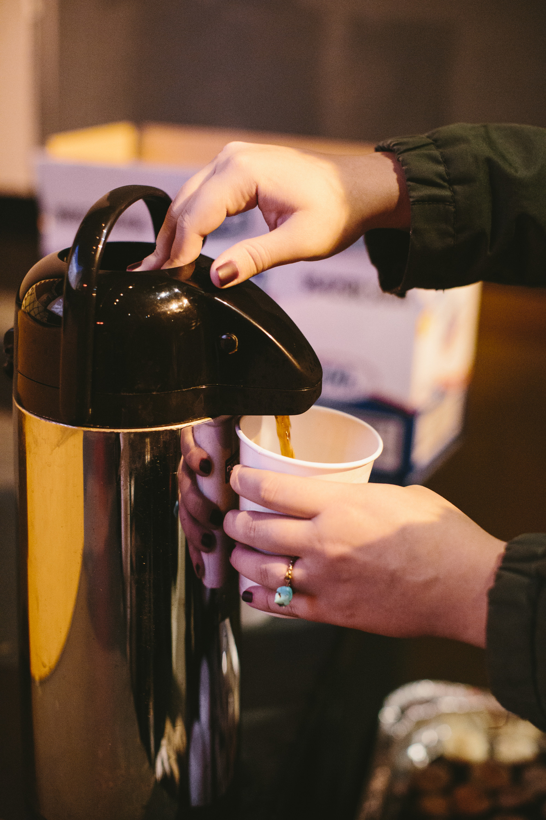
AGENDA
8:30 Welcome and Why
8:40 Meetings: Extension of our state brand and an opportunity to market North Dakota.
Resources to help
9:00 Meeting Planning Tools
Event messaging framework
Event score card
Project plan
FAQs and Q & A
10:30 Introductions – suppliers
10:35 Break with suppliers
11:00 Budget Template
11:30 State registration system – Eventbrite demo
11:50 Q & A
12:00 Wrap

Slide 5
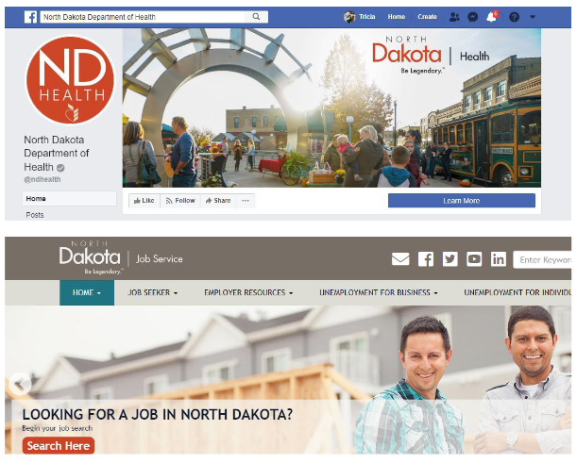
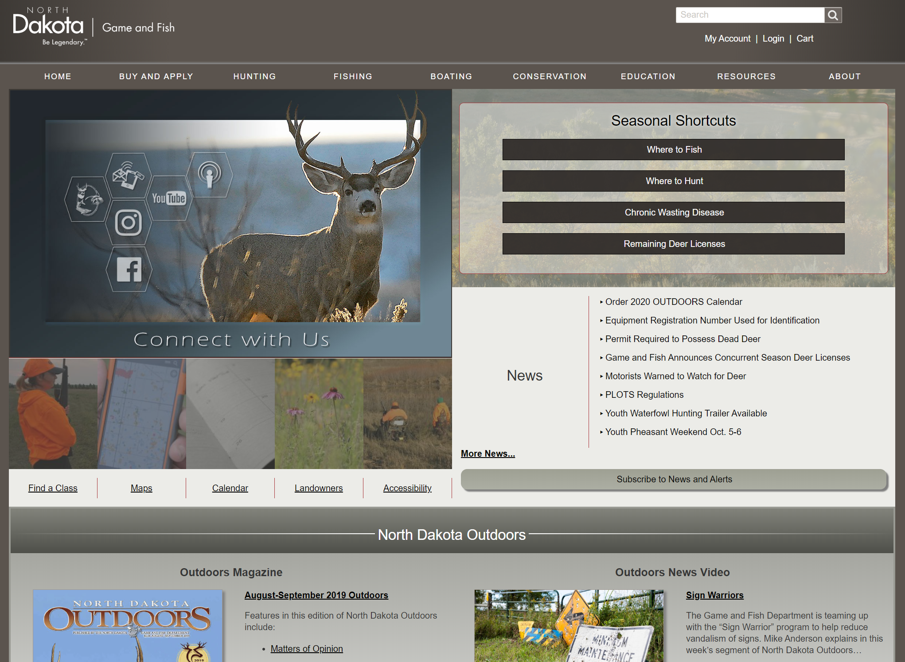
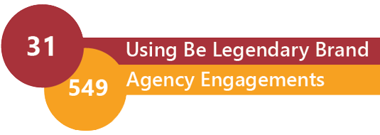
Branding UpdatE

Slide 6
Logos
Please follow brand guidelines for placement of the logo.
The logos on this slide are all saved at .PNGs so they have no background – you can copy and use them per the brand guidelines
Note horizontal version below should only be used on website or by exception.
You are not required to use the trademark (TM) version of the logos for presentations, but are encouraged to use for fact sheets or other distributed marketing collateral.
For alternative resolution requirements please take from the Commerce site ___..

Slide 7
logos
Showing relationship and hierarchy

Slide 8
Logo Lock-ups Provided October 2018

Slide 9
Example: Human services
HORIZONTAL
VERTICAL
Agency with primary citizen relationship takes higher billing
Higher-level department still part of the identity, reinforcing relationship and building awareness
“Be Legendary” visually aligns with Human Services – this works
Horizontal logo is always preferred
Vertical is available with proof of need. There should be very few instances where horizontal space is an issue.
Again, this recommendation does not stack or wrap the department. Rather, the horizontal logo is used and the department or agency is placed horizontally beneath it.
Vertical options should be created upon request (with proof of need); they will not be automatically provided with initial logo request.

Slide 10
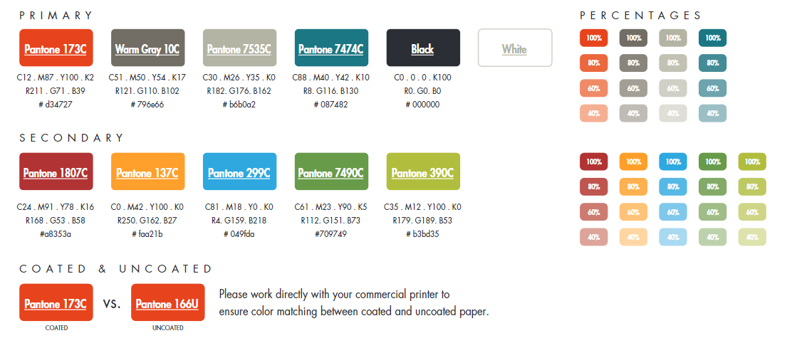
Color palette
How to use

Slide 11
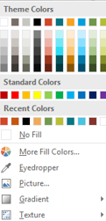
Typography
Titles should be in SEGOE UI (Headings) and all upper case with 44 pt font if possible. Titles should be in black.
Body text can be in Arial or in Segoe UI (Body) in upper/lower with 32 point font when possible declining in size as needed. Bullets and supporting text is in grey.
For most presentations font size should be 20 points or larger

Slide 12
photography
Photos should convey a feeling that you’d like to be there - People and experience centric.
https://www.medialibrary.nd.gov

Slide 13
Examples: census, operation intern, Main Street
Incorrect usage:
Unification goal applies to all divisions, programs and campaigns.
Logo lockups not allowed for programs and campaigns
Individual logos discouraged
Correct usage:

Slide 14
Office Supplies
Email signatures
Stationery
Envelopes
Business cards
Name tags
How and where to use

Slide 15
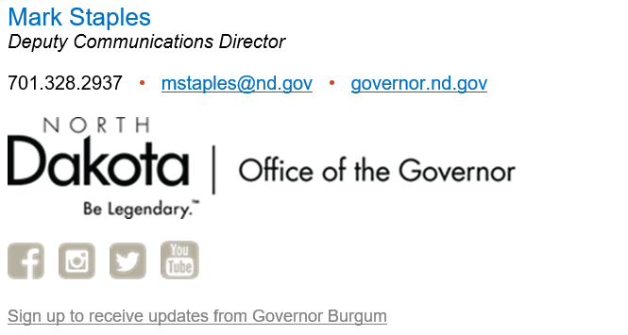
Email signatures

Slide 16
Letterhead

Slide 17
envelopes

Slide 18
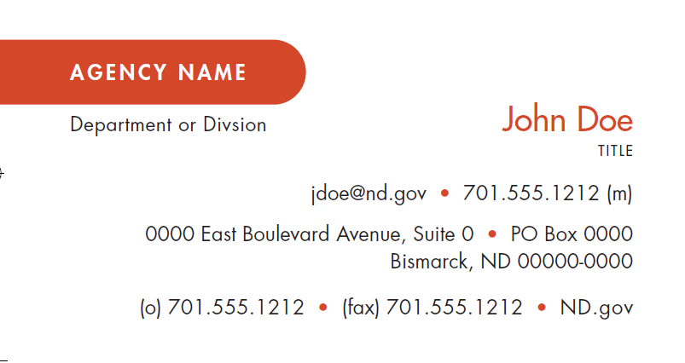
Business cards

Slide 19
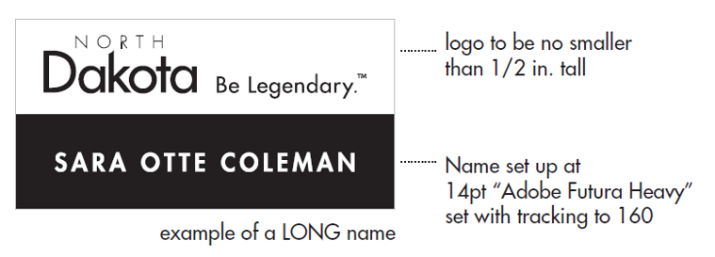
Name tags

Slide 20
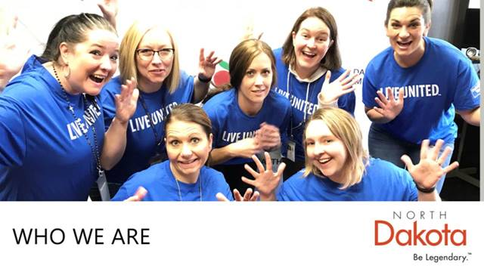
Powerpoint presentations

Slide 21
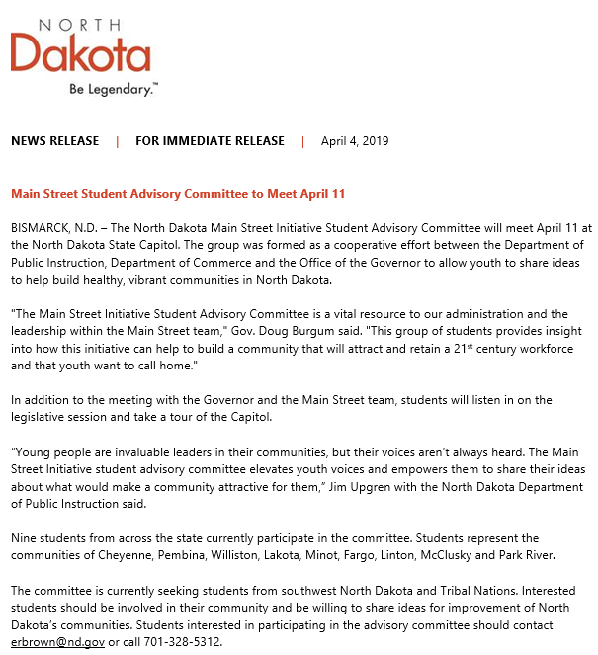
Press releases

Slide 22
Promotional materials
Newsletters
Educational Materials
Displays
Merchandise

Slide 23
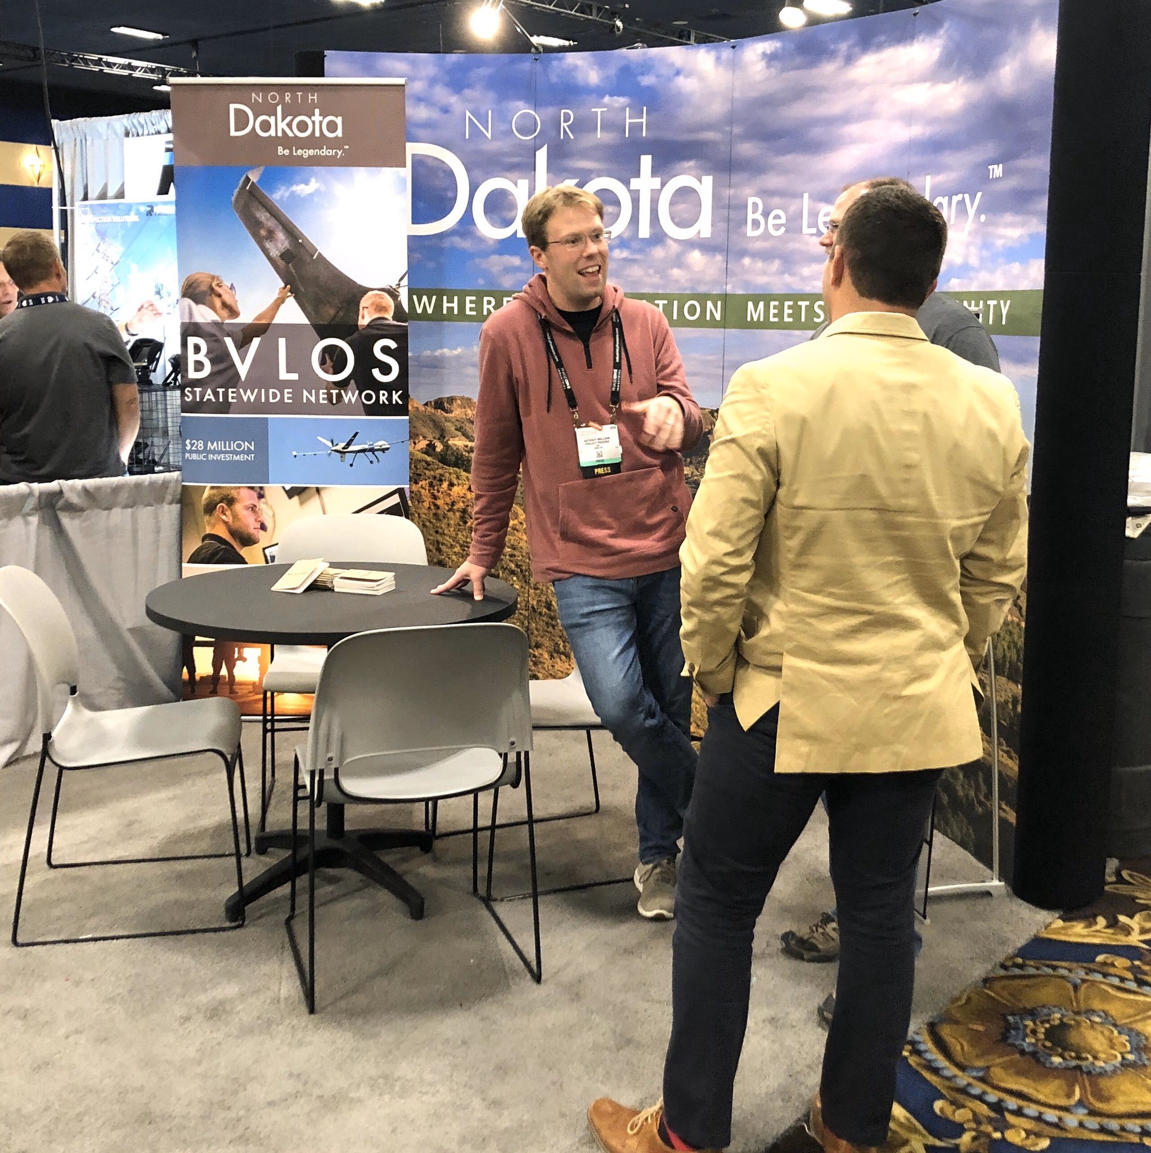
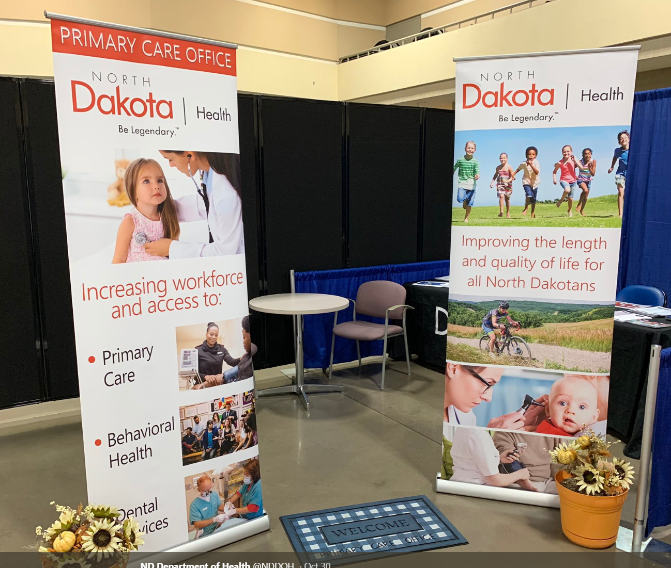
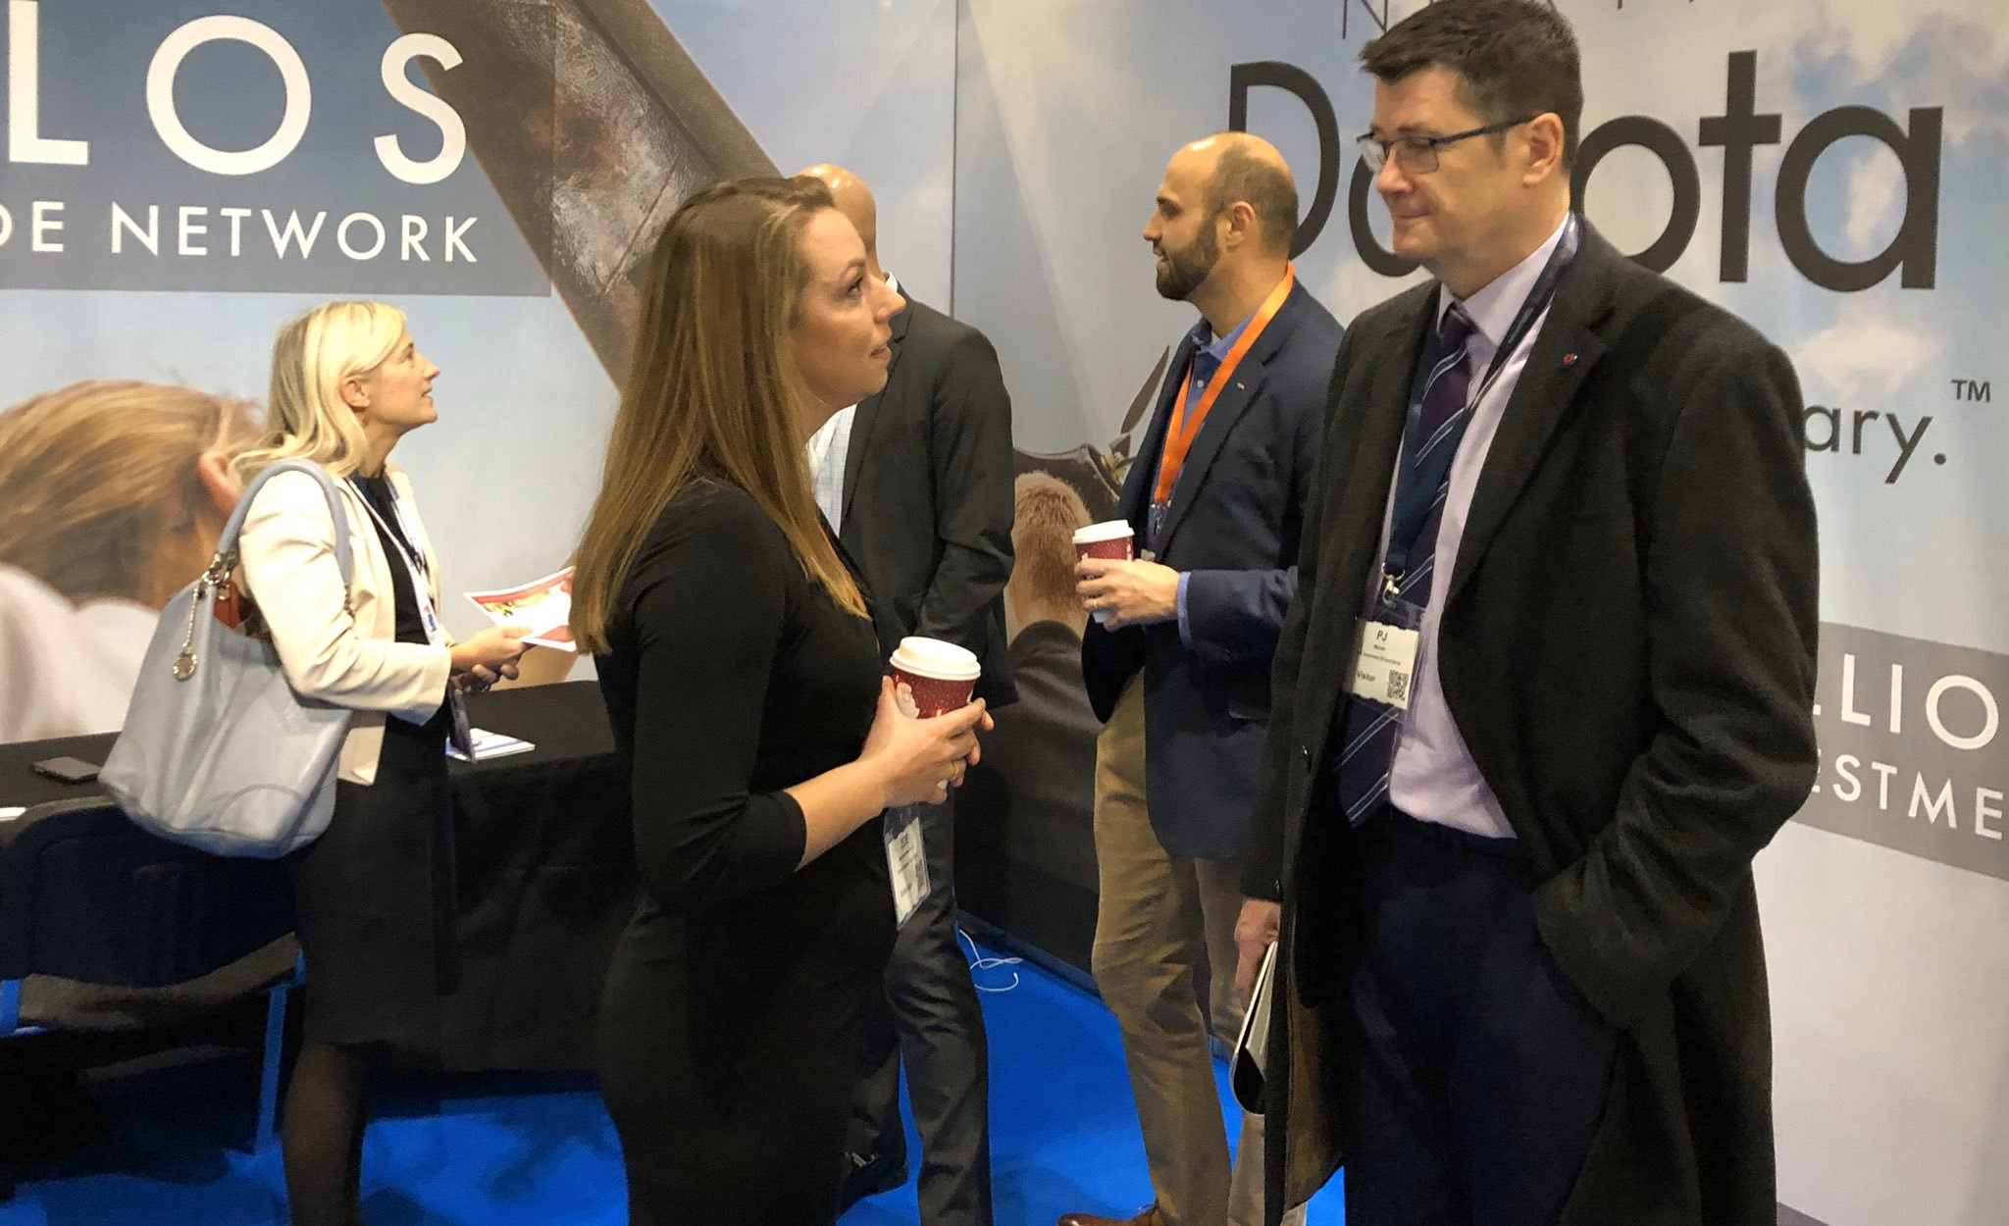
Other Applications
Booths, displays and other marketing materials

Slide 25
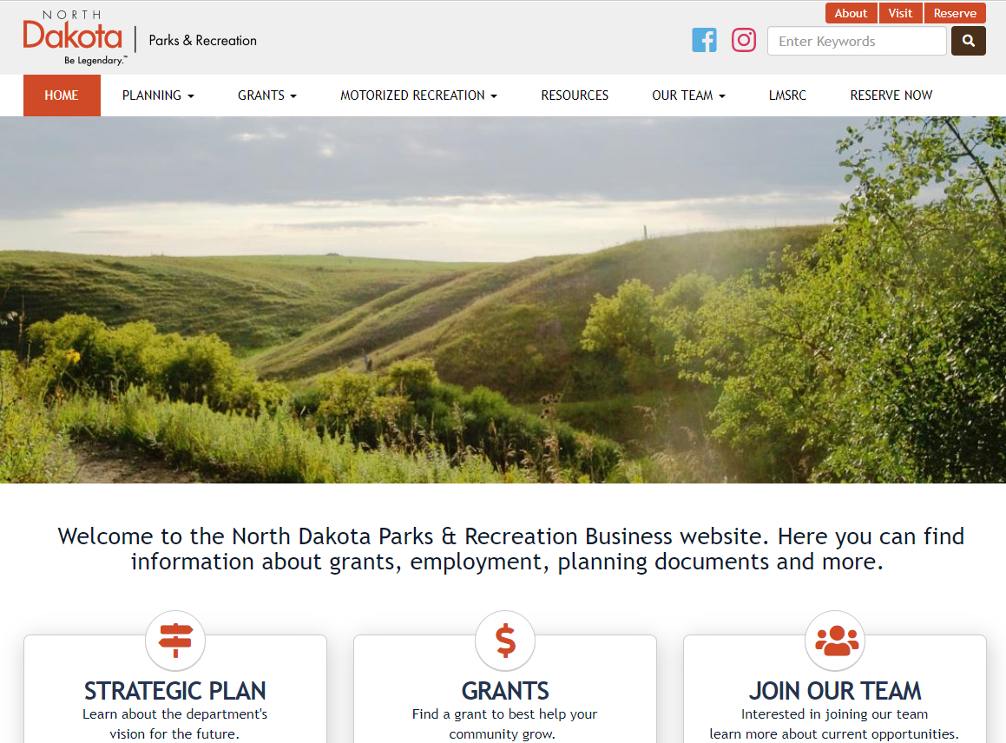
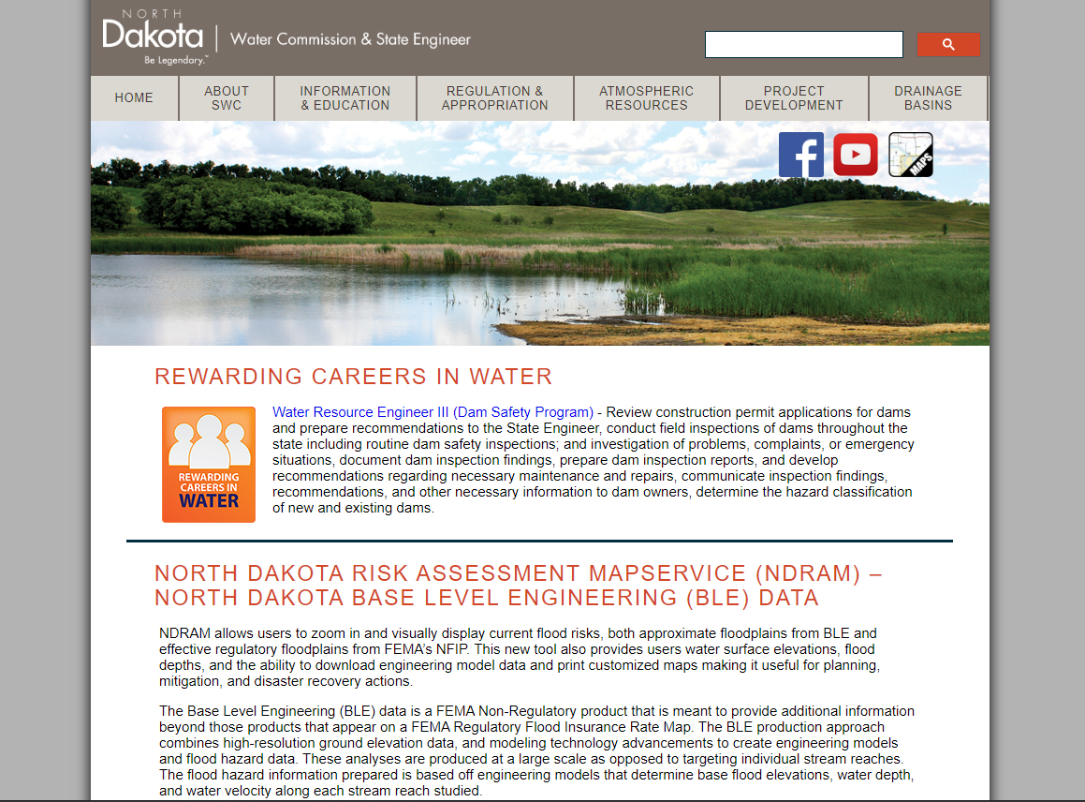
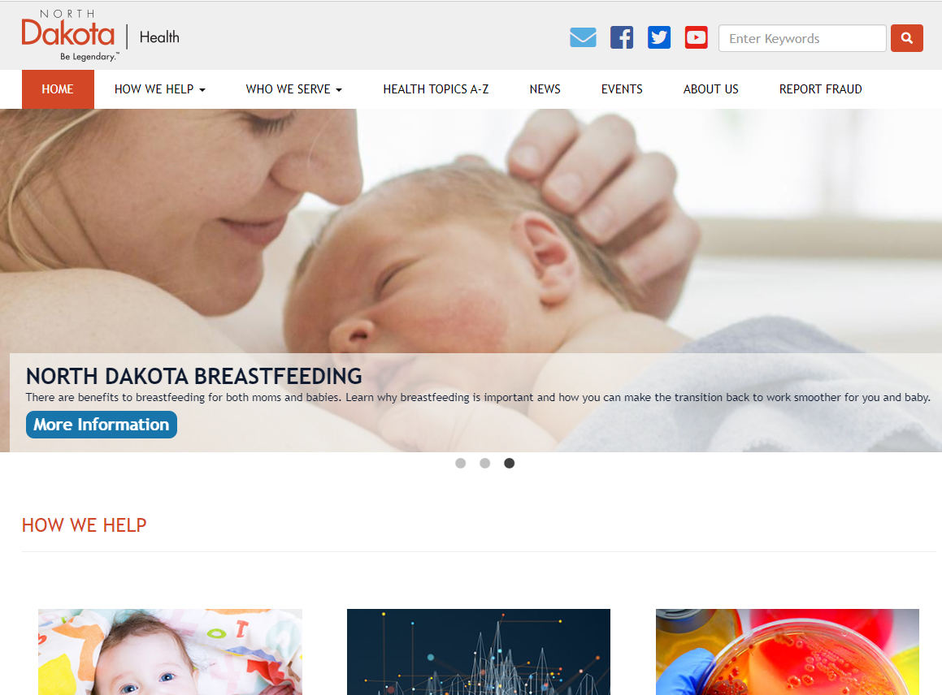
Websites
Consistently branded for better user experience

Slide 26
Social Media
SOCIAL MEDIA STYLE GUIDE
Go-to resource for how the “Be Legendary” brand will appear and act across all social channels.
How to use

Slide 27
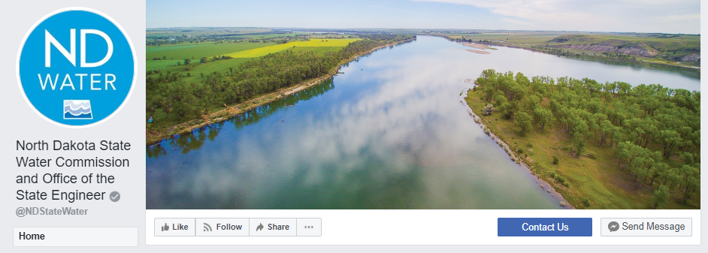
favicons

Slide 28
Heather Kulla
Graduate of the University of North Dakota with a major in Communications
Started event career right out of college as a special event coordinator in 1993- focus was managing a regional tradeshow program
Moved on to national tradeshows - spanning across the United States
Began as Event Manager - managing multiple events in a year ranging in attendance from 100 - 5,000 all held in the United States
Promoted to Director of Events - focusing on both domestic and international events - including Europe, Asia, Canada
Currently Vice President of Events at Dynamic Communities - managing a team of 15 meeting professionals - managing over 30 events a year spanning the globe

Slide 29
Meeting planning tools
Heather Kulla

Slide 30
GRATITUDE
Notes:
Thank you for having me here. I love sharing the knowledge I have gained over my years of experience with other in the industry. I am also thankful for what I learn through the interactions I have with meeting professionals.

Slide 31
Our time together
Showcase the tools that have been created
Share insights from experiences
Answer questions you have
GOAL….
Notes:
With the time today I want to make the most of our time together.
The ultimate goal of today is that you… (next slide)

Slide 32
EMPOWER PEOPLE. IMPROVE LIVES. INSPIRE SUCCESS.
Notes:
Feel empowered through the tools we have created
That your lives are improved by the efficiencies these tools create for you
And that you have even more success with the events you manage
Of course this ties nicely to your purpose

Slide 33
Event messaging framework
Elements:
Value Proposition
Target Audience
Event Objectives
Attendee Experience Pillars
Positioning Statement
Benefits of implementing:
Clear message
Targeted marketing efforts
Consistency
Notes:
A value proposition describes how the event will improve the customers business/life and how it is measured
Defining your target audience is critical as it streamlines your content and marketing efforts – not every event is for all people – this also increases the ability for customer satisfaction.
Agreed upon event objectives are important so you have clearly defined goals your team is striving for. It also helps you define your event from an experience perspective.
Brief attendee experience pillars give you fun pithy statements you can build your marketing messages around. Also it can drive excitement with your attendees.
A positioning statement summarizes the value of the event. Think of the elevator pitch – if you had a short ride in an elevator what would you say to describe your event to that person in the elevator.

Slide 34
Event scorecard
Elements:
Status of the event areas
Notes to communicate any wins, red flags, potential issues
Benefits of implementing:
Consistent way to communicate the event status
Visibility to any red flags
Tracking of the event planning progress and status
Notes:
The event scorecard is your way of communicating the event status to your team, your leadership and others that need to understand if everything is on track. It can serve as a tool to drive your status meetings to remove obstacles, double down on any areas that have proven to produce results or change a strategy that is not working. Keeping this document updated will be helpful as it will answer questions and create action when needed.

Slide 35
Project Plan
Elements:
Event workback plan
Event agenda
Rooms @ a view
Ancillary events
Rehearsal Schedule
Pricing
Sponsorship
Staff & Speaker Travel
Benefits of Implementing:
One source for all event elements
Consistency in all communications to vendors
Team stays informed through one document
Notes:
This document will serve as your one single source for all. So many key elements are included in this document so we will be spending quite a bit of our time digging into it.
Event workback –
5 stages of event planning:
Defining the event – laying the foundation – event messaging document
Registration Open – ensure website is up to date, registration tool is working, marketing plan is in market
Event Execution – Logistics is the focus here
Onsite Execution – Ensuring the moment people arrive onsite until they leave the venue the experience exceeds expectations – EXAMPLE – registration – lines – what to do
Post event wrap up
this document is broke into different event areas it also keeps track of who the lead of the particular action is, who is supporting, the due date and the status.
(TALK THROUGH THIS DOCUMENT – highlight executive speaking management – airport pick ups, green rooms, sleeping room check in, etc)
Event Agenda:
Template to lay out the agenda – easy to read, follow and share
Rooms at a view:
This document allows you to see what is happening in each of your contracted meeting rooms throughout the duration of the event, indicates room set up, any change overs, layout of the room, internet orders, capacities, etc.
Ancillary Events:
Tracks the events outside of the standard events – evening events, executive meetings, side meetings – things outside of the events included on your published agenda
Rehearsal Schedule:
Keeps track of all rehearsals taking place – easy to share with vendors and your staff
Pricing:
Quick reference for all of your pricing with deadlines, etc.
Sponsorship Packages:
Details on the sponsor packages for everyone to be on the same page
Staff & Speaker Travel:
- Details area kept in one central spot to manage the logistics

Slide 36
FAQ’s
Guidance with event elements that have served the most questions
Living document
Add as you encounter experiences

Slide 37
Q & A

Slide 38
Thanks to our Partners
CVBs
Dickinson
Bismarck – Mandan
Devils Lake
Fargo – Moorhead- West Fargo
Greater Grand Forks
Jamestown Civic Center
McKenzie County
Minot
Williston

Slide 39
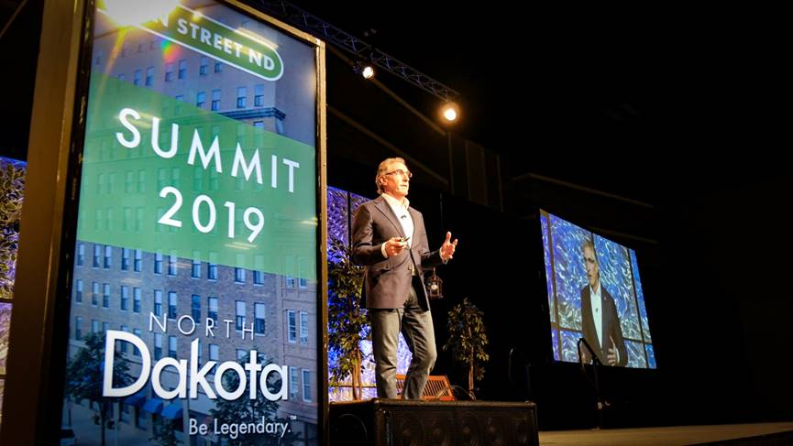
Production Companies
HB Sound and Light
Live Wire
Media Productions

Slide 40
Budget template
Elements:
Tabs with details for each bucket of the budget
Formulas built into each tab and roll up to the summary
F&B Tab allows for attrition percentage to give you a better idea of what you should be guaranteeing
Allows tracking budget to actuals as well as include the previous years budget and actual
Benefits of implementing:
Formulas allow for easy calculation
Easy to track how you are trending on your budget to actual
Summary page is the perfect way to report to procurement, management and team on how you are trending
Notes:
Talk through the budget document in details – demo of how formulas work

Slide 41
Q & A

Slide 43
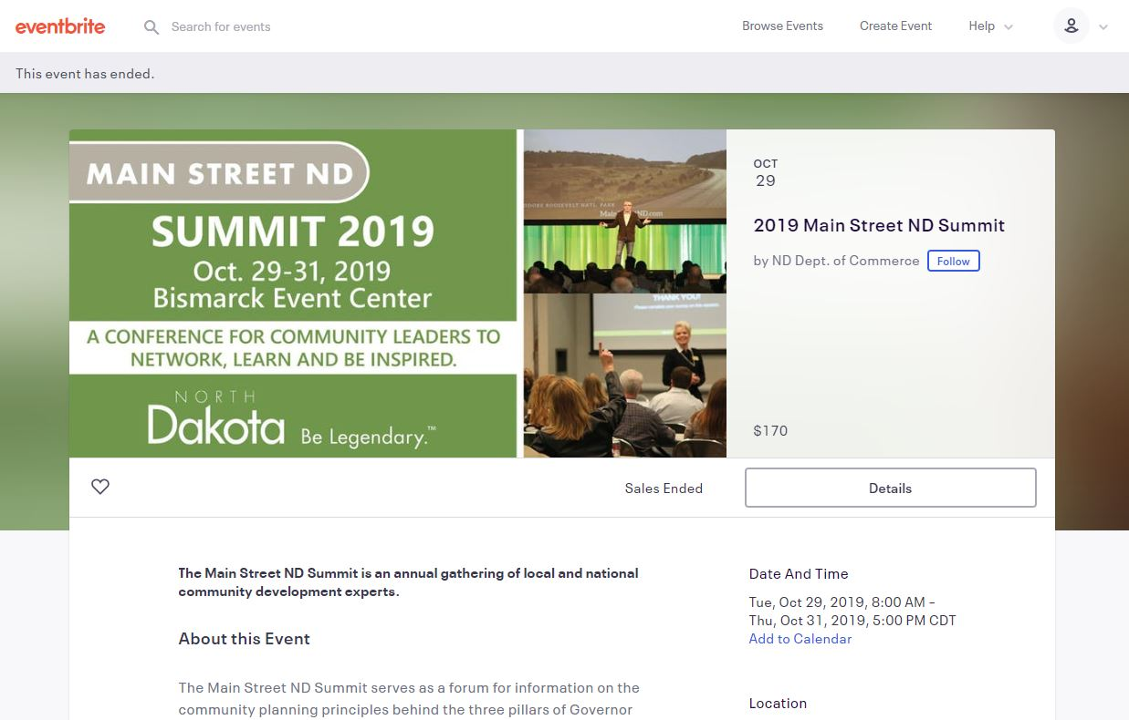
Eventbrite – Registration System nd.gov/statemarketing

Slide 44
EMPOWER PEOPLE. IMPROVE LIVES. INSPIRE SUCCESS.
Notes:
Preferred purpose slide

Slide 45
For more information
www.ND.gov/statemarketing
marketingnd@nd.gov

Slide 46
TEAM ND
VALUES
GRATITUDE
HUMILITY
CURIOSITY
COURAGE

