Slide 1
Please note
The first thing you’ll want to do when building a new presentation is save this one under the name of whatever you’re building. That allows you to preserve this one in its entirety, and use the built in slides as needed without recreating them for yourself.
The slides below are to provide instructions for the user. They can all be deleted when you’ve completed your presentation.
Deleting the fundamentals, purpose value cultural aspirations, and example/starter slides will not delete the underlying template.

Slide 2
Presenter notes
The following slides provide guidance, slide starts and templates for the state team’s purpose, values and cultural aspirations.
Remember PowerPoint is a visual medium like television. People will better remember images and headlines that text heavy slides.
Artifacts can be found at https://www.ndtourism.com/northdakotabelegendarylogo
If you have questions, or would like guidance, please email marketingnd@nd.gov

Slide 3
Logos
Please follow brand guidelines for placement of the logo.
The logos on this slide are all saved at .PNGs so they have no background – you can copy and use them per the brand guidelines
Note horizontal version below should only be used on website or by exception.
You are not required to use the trademark (TM) version of the logos for presentations, but are encouraged to use for fact sheets or other distributed marketing collateral.
For alternative resolution requirements please take from the Commerce site ___..

Slide 4
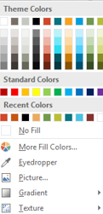
Slide palette info
The PowerPoint palette for this template has been built for you and is shown below. Avoid using too many colors in your presentation.
Accent colors 1-6 – (6 Theme Colors to the far right)
Text
Dark 2
Accent 1
Accent 2
Accent 3
Accent 4
Accent 5
Accent 6
Use Accents 4-6 sparingly – only when more colors are necessary.
Use Accent 1 as the main accent color on light background. Use Accent 2 for subhead text or as an accent color on dark grey background. Use Accent 3 when additional colors are needed.
Note – white type on darker backgrounds, but black on the gold for best readability.

Slide 5
Typography
Titles should be in SEGOE UI (Headings) and all upper case with 44 pt font if possible. Titles should be in black.
Body text can be in Arial or in Segoe UI (Body) in upper/lower with 32 point font when possible declining in size as needed. Bullets and supporting text is in grey.
For most presentations font size should be 20 points or larger

Slide 6
photography
Photos should convey a feeling that you’d like to be there - People and experience centric.
When possible use horizontal images to represent vast spaces and opportunities.
Photos should be inserted – do not cut and paste the image into the placeholder or it won’t resize correctly.
Please note that photos available in the digital asset management system for use will include photo credits if needed. If you are using photos that you know require credit, please be sure to include.

Slide 7
Use cases for following slices
Many of our senior leaders start their presentations with gratitude. It is one of our four core values. Consider using the gratitude slide with both internal and external audiences.
Our purpose is really why the state team exists. We work for the citizens of North Dakota to help them, their communities and the state reach it’s fullest potential. Consider using the purpose slide (Empowering People. Improving Lives. Inspiring Success.) for both internal and external audiences as appropriate.
The other slides may be of value in coaching teams, collaborating with others, or sharing to provide context in given situations.
Any slides you choose not to use should be deleted from your final presentation.

Slide 8
Background for team members
PURPOSE: We’re bringing that idea forward that everyone in state government can make a difference in the lives of our citizens everyday
VALUES: Our team is grounded in our state values - gratitude, humility, curiosity and courage
CULTURAL ASPIRATIONS: We aspire to foster a culture that supports our Purpose
Work as One
Citizen Focused
Growth Mindset
Make a Difference
Leadership Everywhere

Slide 9
EMPOWER PEOPLE. IMPROVE LIVES. INSPIRE SUCCESS.
Notes:
Preferred purpose slide

Slide 10
TEAM ND
VALUES
GRATITUDE
HUMILITY
CURIOSITY
COURAGE

Slide 11
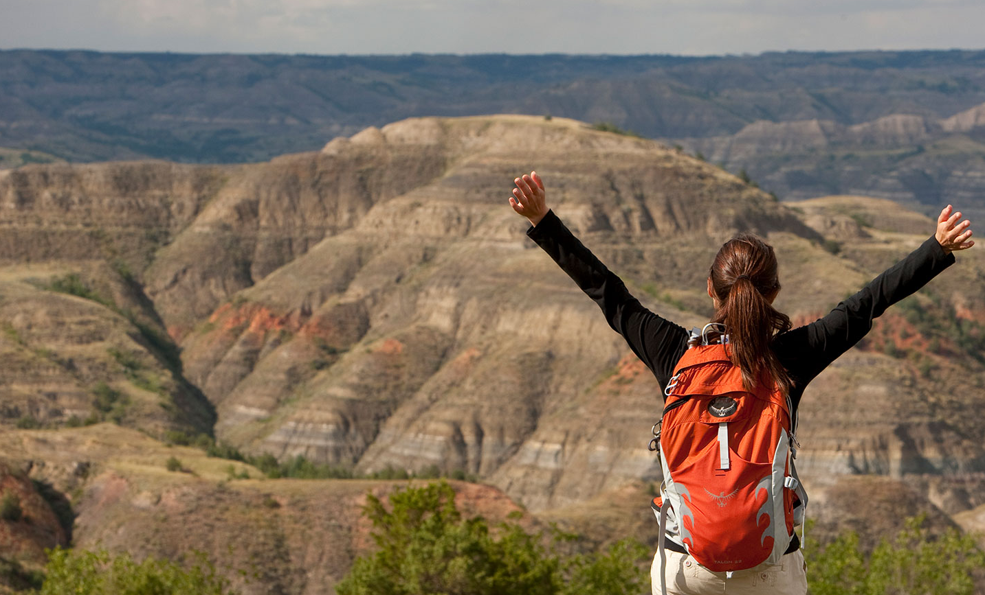
GRATITUDE

Slide 12
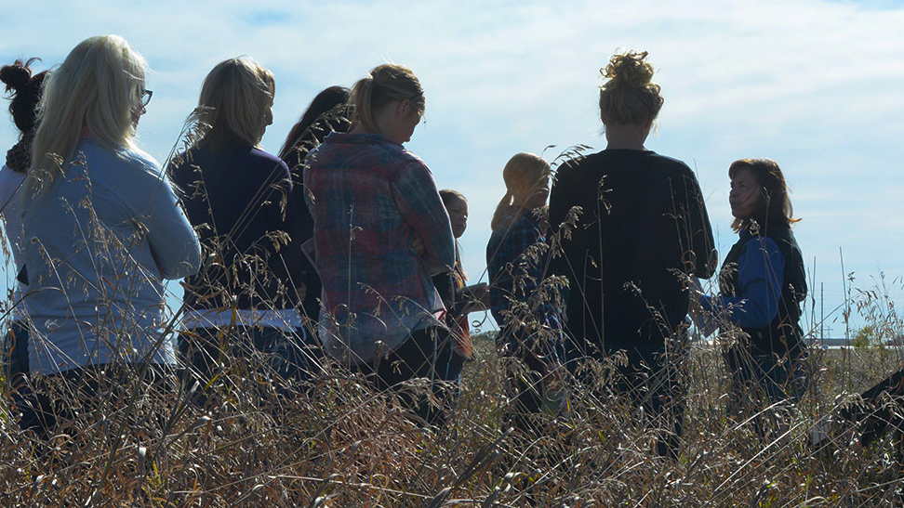
humility

Slide 13
Curiosity

Slide 14
courage

Slide 15
Cultural aspirations
Work as One
Citizen Focused
Growth Mindset
Make a Difference
Leadership Everywhere

Slide 16
Paragraph title Segoe UI Regular 14
Body copy Segoe Regular 14/10.5
Paragraph title Segoe UI Regular 14
Body copy Segoe Regular 14/10.5
Paragraph title Segoe UI Regular 14
Body copy Segoe Regular 14/10.5

Slide 17
Three column photo layout
Paragraph title Segoe UI bold 18/14
Highlights and/or key points
Short sentence and/or “bullet” points here.
Body copy use the font Segoe Regular 10.5pt
Paragraph title Segoe UI bold 18/14
Highlights and/or key points
Short sentence and/or “bullet” points here.
Body copy use the font Segoe Regular 10.5pt
Paragraph title Segoe UI bold 18/14
Highlights and/or key points
Short sentence and/or “bullet” points here.
Body copy use the font Segoe Regular 10.5pt

Slide 18
Three column photo layout
Paragraph title Segoe UI bold 18/14
Highlights and/or key points
Short sentence and/or “bullet” points here.
Body copy use the font Segoe Regular 10.5pt
Paragraph title Segoe UI bold 18/14
Highlights and/or key points
Short sentence and/or “bullet” points here.
Body copy use the font Segoe Regular 10.5pt
Paragraph title Segoe UI bold 18/14
Highlights and/or key points
Short sentence and/or “bullet” points here.
Body copy use the font Segoe Regular 10.5pt

Slide 19
Table layout — 2 column
 | Column 1 | Column 2
Row 1 | 12 pt. Table text | Table text
Row 2 | Table text | Table text
Row 3 | Table text | Table text
Row 4 | Table text | Table text
Row 5 | Table text | Table text
Row 6 | Table text | Table text
Row 7 | Table text | Table text
Row 8 | Table text | Table text
Row 9 | Table text | Table text
Row 10 | Table text | Table text
Row 11 | Table text | Table text
Row 12 | Table text | Table text
Row 13 | Table text | Table text
Row 14 | Table text | Table text
Row 15 | Table text | Table text

