Slide 1
Annual Celebration
February 4, 2025

Slide 2
Agenda
About Us
Meet the Team
Impact Areas - Education, Advocacy, and Grants
Theory of Change
Upcoming Needs Assessment
Q&A
How to Get Connected

Slide 3
About Us

Slide 4
Councils were created under the Developmental Disabilities Assistance and Bill of Rights Act (DD Act) to engage in capacity building, systems change and advocacy work in every state and territory.
Our Council includes 23-members appointed by the Governor. The DD Act requires that 60% of Council members are people with intellectual and/or developmental disabilities, their families and caregivers.
Key Partners:
North Dakota Center for Persons with Disabilities (NDCPD)
University Center on Excellence in Developmental Disabilities (UCEDD)
North Dakota Protection and Advocacy Project
Protection & Advocacy (P&A) Agency
Impact Areas:
Education
Advocacy
Grant Making

Slide 5
Council Purpose: The purpose of the Council is to promote activities that are consistent with the Developmental Disabilities Assistance and Bill of Rights Act . These include recognizing, supporting, and encouraging the competencies, capabilities, and personal goals of individuals with developmental disabilities and their families. Any assistance to such individuals should be provided in an individualized manner, consistent with the unique strengths, resources, priorities, concerns, abilities, and capabilities of the individual.

Slide 6
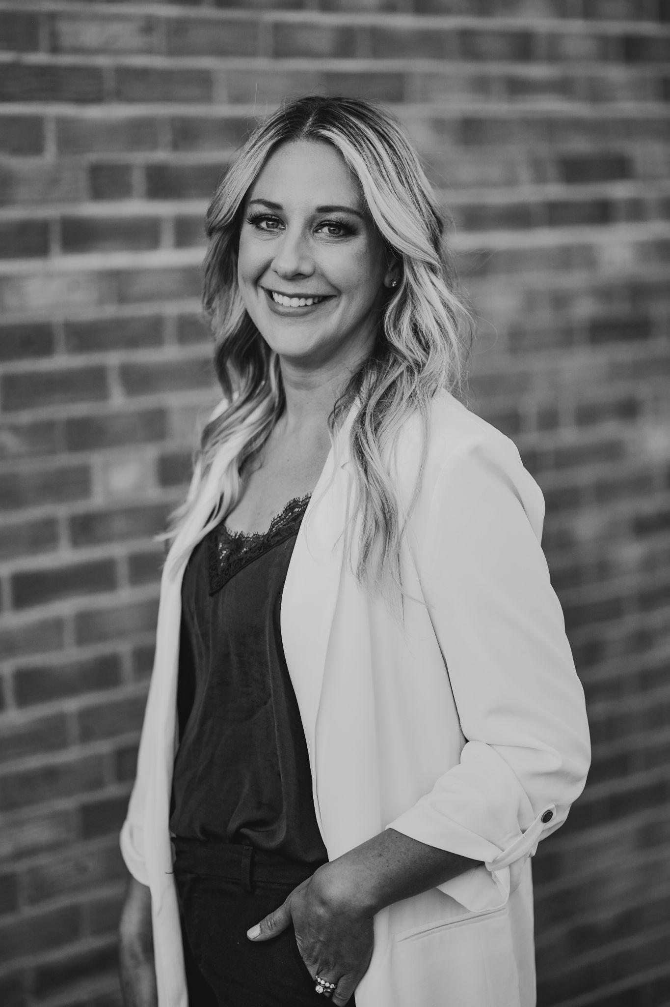
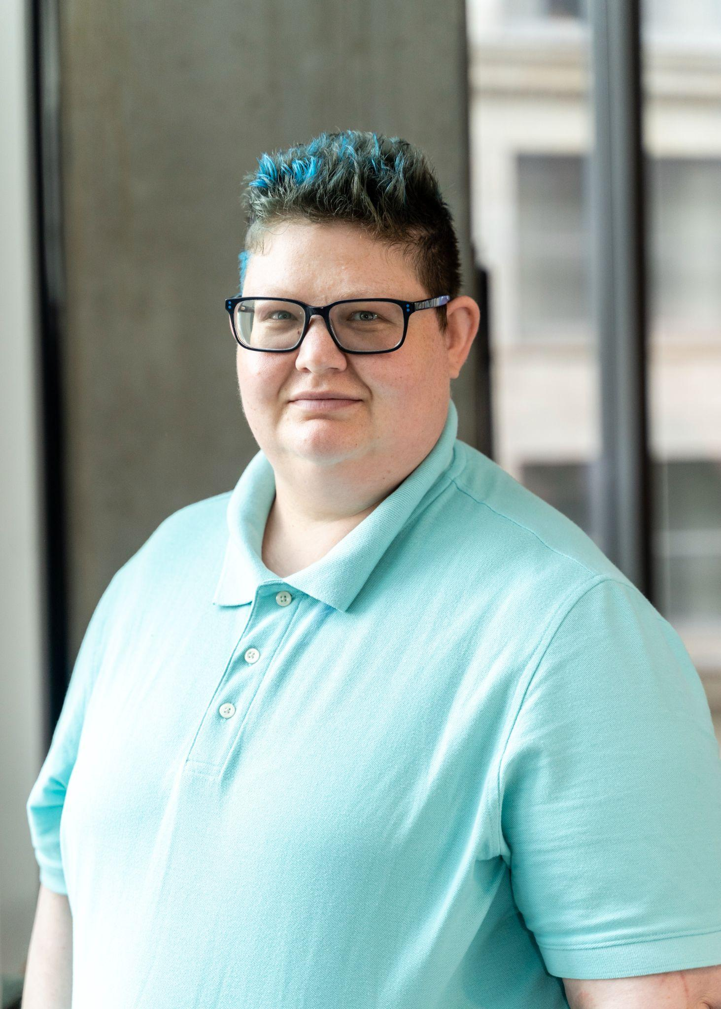
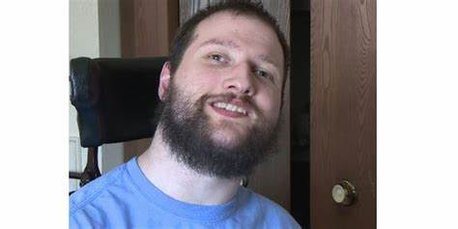
Meet the Team!
Trevor Vannett
Council Chair
Julie Horntvedt
Executive Director
Chaz Brobst
Advocacy Coordinator

Slide 7
Education
Council funding is, at times, used to develop publications that serve as resources for persons living with a developmental disability, their family members, and support teams and that support the accomplishment of the goals and objectives of the Five Year Plan they were funded under.
Successes: Research Study on the Peer to Peer Programs in ND; Supported Decision Making materials (Currently being shared amongst DD Council and P&A); Launch My Life website, were funded or created in partnership with other entities.
Future Plans: Inclusive education, employment and housing; updated policy statements and research projects.
Resource: Peer to Peer Study

Slide 8
Impact Areas: Advocacy
Chaz Brobst
Advocacy Coordinator

Slide 9
Advocacy
The Council’s Advocacy Committee leads our work with educating, advising, and informing lawmakers around issues of importance for people with IDD. The Advocacy Committee guides our legislative process in support of the IDD community in a manner that aligns with the Council’s mission, vision, and values.
In 2024, the Council:
Created a Statement (April, 2024) about the importance of Supported Decision Making
Created a Community Living Policy (March, 2024) about what does living in the community mean
Created a Statement on Adaptive Life Skills vs. IQ (September, 2024) which centered on using a person’s IQ to determine service eligibility is not the best approach
Adapted an Employment First Document to use for advocacy (March, 2024)
Adapted and Adopted a “Just Do It Statement” (March, 2024)
Did a Statement and Press Release on Measure 4 (September, 2024)
Discussed the Council’s Advocacy trainings and opportunities for advocacy work throughout the year

Slide 10
Advocacy
The Council’s Advocacy Staff continues to travel the state and provide education and training to advocates in their local community. We had meetings in 7 communities in 2024.
Communities Served:
Jamestown-Together We Stand
Fargo-Fargo Friends Moving Forward
Minot-Hands for Change
Williston
Bowman
Grand Forks
Grafton

Slide 11
Advocacy
In 2025 the Council’s Advocacy Committee will monitor legislation to ensure equitable, accessible and affordable services and to promote community inclusion and integration:
Self-Determination and Self-Advocacy
Guardianship reform (education on Supported Decision Making)
Inclusive and integrated employment
Housing
Expanding accessible and affordable housing options for people with IDD
Healthcare and Medical Rights
Advocating for more equitable, affordable, and accessible Medicaid and HCBS for people with IDD
Education
Educating lawmakers on eliminate the use of seclusion for people with IDD
Belonging and Community Inclusion
Making involvement in policy and rulemaking more accessible for a variety of communicators
Increasing support for people with IDD
Advocating for increased paratransit and fixed route services

Slide 12
Grant Making
The Council leads the distribution of funding each year for projects related to the five year state plan. These projects fund advocacy, systems change and capacity building activities for both Council-led projects and programs and projects developed by community partners.
Successes: Provided core funding and mini grants for projects under our state plan goals including self-advocacy, targeted health disparities, integrated housing, employment, education, new/innovative projects, use of technology, bridging aging and disability, and more.
Future Plans: The Council identified continued efforts in core funding as we complete our current 5 year goals and objectives and get ready for the 2025 needs assessment.
Resource: State Plan

Slide 13
2024 Core Funding Projects
Advocacy Training: Partners in Policymaking. We graduated a class of 10 people.
Self Advocacy-Health Conference: We hosted a conference in Bismarck with over 200 attendees
Leadership and Training Grant: We supported 8 individuals/families to attend trainings and 6 families to attend the ND Vision Services Family Weekend
Aging-Disability Grant: Gathered a state team of 14 members. More have joined since we began the work. The work focuses on a comprehensive and coordinated system of home and community-based services (HCBS) that allows older individuals with disabilities and individuals with physical disabilities to remain independent, in their own home, and to age with dignity.
Inclusive Housing: We provided funds for a grantee to advocate, develop, support, and demonstrate unique alternative housing options for people with IDD. We funded 1 project in Grand Forks.
Childcare/Daycare: The Council funded 2 projects surrounding childcare. 1 project provided an inclusive summer care program in Fargo. The second project focused on training, technical assistance, and a community of practice for community providers to come together and learn from each other to provide and promote inclusive daycare practices.

Slide 14
2024 Core Funding Projects
Self-Advocacy Projects (3): No cost legislative policy and advocacy trainings for the disability community and its allies (Advocates Leading their Lives (ALL) Statewide Self Advocacy Group), and no cost virtual trainings for North Dakotans with IDD on using technology effectively (My Tech for All Project), and provided 3 trainings on Behavioral Health topics to advocates.
National Core Indicators: Finished a funding project and full state implementation of the NCI project in North Dakota in collaboration with the Department of Health and Human Services and the Aging Services Division.
Small Innovative Projects: Funded 9 grants to various non-profits, providers, etc. around the state
FASD: Provided 12 free trainings on various topics concerning FASD to foster families, parents, providers, teachers, social workers, etc.
Inclusive Higher Education: Provided funds to Bismarck State College to Provide peer mentoring services to students on campus. There were 7 peer mentors, 15 students receiving mentoring services, and 173 active students receiving accessibility services.

Slide 15
2024 Mini Grants Summary (to include some public health workforce projects)
United African Community
Lake Region
DSP Support and Recruitment Video
Children support group through art expression
Anne Carlsen Center
Creation of a DSP Certification
Lay Health Ambassadors
NDSU
Apparel design project to make new clothing for individuals with Down Syndrome
Triumph
Self-Advocacy Support for Together We Stand
Outreach to New Americans to provide resources about IDD Services
Arise Above
Pathfinders Services
10 month program for caregiver support for caring for children with IDD
Poppy’s Promise
Creation of a DSP trianing program to promote frontline supervisor trainings
Family stipends to attend their conference
Spirit of Wonder
Assistive ND
Creation of a therapeutic riding program
Rural Volunteer Training and KIT update

Slide 16
Council Membership
If you have interest in joining our Council, you have to apply on the Governor’s Board and Commissions Website.
To apply visit Boards and select State Council on Developmental Disabilities.
Membership applications are welcome all year long for all positions.

Slide 17
Communications
Website: News page for updates
Open Meetings: Secretary State’s Website
Social Media: You can find us on Facebook
Contacting Staff: E-mail is the best way to connect with staff.
Julie: jhorntvedt@nd.gov
Chaz: chnbrobst@nd.gov
Community Inquiries: We have an office phone number for the Council for general inquiries. The Council uses the Capitol’s mailing address and mail will be forwarded.
Office Phone: 701-328-4847
Mail to: North Dakota State Council on Developmental Disabilities, 600 E. Boulevard Ave., Bismarck, ND 58501

Slide 18
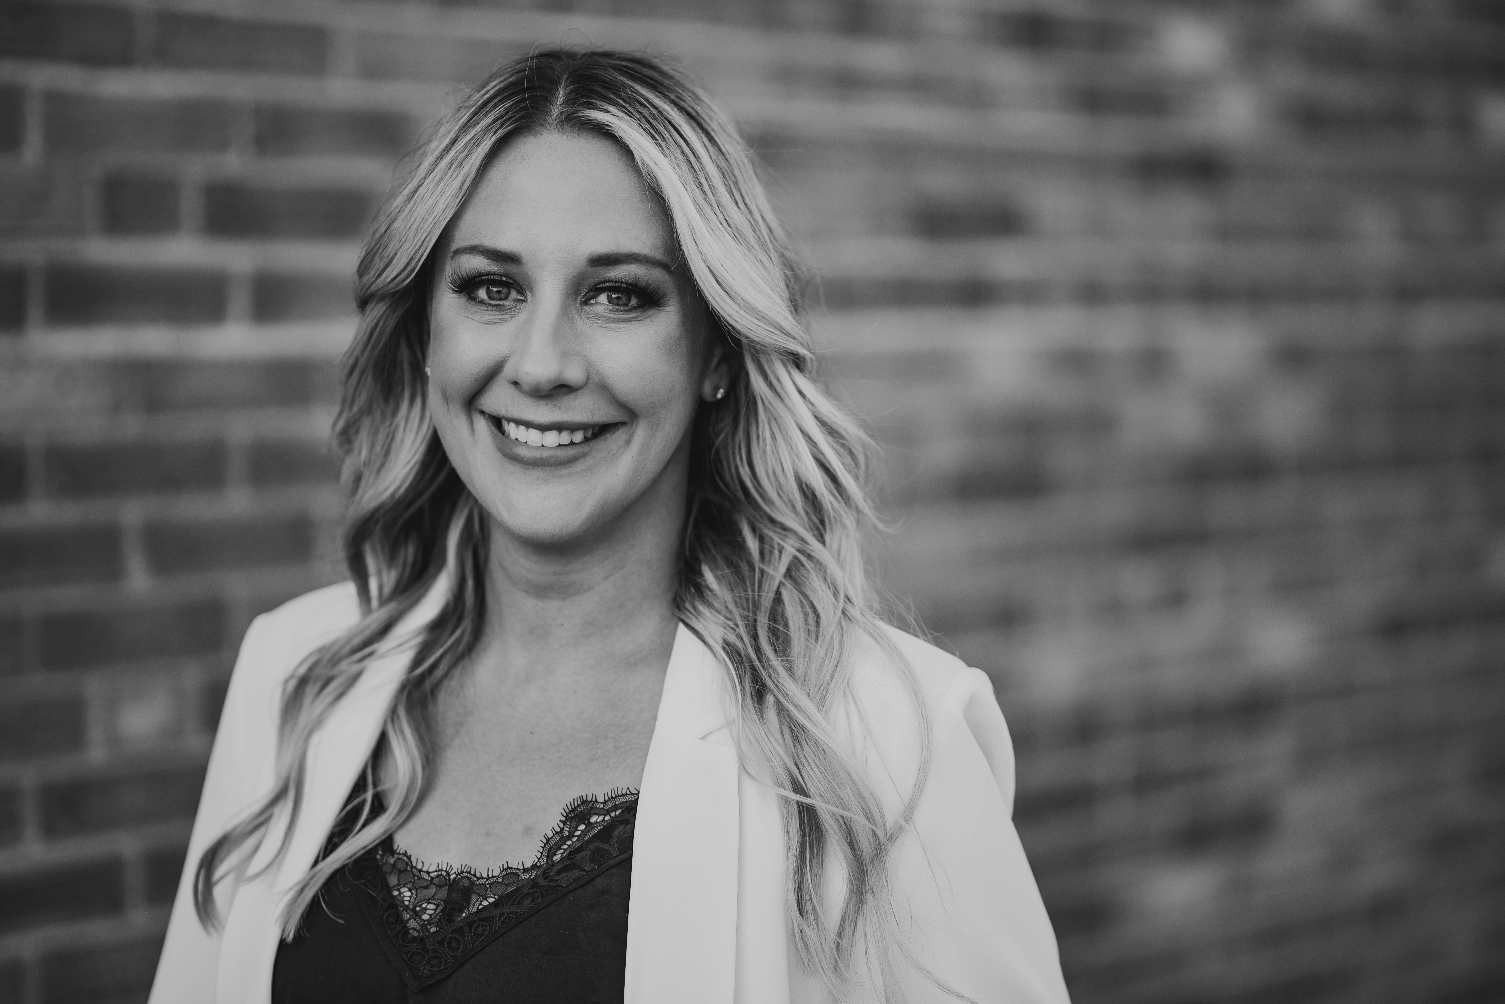
Theory of Change
Julie Horntvedt
Executive Director

Slide 19
Where We Have Been
Created a State Plan Survey for 2027-2031
Hosted a Legislative Training (December 2024)
Onboarded 6 new Council members
Council Executive Committee developed and updated policy documents and bylaws (2024)
Participates in the Department of Public Instruction Community of Practice
Participates in the North Dakota Disability Advocacy Consortium www.nddac.org
Participated on the board for the National Association of Councils on Developmental Disabilities

Slide 20
Intended Uses
Consistency: Provide continuity in the heart of the Council across membership changes
Alignment: Ensure Council decision making and resource allocation reflects our values
Strategic Planning: Guide our needs assessment, state plan development and program evaluation plan to align with the meaningful life framework
Communications: Share our work with partner organizations, policy makers, our funders and other stakeholders
Transparency: Hold ourselves accountable to the communities we serve
Notes:
What’s our why? These were some of the needs we identified in our conversations with community members and council members. Our Theory of Change is the result of a lot of conversations about what we need and what our community needs from us.

Slide 21
Person-Centered Values in Action
Self-determination (Independence): We believe that each individual has the right to design their own vision of a meaningful life of their choice.
Purpose (Productivity): We value the contributions of all individuals
Inclusion: We fully take part in learning, living, working, and other community activities of our choice.
Integration: We have the right to the same opportunities, services, and community resources as other people. This includes access to services as well as access to supported education, employment, healthcare and community life.
Belonging: We value human connection and honor people’s identities and lived experiences. We all have the right to feel safe at home, at school, at work and in community.
Notes:
The first 4 are from the DD Act. We updated some of the language to how we talk about our work now but the heart of the values now are still true 50 years after the DD Act was passed. We added belonging to reflect connection, safety and intersectionality as key aspects of our work.

Slide 22
Community Values in Action
Our work is with and for the community we serve. No one person or organization can do this work alone and we seek to bridge communities and break down silos.
Legacy: We believe that at each step of our individual paths, we learn more from those who went before us and have more to teach those who follow behind us.
Collective: We bring together capable and powerful community members to create long term systems change through their lived experience.
Collaborative: We work in partnership and we seek to lead, partner, amplify or support projects based on our community’s needs.
Forward-thinking: Together, we advance disability efforts with and for people with IDD.

Slide 23
Person-Centered Values

Slide 24
Why We Exist
Individual/Family: What a meaningful life looks can be based on a person's interests, strengths, support needs, vision for community, and the intersection of their identities. For individuals with IDD, too often other people define measures of success, worth, and meaning for them based on societal norms, values, and a nondisabled experience of the world.
Community: Today’s disabled adults are the first generation of people with disabilities who are mainly living in community instead of institutional settings. People with disabilities are now integrated into schools, workplaces, and other public spaces thanks to the work of advocates, policymakers, and community workers. While this is a big win, people with disabilities continue to face routine barriers to equitable community integration due to many physical, social, and emotional barriers that exist in our communities.
Systemic: Our systems models (medical, educational, employment and others) require that deficits and functioning levels are identified to allow an individual to access services that support independence. Sometimes too much emphasis may be placed on these assessments to determine an individual's potential leading to expected educational, employment and health trajectories. Policies and laws often reinforce these deficit models.
Together, these conditions lead to a loss of joy and connection, and unrealized potential, which ultimately leads to poor social and health outcomes for people with IDD. Our role at the Council is to create the individual, community and systems level conditions that allow people with intellectual and developmental disabilities the ability to achieve their vision of a meaningful life.

Slide 25
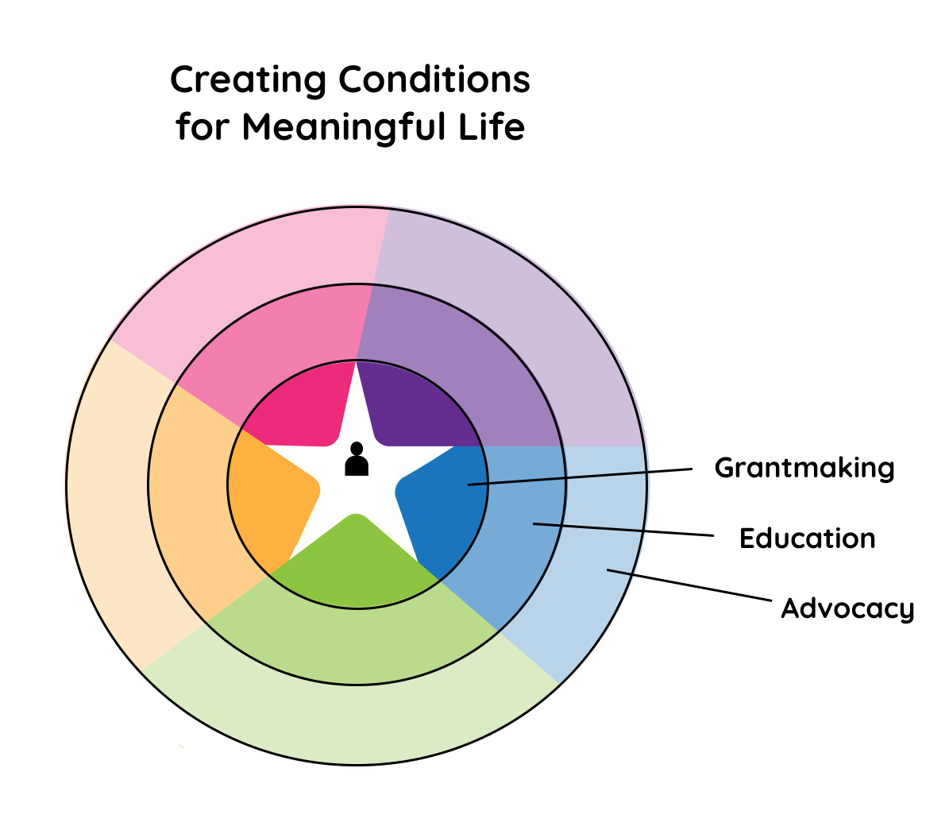
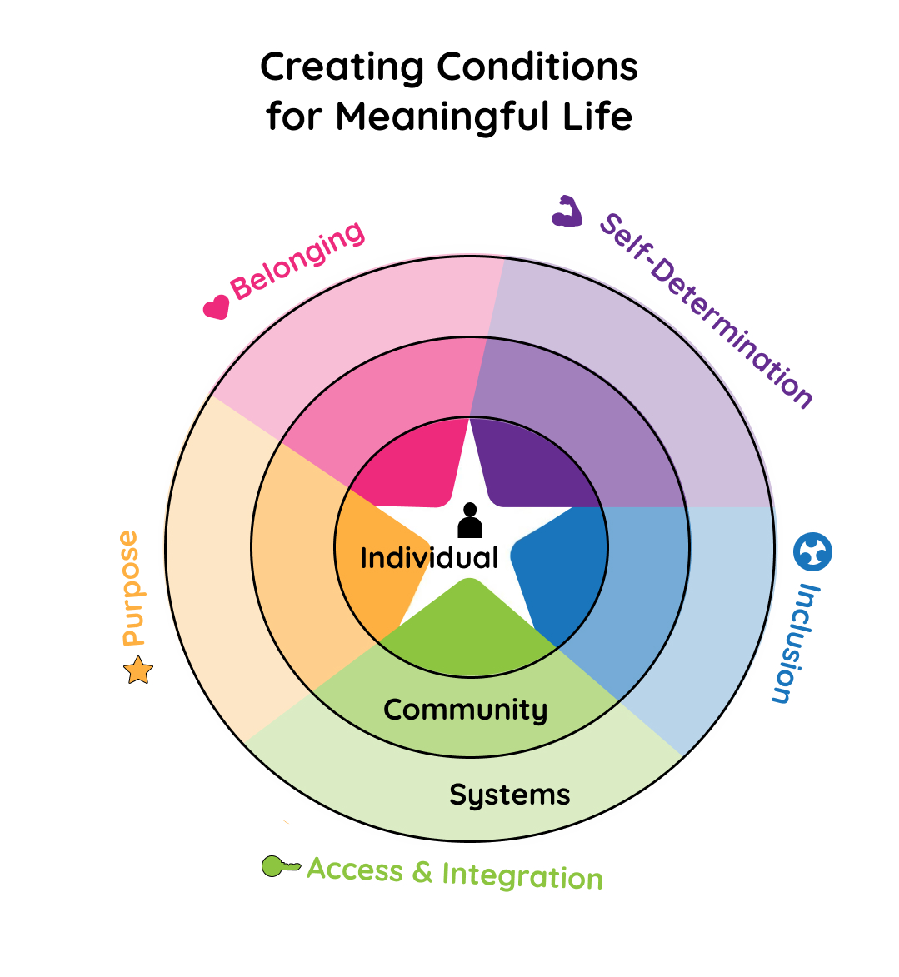
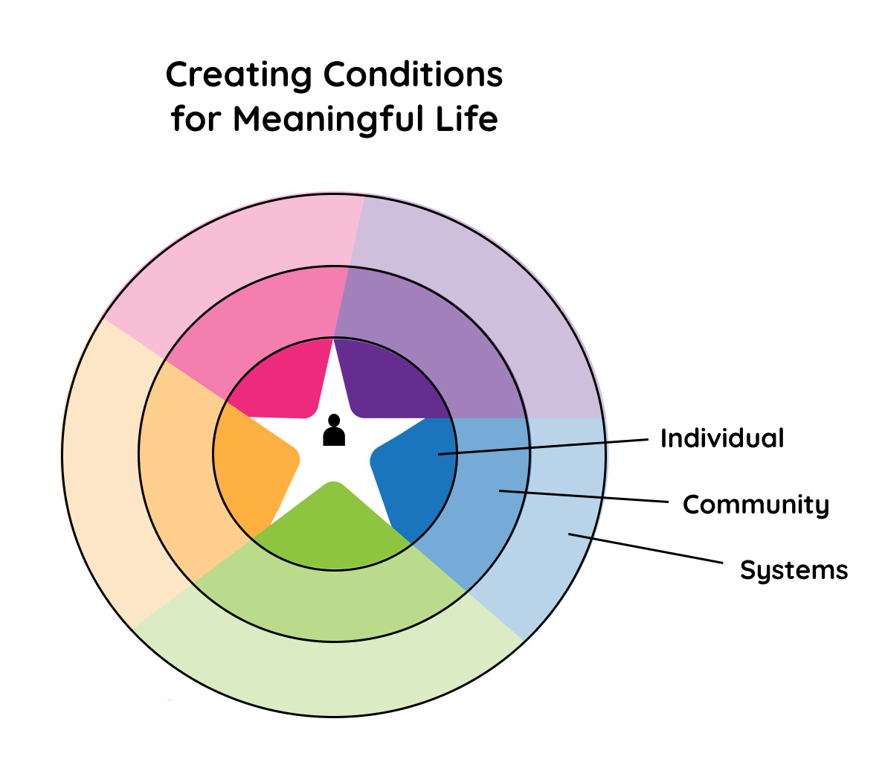
Creating Conditions for Change
1.
3.
2.

Slide 26
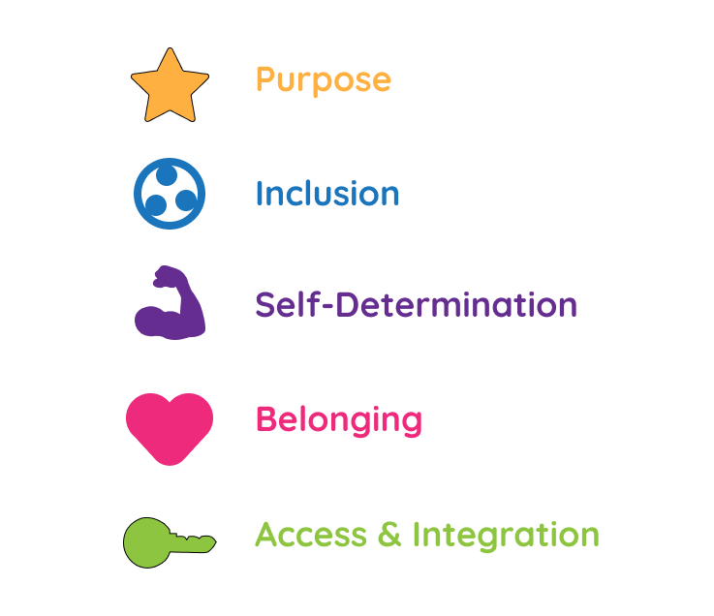
Linking Our Values to Our Work
Impact Areas:
Education
Advocacy
Grant Making

Slide 27
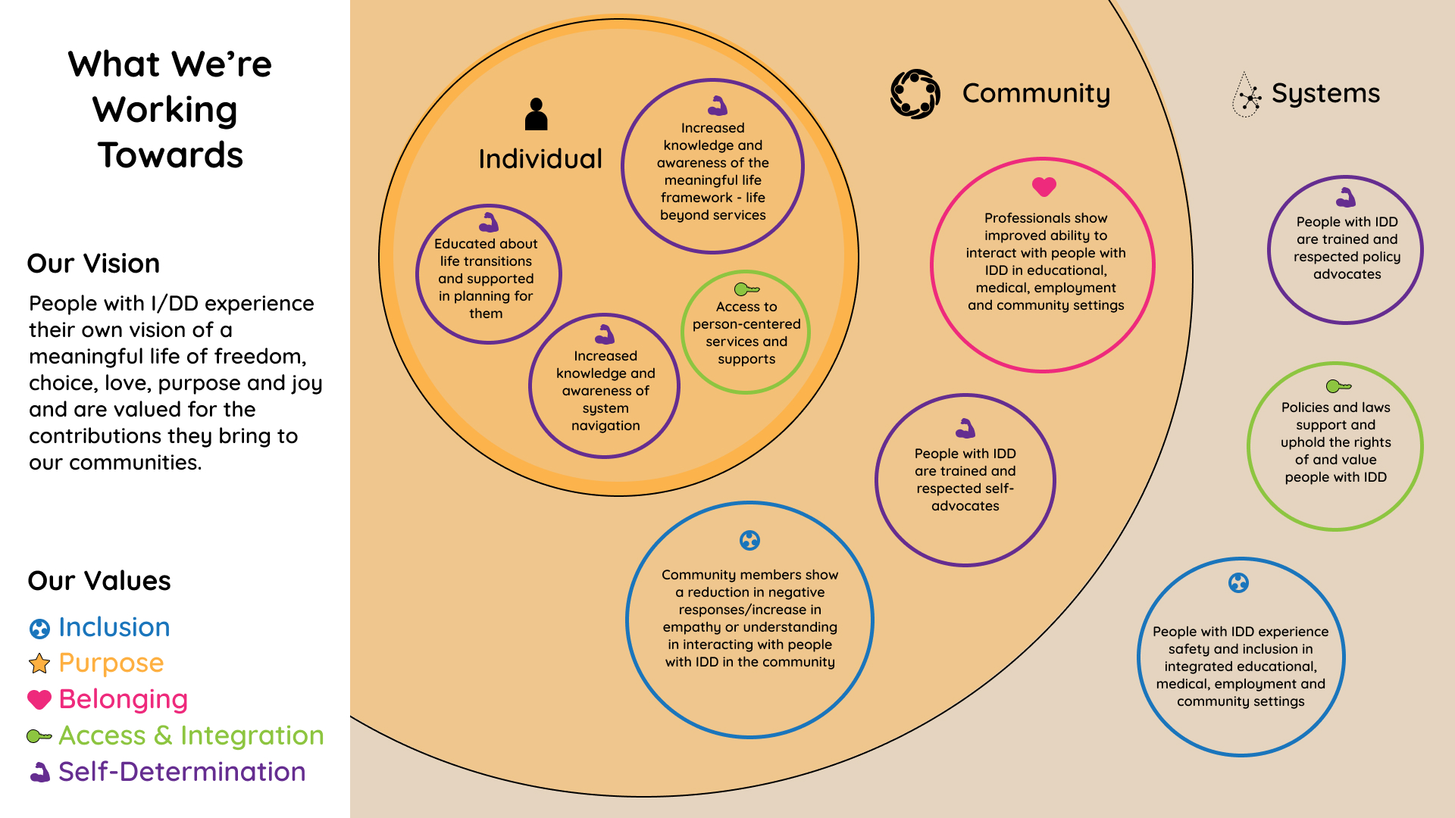
What We Are Working Towards
1.
Notes:
Option 1 - allows everything to be in black print and meet visual accessibility standards, incorporates values through colored borders and use of icons.
Please note the words can be simplified - we originally did not provide them so people do not get stuck there but it helped workgroup members to understand and visualize it better to include the outcomes from the original presentation. What we want to highlight is whether the visuals capture everything we want to convey and allow us to build on them as we learn, and as we do our new state plan.
Considering adding key strategies of education, advocacy and grant making to the left hadn column under vision.

Slide 28
Needs Assessment Objectives
Develop and Prepare for state plan for the next 5 years
Developed through data driven strategic planning
Identify health disparities, disadvantages, challenges for people with IDD.
Gather input on importances of issues
Review our Comprehensive Review and Analysis Data
Identify the priorities that lead to goals in advocacy, capacity building and systems change
Gather information from people with IDD and their families from culturally diverse groups and communities
Notes:
Use SMART framework to develop goals and objectives that are realistic, clear, and carefully written.

Slide 29
Federal Requirements
The Comprehensive Review and Analysis section should show understanding and analysis of:
Required demographic data (state level and people with disabilities).
Services, supports, and other assistance that are available to people with intellectual and developmental disabilities (ID/DD) and their families.
Required - Health/Healthcare • Employment • Informal and Formal Services and supports • Interagency Initiatives
Optional - Quality Assurance • Education/Early Intervention • Housing • Transportation • Childcare • Recreation
The unmet needs for services, supports, and other assistance for people with ID/DD and their families.
Notes:
CRA Guidance under the Information and Technical Assistance Center

Slide 30
Planning and Development Stage - February 2025
February 2025:
Conduct Literature Review
Provide a comprehensive overview of existing knowledge on gaps of IDD
Build knowledge surrounding the IDD community
Next: Develop Survey for 2025
Address required and optional areas for federal requirements
Address relationships with others, quality of life, and health and well-being
Apply Theory of Change and Meaningful Life Model
Individual outcomes
Community outcomes
Systemic outcomes
Notes:
As we have had multiple sessions for people for the theory of change model, we plan to apply what has been learned into this needs assessment
The purpose of a literature review is to gain an understanding of existing research and relevant topics in the field. Literature is great to gain a better understanding of how research findings are presented and discussed in particular discipline. Literature review shows the reader where current gaps exists and outline the missing pieces that are looking for. This can be achieved through reviewing data sources and peer reviewed journal articles.

Slide 31
Data Collection and Analysis: January-September 2025
March-May 2025:
Create a form/survey link for people to complete electronically.
Distribute via community partners, social media, email and family networks
June-August 2025:
Identify and correct gaps with our data collection process
Adjust survey distribution to close gaps
Continue data collection, targeting communities we have not yet heard from
August-September 2025:
Perform quantitative and qualitative data analysis
Identify common themes and findings
Notes:
Collect both quantitative and qualitative data
Would like to provide funding for partner agencies to help us expand our reach, especially into rural communities.
Deciding on the survey platform

Slide 32
State Plan Development: Oct 2025 - Aug 2026
December 2025:
Present results of the needs assessment to the Council
Present results to the general public
Facilitate open discussion on results
Identify potential state plan priorities
January-April 2026:
Determine priorities
Collaborate with committees to develop goals, objectives for selected priorities
Council reviews draft work plans from committees
Present drafts to the general public
Integrate community feedback
May-July 2026:
Budget and scope the work to fit resource allocation
Host two public comment sessions
Apply feedback from sessions
Report back with changes made
Final public comment opportunity
July-August 2026:
Council performs final vote on state plan goals and objectives
Submit final State Plan due in August 2026 to ACL
Publish final State Plan

Slide 33
Q&A

Slide 34
Website: www.nd.gov/scdd
News page for updates
Open Meetings:
Calendar
Social Media:
Facebook
Let us know what you would like to see from us: https://forms.gle/LKEYDV3otrMzzpZ8A

