Slide 1
Sample PowerPoint
Graduating All Students Choice Ready
and The Impact Board Members Can Make

Slide 2
What is Choice Ready?
Choice Ready is a component in the North Dakota accountability system to measure whether our high schools produce students who are ready for success upon graduation.
The metrics outlined within the Choice Ready initiative are intended to measure growth for North Dakota high schools, as indicated by student readiness upon high school graduation.

Slide 3
Student growth Model
North Dakota educators have been requesting to use student growth in the accountability system for many years.
Under ESSA, all states are now able to incorporate growth into their accountability system.

Slide 4
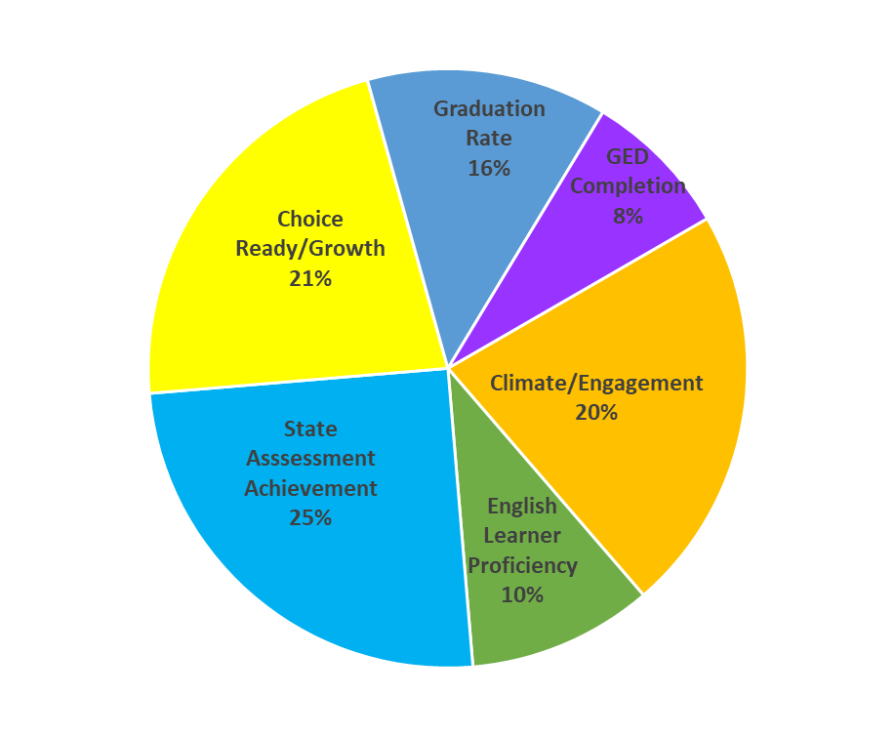
Student growth Model Pie charts
Under ESSA, North Dakota will have a growth model at both the elementary and high school levels.
State Assessment Achievement Growth
30%
Climate/Engagement
30%
State Assessment Achievement 30%
English Learner Proficiency 10%
Elementary
High School

Slide 5
Choice Ready Metrics
The metrics within the Choice Ready initiative measure student readiness in multiple areas:
  Possessing Essential Skills
    Post-Secondary Ready
    Workforce Ready
    Military Ready

Slide 6
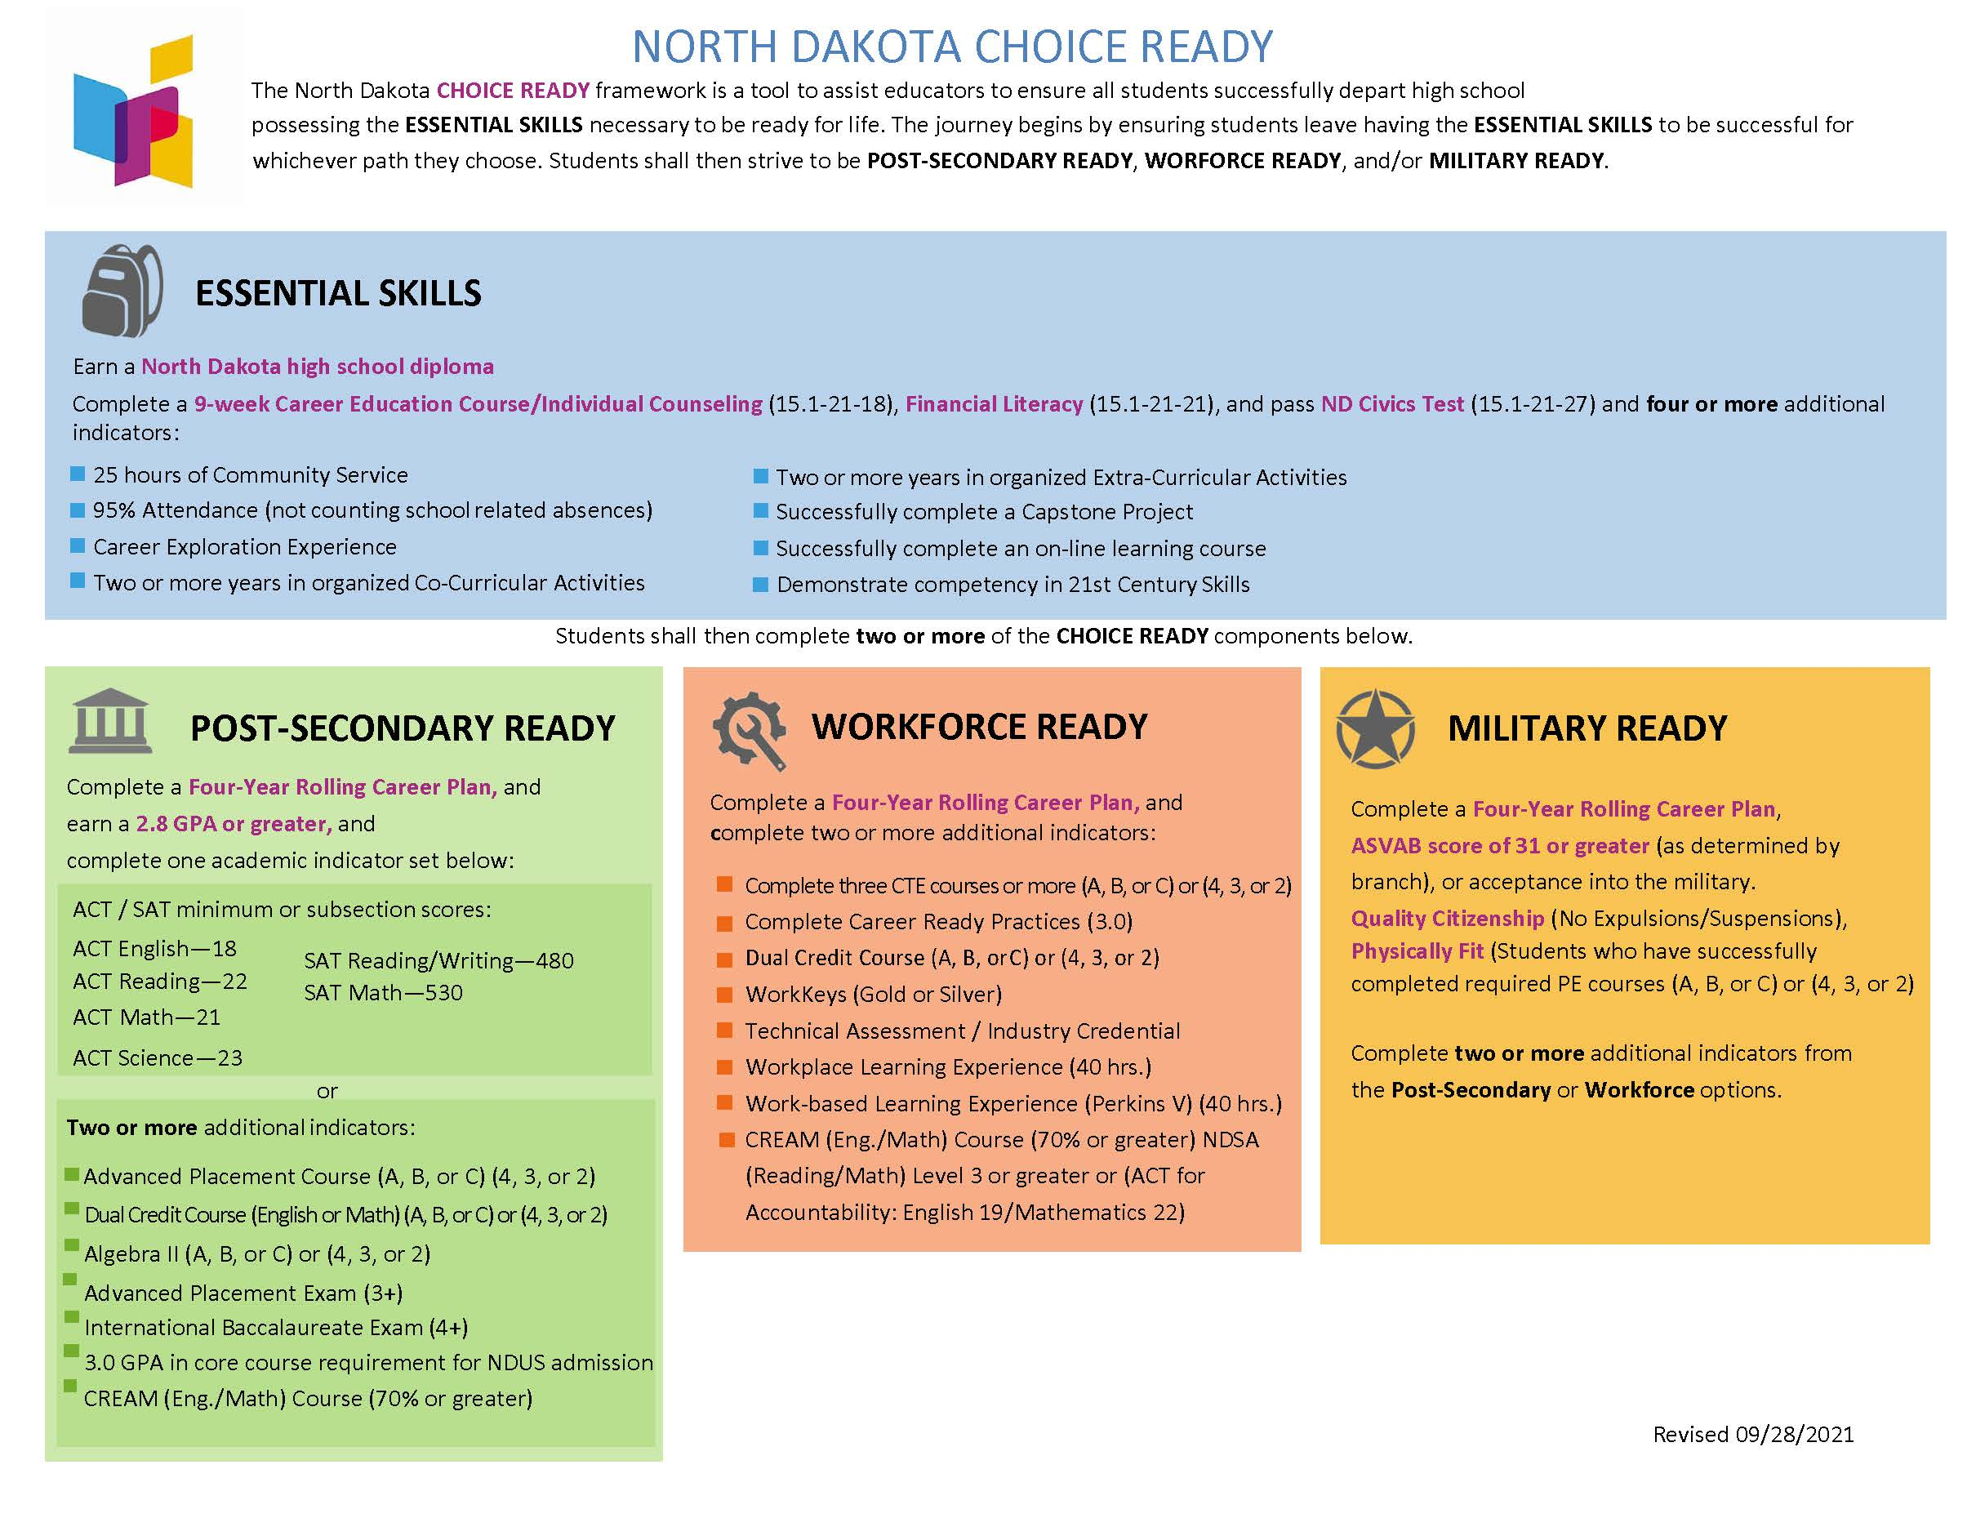
Choice Ready Visual

Slide 7
Choice Ready Components
Ideally, all students would be Choice Ready in all three pathways. In order for students to be Choice Ready for accountability purposes, students must be Choice Ready in two of three pathways.

Slide 8
School accountability reports
North Dakota has a new accountability system under ESSA.
Under ESSA, state education departments are required to annually create an accountability report for every public school in the state.
NDDPI released the first School Accountability Reports in March 2018.
NDDPI released the most recent School Accountability Reports in September 2021.
The School Accountability Reports outline how students are performing on the accountability elements North Dakota selected within its ESSA Plan.

Slide 9
Interactive school dashboard
An external interactive dashboard has been developed and is now open to the public and community. It is housed on an external site call “Insights,” which allows multiple factors to be used when summarizing a school’s measure of quality.
The dashboard can be accessed from either the NDDPI website or via Insights.nd.gov.
The School Accountability Reports are available on the Insights dashboard.

Slide 10
Choice Ready
The Choice Ready report is open and school personnel should be working to complete the report all year long.
The final due date to submit the Choice Ready report is June 30.
It is critical that every public high school in North Dakota complete and submit a Choice Ready report to secure these points in the accountability system. The Choice Ready report is 21% of your accountability report and worth 129 points.

Slide 11
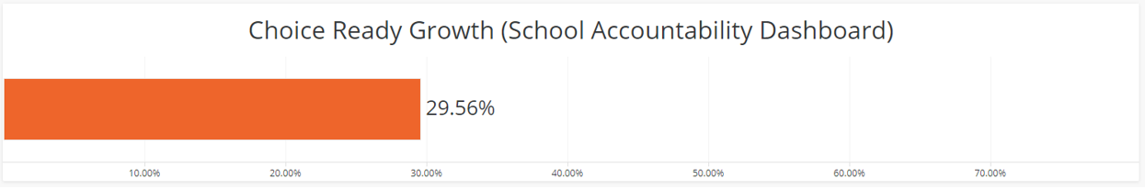
Choice Ready Results
The department is now compiling the data for inclusion of Choice Ready results on the School Accountability report, which will be represented by a graphic showing growth, as indicated below:
Choice Ready Visualizations
The Choice Ready measure is calculated based upon year-over-year growth in the overall performance of the school’s graduating class having acquired the Essential Skills and attained the readiness areas of Post-Secondary, Workforce, and/or Military/Life Skills within the framework. High schools must improve year after year to maintain the Choice Ready goals as established within North Dakota’s accountability initiatives.

Slide 12
Choice Ready Benefits
The Choice Ready initiative provides an opportunity for:
  Schools to fare well in accountability determinations.
  Students to graduate high school choice ready for their chosen path, or plan to be explored later in life.
  Parents to have their students take credit-bearing courses at a college or university - saving time and money.

Slide 13
SB 2289: State scholarship and choice ready
Redefines the requirements for the state scholarship program and aligns the requirements to Choice Ready.
  Aligns to Choice Ready but has high expectations of Choice Ready elements.
  3-year overlap (classes of 2022-2024), in which students can use either the old or new requirements.
    Starting with the Class of 2025, only the new requirements can be used.
Signed by Governor Burgum on April 20.

Slide 14
Questions to ask the Superintendent and/or principals
For 2020-2021, listed below is how many of our seniors were:
  Post Secondary Ready ___
  Workforce Ready ___
  Military Ready ___
In 2020-2021, ___ seniors graduated Choice Ready.

Slide 15
How Can Board Members Get Involved?
Opportunities to show growth include:
  Expand options available to students
  Build elements into the school day
  Allow activities outside of school day
  Complete Choice Ready reports throughout the year
  Provide CREAM option to students
  Partner with businesses and community
  Create opportunities for students (i.e., restitution)

Slide 16

questions
Our school’s Choice Ready coordinator is _________. Contact the coordinator or high school principal with any questions.

