Slide 1
[Insert ELEMENTARY School NAME Here]
[ Insert Your
Logo Here]

Slide 2
Release of School Accountability Reports

Slide 3
School Accountability Reports
School Accountability Reports
Under the Every Student Succeeds Act (ESSA) federal law, state education departments such as the North Dakota Department of Public Instruction (NDDPI) are required to annually create an accountability report for every public school in the state.
The school accountability reports outline how schools are performing on the accountability elements North Dakota selected within its ESSA plan.
The preliminary school accountability reports, based on data from the 2023-2024 school year, were posted in a private portal for review in mid-August 14, 2024.
Schools had until mid-September to review the reports, ask questions, or appeal their data.

Slide 4
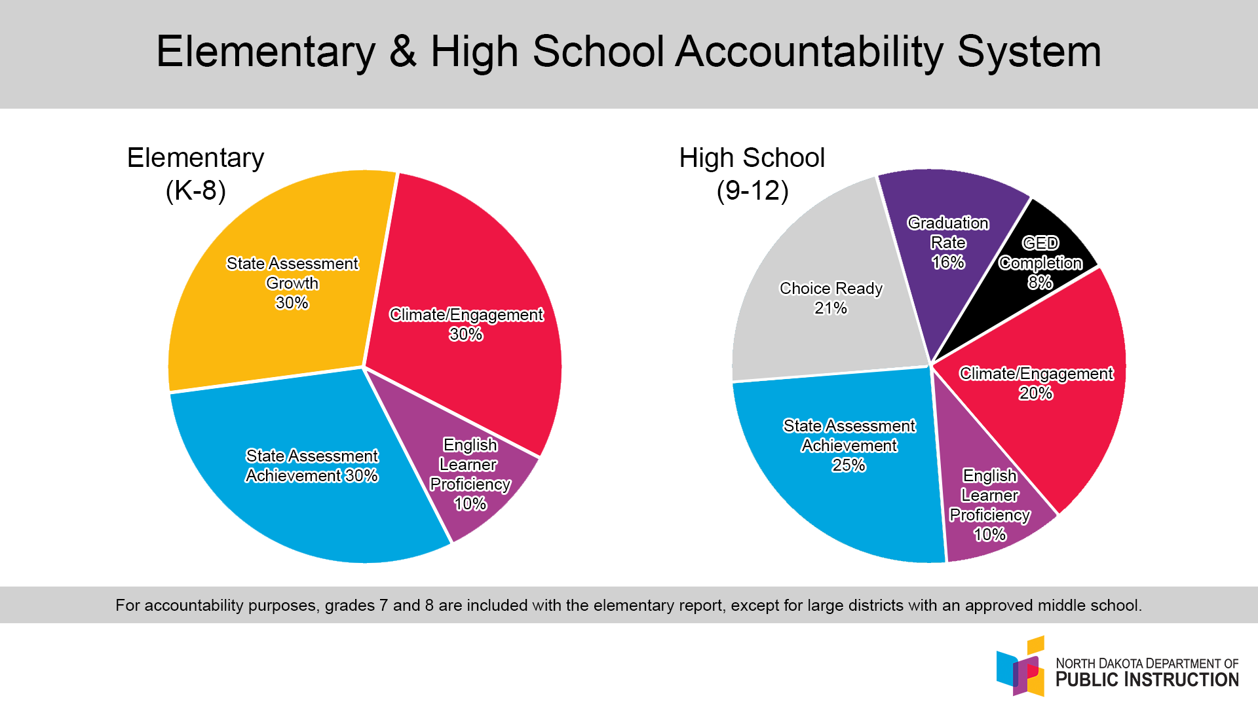
Elementary/High School Accountability system

Slide 5
Interactive School Dashboard
Interactive School Dashboard
An interactive dashboard, Insights.nd.gov , is the home for state agency and community data.
To access our school Accountability Report once it’s final, visit Insights, select “Find My School”, and search alphabetically.
The school accountability report is posted under the Dashboard heading.
The dashboard allows schools and districts to showcase and highlight strengths in their buildings while providing transparency to the public.

Slide 6
Insights dashboard
[INSERT SCREEN SHOT OF YOUR SCHOOL]

Slide 7
Our School Accountability Report

Slide 8
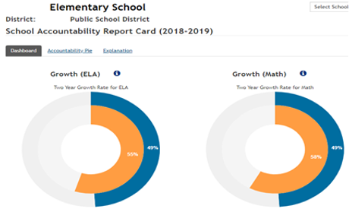
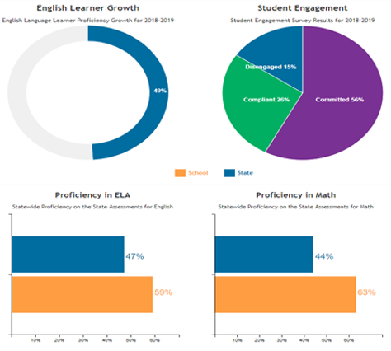
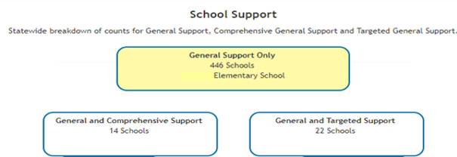
Sample school dashboard-Elementary
[Insert a screenshot of your School Dashboard]

Slide 9
Academic Achievement
Academic Achievement
North Dakota State Assessment (NDSA)
Our school results: [Insert Summary]
Student test scores have been available since the student finished testing and are available for viewing, downloading, or printing. It is the responsibility of the school/district to share student reports with parents.
These score reports are made available online in “near-real-time” through the Centralized Reporting System (CRS) on the NDSA Portal.
The reports include students’ Lexile and Quartile scores.

Slide 10
Academic Progress
Academic Progress
Student Growth, using the NDSA, is an accountability indicator at the elementary level (K-8).
Student Growth Values (SGV) help compare student performance over time.
The School Accountability Report shows the percentage of students who met the growth targets on the NDSA.
Our school results: [Insert Summary]

Slide 11
ELP Growth
English Language Proficiency (ELP) Growth
Measurement of English Language Proficiency (ELP) growth for active ELs who took the annual WIDA ACCESS for ELLs® assessment is also an element measured for accountability and accounts for 10% of the accountability system.
Schools who don’t have 10 students identified as English Learners will have this data suppressed and the points will be equally re-distributed to the other elements.
Our school results: [Insert Summary]

Slide 12
School Quality
School Quality
ESSA law requires states to use at least one additional “indicator of school quality” that is non-academic, which in North Dakota is student engagement.
The student engagement element accounts for 30% of the elementary accountability score.
North Dakota public schools measure student engagement through the use of a survey platform given in January.
Our school results: ___% Committed
  ___% Compliant
  ___% Disengaged

Slide 13
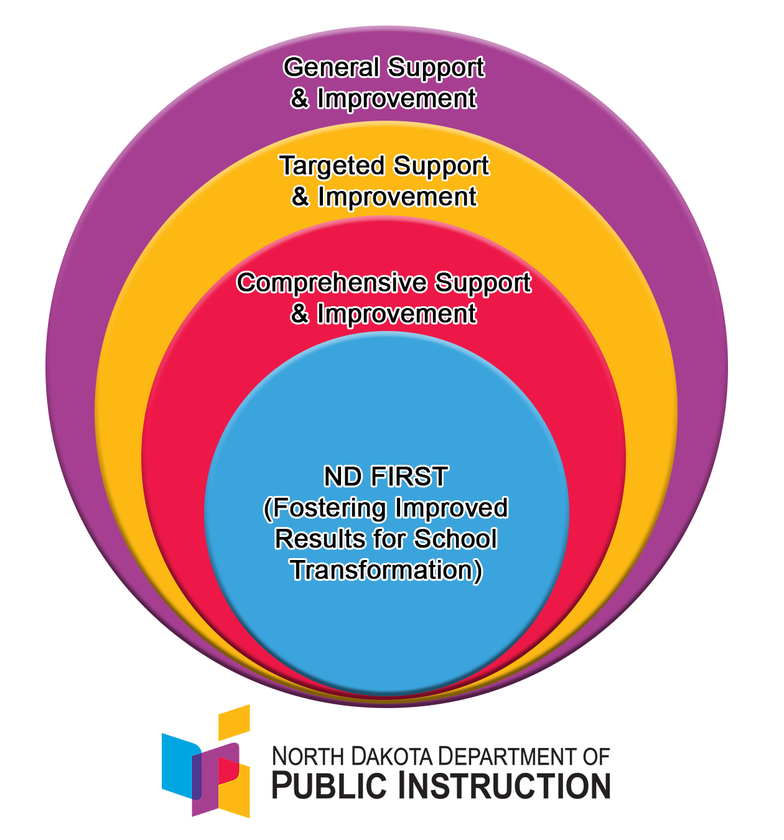
School Support
School Support
North Dakota built its ESSA plan around a Continuous
Improvement model.
Within North Dakota’s System of Support:
  General Support and Improvement
  Targeted Support and Improvement
  Comprehensive Support and Improvement
Our school is in the [_________] category of support.
Our school will receive the following support during this school year [Insert Summary].

Slide 14
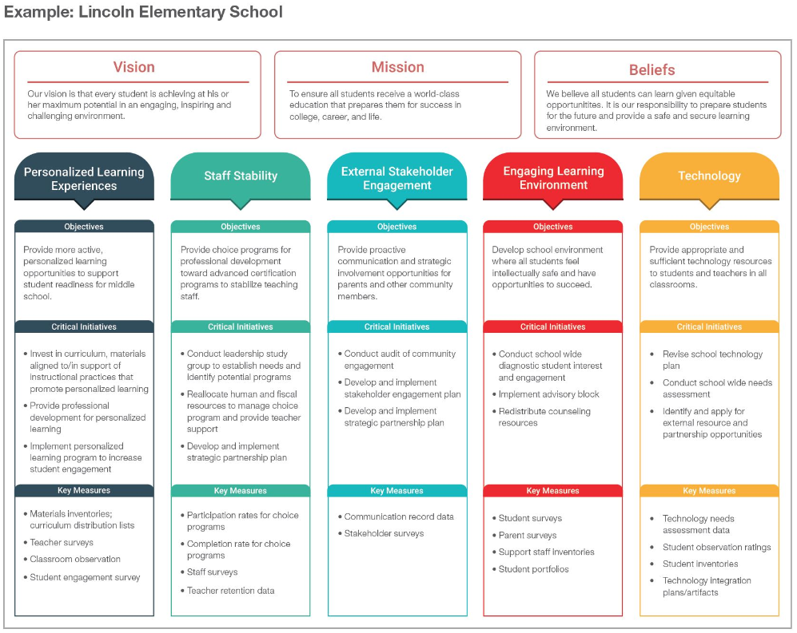
School Strategy Maps
[INSERT SCREEN SHOT OF YOUR SCHOOL]
School Strategy Maps
All North Dakota public schools have a school improvement plan.
Our strategy map outlines our key school improvement initiatives and is available on Insights.nd.gov.

Slide 15
Notifications after final release
Notifications – After Final Release
Under ESSA, all public school districts receiving federal funding are required to notify the parents of each enrolled child in the school regarding the performance measures outlined in the state’s accountability system. Schools will disseminate information to parents after the September release. [Attach/send a parent notification letter].
Federal law also requires each district to provide a link Insights.nd.gov on the school/district website. [See template.]

Slide 16

questions
Questions can be directed to:
[Insert name of who to contact at the school regarding the information within the presentation.]
[Phone:]
[Email:]

