Slide 1
General Audit Topics
Michael Scherr
mascherr@nd.gov
701-328-9500
North Dakota State Auditor’s Office
Annual Audit Summit
July 19, 2023
Heath Erickson
hmerickson@nd.gov
701-239-7286

Slide 2
What does someone look like right before a corrective entry is made?

Slide 3
What is a Corrective Entry?
A corrective entry is a journal entry that is made in order to fix an erroneous transaction that had previously been recorded in the financial statements.

Slide 4
A Mistake Was Made…. Now What?
Mistakes happen at any point during your fiscal year
Don’t feel bad; you caught it and are fixing it
Tell someone like:
Other Staff Members
Board Members
Auditors
Follow the protocol (example: Corrective Entry Policy) to deal with a corrective entry

Slide 5
Examples of Corrective Entries…
Revenues or Expenses - Coding
Capital Assets – Adds, Deletes, Construction in Progress
Long Term Debt
Accounts Receivable or Payable
Bank Reconciliations – Errors Found
Transfers

Slide 6
Corrective Entry Policy
Assess and document the mistake/error
When did it happen
What went wrong
What is needed to fix it
What is the amount of the mistake or error
Do small errors get treated differently than large errors?
This is a management decision
Maybe small errors can be corrected without a formal policy and by the staff member who made the error and caught it
Large errors may need to follow the formal policy that is approved by the board
Prepare the documentation
List what the entry is and what needs to happen in the general ledger
Be prepared to explain what happened to the board or your auditors

Slide 7
Corrective Entry Policy
Submit the information to the board to review
The board may want to see a packet or at least a listing
The board may not want to approve all corrective entries (maybe just entries over a certain amount)
Make the corrective entry in the general ledger
When approved, the actual entry can happen
Make sure after the entry is made that it fixes what it was supposed to
You may need to phone a friend
File it away
Create an audit trail for your corrective entries
You may need to explain it to someone someday

Slide 8
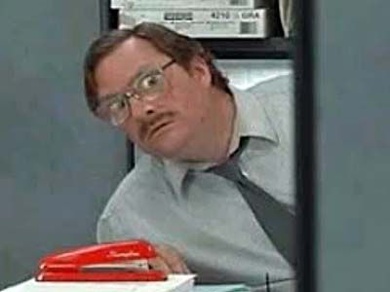
Why Do Auditors Care?
They need to know what changed during the year
Your auditor is going to review beginning balances
More corrective entries = more audit risk
The audit opinion may need to be modified
Your auditor may withdraw from the engagement
Auditors may feel that fraud occurred

Slide 9
What Could Go Wrong with Corrective Entries?
It didn’t fix what it was supposed to
Fixing one thing caused another issue
Too many of them may give an indicator of fraud
Accounting staff didn’t understand them
Support was not kept for them
They were not approved

Slide 10
Thank you!
Remember, we are here to help!

Slide 11
Today’s Topics
Revenues and Expenses – How to Properly Classify
Long-Term Debt – Common Issues and Tips to Improve Your Audit
Capital Assets – Common Issues and Tips to Improve Your Audit

Slide 12
Revenues and Expenses

Slide 13
How does this affect me?
ISSUE:
Improperly recording and classifying revenues and expenses can cause various issues such as:
Potential audit findings if auditor identifies reclassifications that are necessary
Incorrect information being presented within annual budgets
Incorrect information being provided to your stakeholders, board, and other users and readers of the financial statements

Slide 14
Counties, Cities, & Districts
Revenue:
Classification can range from Taxes, Charge for Services, Intergovernmental Revenue, Miscellaneous Revenue, and Other Financing Sources
It is up to you to ensure you are properly recording annual revenues into these various classifications for the audit and budget preparation

Slide 15
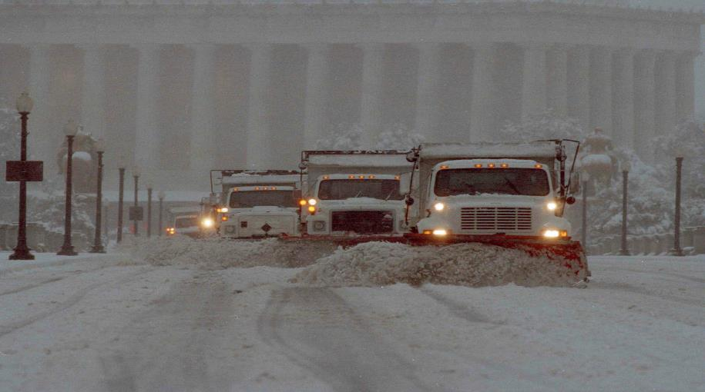
Counties, Cities, & Districts Cont.
Taxes:
Typically includes Property Tax collections, can also include tax collections from other areas such as Special Assessments and Sales Tax
Charge for Services:
Typically includes services that the government unit charges others for various services
Example: County charges various townships for snow removal, these revenues should be reported with the charge for services
Notes:
Note: Account for these three types of taxes separately in the general ledger.
Note: If Special Assessments are related to charging fees for a project and is not debt related, it should be recorded with Charge for Services on the Government Wide Statement of Activities. Special Assessments that are capital in nature, should be reported as a capital contribution.

Slide 16
Counties, Cities, & Districts Cont.
Intergovernmental Revenue:
Is used to include revenues received from other state and federal agencies and governments
Example: The county received $3 million in ARPA funds, the county auditor set up a separate special revenue fund and recorded this revenue with intergovernmental revenues
Miscellaneous Revenue:
This is an Other Source of revenue classification that typically includes donations, other proceeds, and other reimbursements that don’t fall into the other categories
Note: Everything is not considered Miscellaneous! This is where most of the reclassifications occur during the audit

Slide 17
Counties, Cities, & Districts Cont.
Other Financing Sources:
Used for revenue received for bond proceeds, lease proceeds, and sale of assets
Note: This is also a common area where items need be reclassified to
Example: The city received a deposit for their new bond. The city auditor classified this large deposit as an Other Financing Source while preparing the financials

Slide 18
Counties, Cities, & Districts Cont.
Common Reclasses:
If an entity sells a vehicle and receives cash proceeds, we often see this classified as miscellaneous revenue. Reclass is then necessary to move this revenue to Other Financing Sources
Bond proceeds being deposited into miscellaneous revenue
Various reimbursements in miscellaneous revenue that should be moved to intergovernmental revenue

Slide 19
Counties, Cities, & Districts
Expenditures:
Depending on entity, classifications are presented and categorized by function such as general government, highways and bridges, public safety, conservation of natural resources, and debt service to name a few
Some entities may only have one function they classify their expenditures under. For example, a water resource district’s expenses may fall under only conservation of natural resources

Slide 20
Counties, Cities, & Districts
Common Reclass Mistakes for Expenses:
Debt Service:
Common issue is clients classifying annual principal and interest payments in the wrong function. For example, if a County has an excavator that they took a loan out for, the debt payments should be included in the debt service function and not highways and bridges with the other road expenses
Potential audit finding

Slide 21
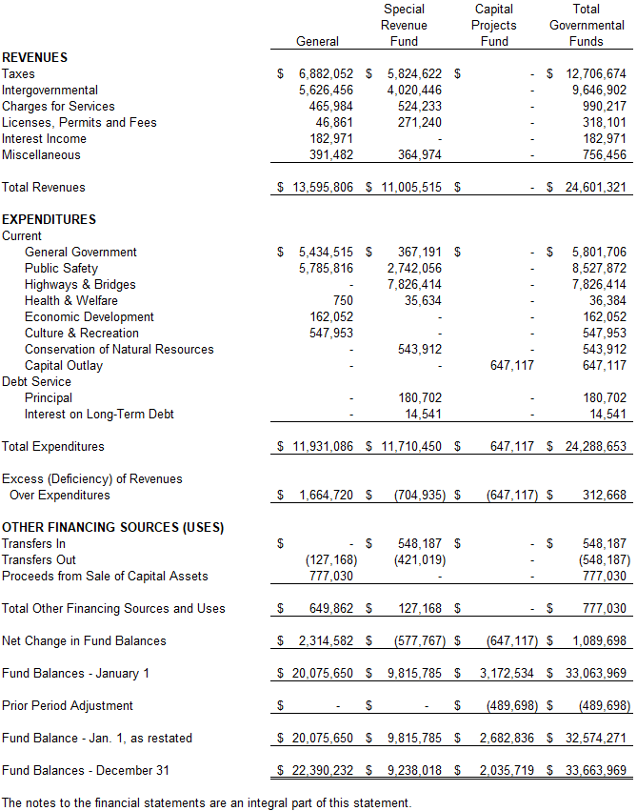
Report Example: County

Slide 22
School Districts
Revenue:
Similar sources as the other entities, but classifications are different
Common classifications sources are Local, State, Federal, and Other
Local Sources are derived from tax collections
Federal and State Sources is made up of intergovernmental revenue from federal or state governments
Other Sources are comparable to miscellaneous revenues

Slide 23
School Districts
Expenses:
Classifications are by program
Common classifications are Regular Instruction, Federal Programs, District Wide Services, Administration, and Transportation
It is up to the financial statement preparer to properly record expenditures in the proper programs when completing the basic financial statements
Audit Finding could be possible if a reclass is needed during the audit

Slide 24
School Districts
Common Reclasses:
Revenues:
Just like miscellaneous revenue, Other Sources is not a catch-all
Federal grants being recorded in Other or State Sources or vice versa
Debt issuances being recorded with Other Sources and not Other Financing Sources.
Expenses:
Debt payments being included with Transportation or District Wide Services and not Debt Service
Other Program expenses being reclassed to more program-specific

Slide 25
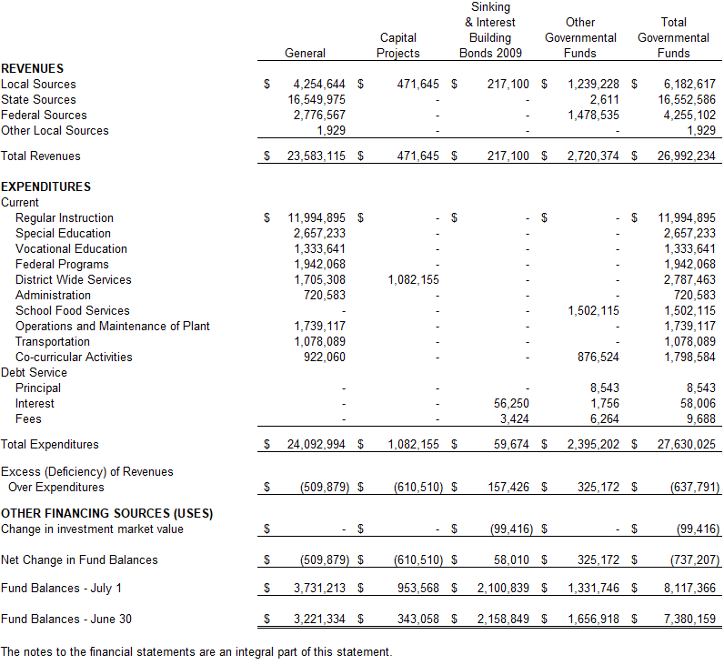
Report Example: School District

Slide 26
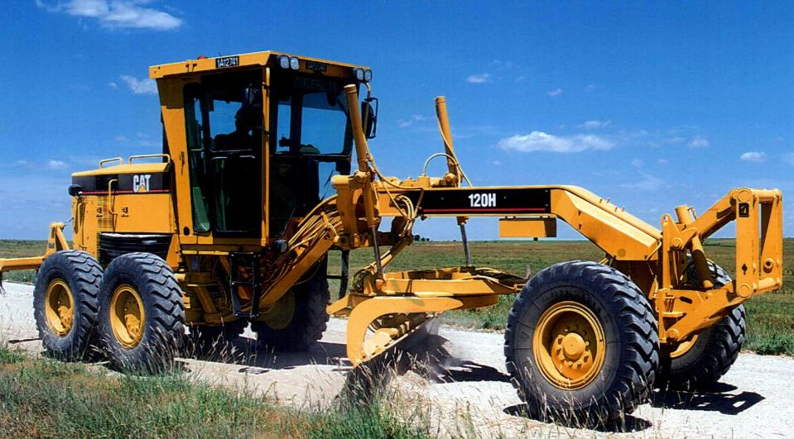
Capital Assets

Slide 27
Capital Assets: Common Issues
Auditee does not maintain capital asset listing
Over relying on Auditor
Switching Auditors
Potential Audit Finding and Opinion Modification
Missing Capital Assets or not following Policy
If listing is not maintained frequently, assets can be missed
Potential Audit Finding
Not following policy, threshold for capitalizing is often any asset over $5,000

Slide 28
Capital Assets: Common Issues
Auditee does not track infrastructure or improvement projects
Potentially missing projects
Auditor will request support to determine CIP amounts
Auditee does not bid out large assets or projects
Potential violation of state law
Potential losses by not exploring options
Auditee does not maintain support
Missing invoices for purchases of assets
Missing titles and other supporting documentation
Missing insurance coverage

Slide 29
Capital Assets: Tips and Tricks
Maintain Listing
Request from Auditor and start maintaining
Can reconcile to Auditor’s listing
Maintain Support and Documentation
Auditors will always request support for invoices and various projects

Slide 30
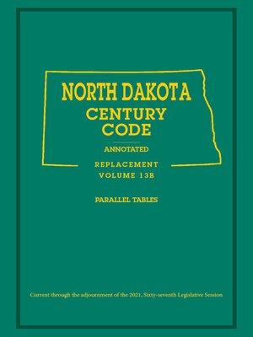
Capital Assets: Tips and Tricks
Follow ND Century Code.
Consult with legal or States Attorney.
Inquire with Auditor

Slide 31
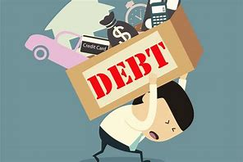
Long Term Debt

Slide 32
Long Term Debt: Common Issues
Unrecorded Debt
Not maintaining a summary or schedule of outstanding debt can cause some debt to be unaccounted for
Potential Audit Finding
Covenants
Covenants are common in Bonds but can be in other forms of debt
New funds are often required to be set up
Potential Audit Finding

Slide 33
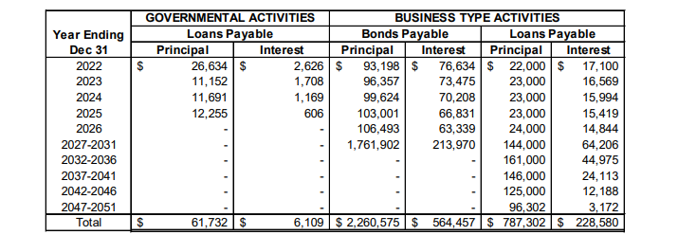
Long Term Debt: Common Issues
Tracking Debt
Amortization Schedule for Note Disclosure
Making payments

Slide 34
Long Term Debt: Tips and Tricks
Maintain Schedule of Outstanding Debt
Update once debt is extinguished or issued
Get updated agreements/amortization schedules if needed
Read Debt Covenants
Ensure compliance
Inquire with legal or States Attorney

Slide 35
Recap
Properly classify and record revenues and expenses to prevent reclassification and potential audit findings
Maintain Capital Assets and support documentation
Verify compliance with ND Century Code regarding bidding.
Follow Capital Asset Policy
Maintain Long Term Debt Schedule and Review Debt Covenants
Potential missing debt if not maintained
Potential violation of covenants if not followed

Slide 36
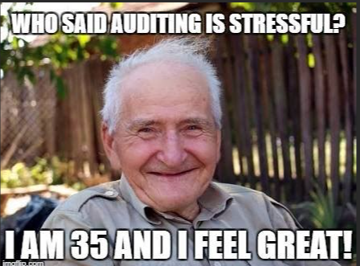
Thank You!

