Slide 1

How to Figure Out Bank Reconciliations
Jon Worrall, CPA

Slide 2
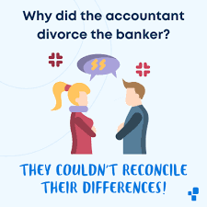
Bank Recons explained
Process where an entity’s General Ledger cash balance is reconciled to the bank statement
Reconciling items can include:
  Uncleared Checks
  Deposits in Transit
  Interest Earned
  ACH/wire items, NSF Fees, Service Fees
Serves as periodic check for Cash:
  Catch items not recorded in Ledger
  Detect fraud
  Identify bank errors

Slide 3

Paper/Excel vs. Software
Paper/Excel
  Start with prior reconciliation including reconciling items
  Print off Cash Ledger for the current month
  Grab/Print Bank Statement
  Mark off items that have cleared the bank statement
  Compile new list of reconciling items
  Record any transactions discovered on the bank statement that wasn’t previously recorded
  Buy new highlighter
Software
  Enter bank statement balance
  Check off items that have cleared
  Record any transactions discovered on the bank statement that wasn’t previously recorded
  Print for your records

Slide 4
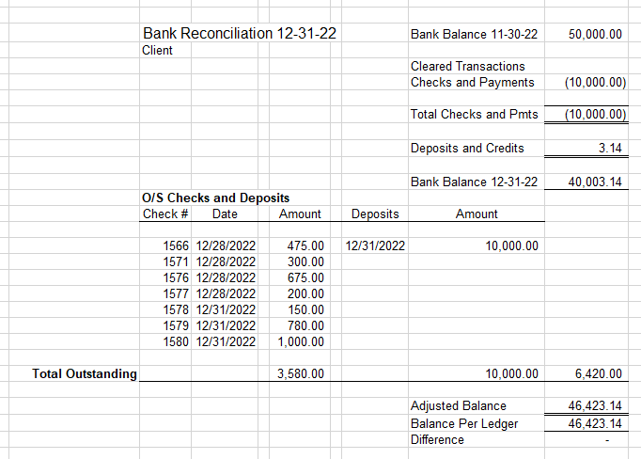
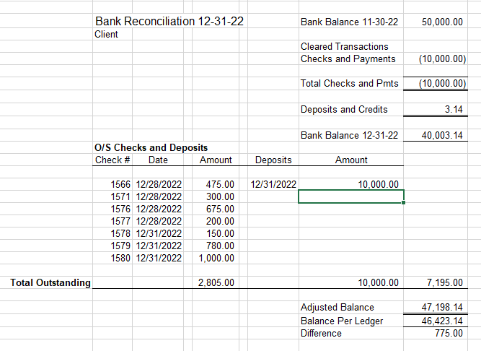
Good vs. bad

Slide 5

Slide Title
Utilize your software
  Can help prevent human error
  Not as much printing and highlighting
  If that’s not an option
    Utilize excel
    Verify your formulas
Perform timely
Have someone else review
  Other accounting department staff
  Finance Committee/Board
Look at old outstanding items on reconciliation
Look for cutoff issues
Save it so the pesky auditors can see them

Slide 6

Questions?
  jworrall@nd.gov

