Slide 1
Going Back in Time to Visit GASB 54……….
Heath Erickson, CPA
Audit Manager
hmerickson@nd.gov

Slide 2
GASB 54 – Traveling Back in Case You Missed it the First Time……
The Governmental Accounting Standards Board (GASB) issued GASB Statement No. 54 on February of 2009.
GASB 54 was effective for financial statements for periods beginning after June 15, 2010.
Example – fiscal year end June 30, 2011 and December 31, 2011 would be the first time the new changes would be seen.

Slide 3
What was the objective?
The objective of this Statement is to enhance the usefulness of fund balance information by providing clearer fund balance classifications that can be more consistently applied and by clarifying the existing governmental fund type definitions. This Statement establishes fund balance classifications that comprise a hierarchy based primarily on the extent to which a government is bound to observe constraints imposed upon the use of the resources reported in governmental funds.

Slide 4
GASB 54 – Fund Definitions
The general fund is used to account for all financial resources not accounted for and reported in another fund.
Special revenue funds are used to account and report the proceeds of specific revenue sources that are restricted or committed to expenditure for specific purposes other than debt service or capital projects.
Debt service funds are used to account for all financial resources restricted, committed or assigned to expenditure for principal and interest.
Capital projects funds are used to account for all financial resources restricted, committed or assigned to expenditure for the acquisition or construction of capital assets.
Permanent funds are used to account for resources restricted to the extent that only earnings, and not principal, may be used for purposes that support the Entity’s purposes.

Slide 5
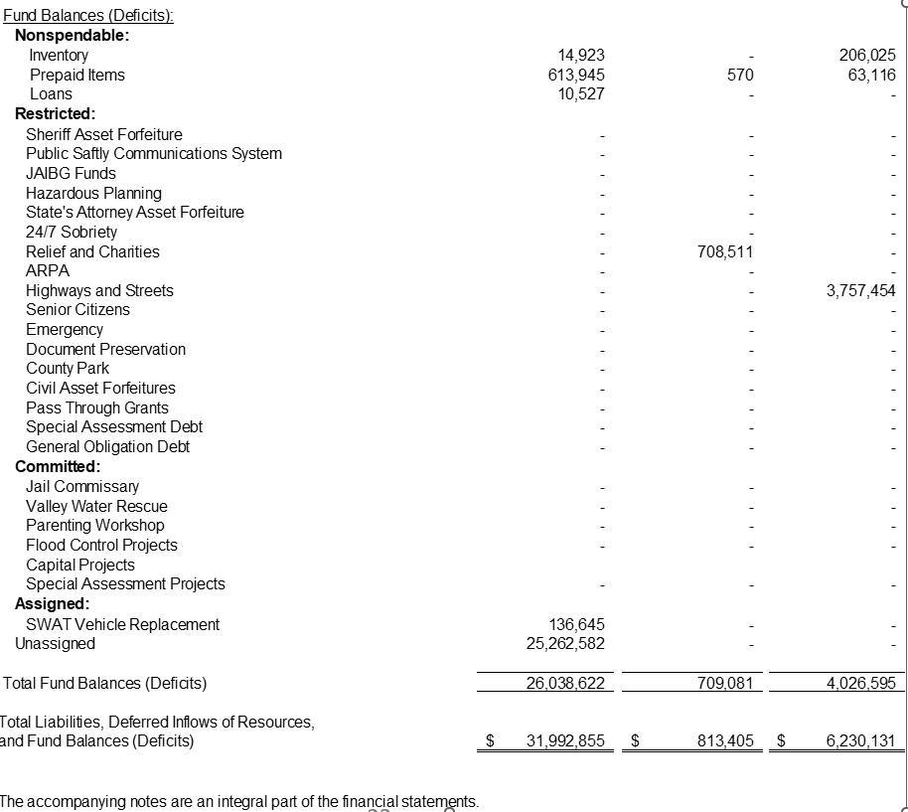
GASB 54 – What Happened to My Balance Sheet??

Slide 6
GASB 54 – The Five Classes of Fund Balance
Non-spendable fund balance shall mean the portion of the gross fund balance that is not expendable (such as inventories) or is legally earmarked for a specific use.
Examples of non-spendable fund balance reserves for which fund balance shall not be available for financing general operating expenditures include:
• Inventories;
• Prepaid items;
• Deferred expenditures;
• Long-term receivables; and
• Outstanding encumbrances.

Slide 7
GASB 54 – The Five Classes of Fund Balance
Restricted fund balance shall include amounts constrained to a specific purpose by the provider, such as a grantor, by restricted tax levy or by bond indenture. Fund balance should be reported as restricted when constraints placed on the use of resources are either:
a. Externally imposed by creditors (such as through debt covenants), grantors, contributors, or laws or regulations of other governments; or
b. Imposed by law through constitutional provisions or enabling legislation.
Examples of restricted fund balances include:
• Tax levy funds;
• Resources from other granting agencies – restricted state and federal grants/reimbursements.

Slide 8
GASB 54 – The Five Classes of Fund Balance
Committed fund balance shall mean that portion of the fund balance that is constrained to a specific purpose by the Board. Authority to Commit – Commitments will only be used for specific purposes pursuant to a formal action of the Board. The commitment amounts cannot be used for any other purpose unless the board removes or changes the specified use by taking the same type of action it employed to commit the funds.
Examples include:
• Potential litigation, claims, and judgments; and
• Board induced Entity approved projects
• Legislation induced restrictions

Slide 9
GASB 54 – The Five Classes of Fund Balance
Assigned fund balance - Amounts that are constrained by the government‘s intent to be used for specific purposes, but are neither restricted nor committed, should be reported as assigned fund balance, except for stabilization arrangements. Intent should be expressed by (a) the governing body itself or (b) a body (a budget or finance committee, for example) or official to which the governing body has delegated the authority to assign amounts to be used for specific purposes. (Accountant, Business Manager, County Auditor, City Auditor, etc.)
Examples include:
• Insurance deductibles;
• Program start-up costs; and
• other special projects (for example: office remodel projects)
.

Slide 10
GASB 54 – The Five Classes of Fund Balance
Unassigned fund balance is the residual classification for the general fund. This
classification represents fund balance that has not been assigned to other funds and that has not been restricted, committed, or assigned to specific purposes within the general fund. The general fund should be the only fund that reports a positive unassigned fund balance amount.
In other governmental funds, if expenditures incurred for specific purposes exceeded the amounts restricted, committed, or assigned to those purposes, it may be necessary to report a negative unassigned fund balance.
Note: General fund can have a positive unassigned balance on the balance sheet, but any other fund can only have a negative amount in this class.

Slide 11
How did everyone do the first year?
Local Governments – I think it was difficult for some to understand what GASB 54 was enabling them to do. Most entities did not have a policy created before implementation of this standard and might still not have one today.
Local Government Auditors – This was a big change for the balance sheet and notes to the financial statements. Most auditors had a difficult time following what the local governments wanted to do with the various classes of fund balance.

Slide 12
What can you do now with knowledge from the past?
Read GASB 54
Talk about GASB 54 with your local government board and others in management of your entity.
Look at your audit reports because your balance sheet probably has most of the 5 classes right now. Ask your auditor to explain them to you!
Use the 5 classes as they were intended for your local government.
Create and approve a GASB 54 policy now!

Slide 13
Have Trouble Going to Bed at Night???
https://www.gasb.org/page/ShowDocument?path=GASBS%252054.pdf&acceptedDisclaimer=true&title=GASBS+54&Submit=
GASB 54 -
Thank you for traveling back in time with me today!

