Slide 1
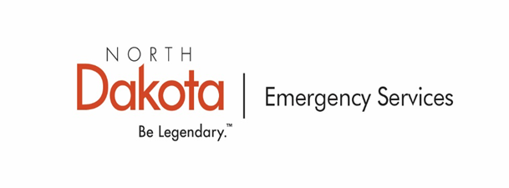
NDDES-FEMA Compliance and Record Keeping

Slide 2
Compliance Requirements After FEMA Obligation
Four Main FEMA Requirements
Scope of work (SOW) is completed as written in project
Environmental, Historic a Preservation (EHP) requirements are followed
FEMA and State funding is trackable
Procurement

Slide 3
Compliance Requirements After FEMA Obligation
Scope of work (SOW) must be met
If your site was awarded 20 CY of gravel you must maintain invoices or force account records identifying the placement of 20 CY at that site
Record of Environmental Consideration (REC)
All EHP requirements are identified under the REC
Material Borrow Compliance (SHPO)
US Army Corps of Engineers
Flood Plain Permitting
Disposal locations – Debris, culverts, bridges, etc.
Pollutant discharge permit

Slide 4
Compliance Requirements After FEMA Obligation
Transfer of funding
Proof of payments to vendors are required to be maintained
Warrants
Cancelled checks
Transfer of funding from County to Township
Township is required to maintain proof of payments to vendors
County is required to maintain proof of payment to townships
Counties should not release FEMA funding to townships unless they have met REC, procurement and SOW requirements

Slide 5
Record Retention – Obligation
You will receive an email from grants.des.nd.gov once your project is obligated
Project Version – When completed PW goes to the applicant.
Attached to the Version for the Project Worksheet (PW) referenced above is a copy of the obligated Project Worksheet (PW) and P.2 Grant report, under the documents in the lower right hand corner, which denotes FEMA's determination of approved funding for work performed as a result of the above referenced disaster. Please logon to [[ObjectLink]] to review the P.2 and eligible amount of the PW. Please keep copies of the P.2 and PW for your records.
Should you disagree with FEMA's determination, you may elect to file an appeal in accordance with 44 CFR §206.206. The appeal must be filed to the North Dakota Dept. of Emergency Services (Recipient) within 60 calendar days of receipt of this correspondence. The appeal must include the amount in question, documented justification that supports your position, and the provisions in Federal law, regulation, and/or policy with which the initial action was inconsistent.
Reimbursement for large projects must be requested by the Subrecipient at www.[[SiteName]] by submitting a Request for Reimbursement (RFR). Small project reimbursement will be processed by the Recipient upon obligation, subject to funding authority. Throughout the grant management process, subrecipients can utilize www.[[SiteName]] to review PW status, submit PW related requests and review payments in progress. For further details on the payment process, please visit www.[[SiteName]] or review the subrecipient agreement.

Slide 11
Record Retention - Grant Funding – Small Projects ($199,999.99 and Below)
Small project funding will be paid at obligation
You will receive email notification from grants.des.nd.gov when your projects are obligated
The email will provide you a link where you can view your project and the supporting documentation
Federal funding is released to the State or Recipient
A second email will follow once the funding has been transferred to your account
The Recipient then forwards the Federal and State funding to the applicant or sub-recipient
Funding must be placed in a noninterest bearing account
Highly recommended to keep funding in its own account
Funding must be trackable

Slide 12
Record Retention – Payment
You will receive an email from grants.des.nd.gov once your project’s funding is processed
This is a confirmation that a payment is being processed for the following project(s): [[Project List]]
Please reference the following link to review your payment and obtain a copy of the payment invoice and associated documents:
[[Item Link]]
Payment Timeline
- All payments will be direct deposited, or live check mailed, within ten (10) business days of this email. A copy of the ACH or live check will be available once the payment has been completed.

Slide 13
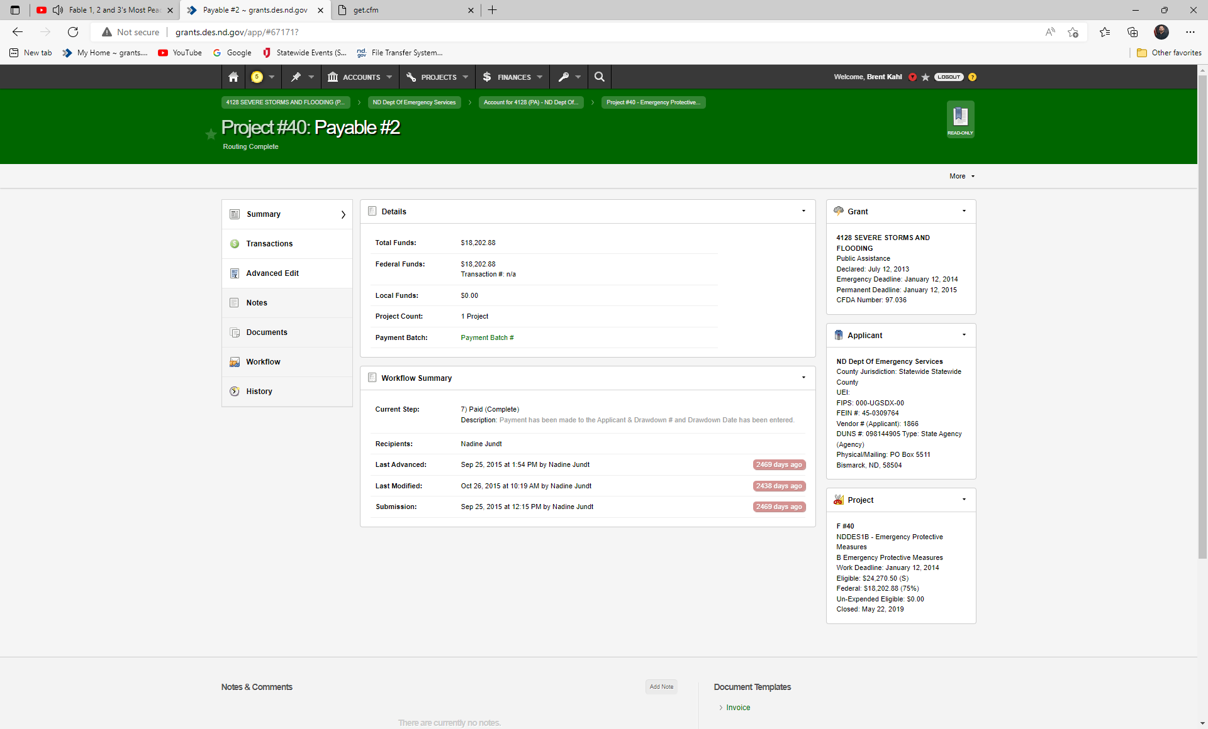

Slide 14
Record Retention - Grant Funding – Large Projects – Single Site - Work to be completed ($200,000.00 and Above)
No Federal or State funding is paid upon obligation
Federal funding can be paid once NDDES has completed the large project closeout review
State share funding will be paid once FEMA has reviewed and closed the project
A portion of the Federal funding can be paid if the applicant can demonstrate the following has been completed;
Procurement policy has been followed – Sealed bidding required
EHP requirements met
SOW requirements met
Proof of payment for work completed
Must request funding through ND Grants (CIVIX)
Non-compliance with Large Project closeout guidelines may result in de-obligation of funding

Slide 15
Procurement
Applicants must comply with Federal procurement standards as a condition of receiving PA funding for contract costs for eligible work
Must comply with the most stringent policy between Federal, State and Local procurement procedures
Applicants are responsible for establishing “Reasonable Costs” AT ALL TIMES
Reasonable Costs are established by:
Seeking multiple quotes &
Establish local market costs &
Establishing in-place costs
FEMA Procurement Disaster Assistance Team Field Manual can be found under the grants.des.nd.gov Public Assistance Section
See P. 77-85, Section A-D of the Public Assistance Program and Policy for additional procurement guidance

Slide 16
Procurement - State Standards
Public Improvement - N.D.C.C. Chapter 48-01.2
http://www.legis.nd.gov/cencode/t48c01-2.html
$200,000 threshold for bidding. $200,000 threshold for procuring plans, drawings, specifications from an architect or engineer
Must advertise by publishing 3 consecutive weeks at least 21 days before the bid opening.
Emergency exception N.D.C.C. § 48-01.2-04
NDDES recommends that all large projects are competitively advertised and bid

Slide 17
Procurement Purchasing - State Standards
EFFECTIVE JULY 1, 2018
Purchase Price | Competition Requirement | Documentation Maintenance Requirements
LEVEL 1 Less than $10,000 | At least one fair and reasonable quote. Note: Equipment and software must be added to inventory if $5,000 or greater. (N.D.C.C. § 54-27-21) | Alternate Procurement form not required if multiple quotes not solicited.
LEVEL 2 At least $10,000 but less than $50,000 | Solicit informal quotes/bids or proposals from at least three vendors, or post on SPO Online with appropriate state Bidders List. May send to additional vendors. | Documentation is required. Alternate Procurement form required if competition not solicited from at least three vendors. The form is not required if fewer than three bids or proposals are received.
LEVEL 3 At least $50,000 but less than $100,000 | Solicit informal bids or proposals using SPO Online with appropriate state Bidders List. May send to additional vendors. | Documentation is required. Alternate Procurement form required if: Competition is not solicited. SPO Online is not used.
LEVEL 4 $100,000 and over | Must be purchased using formal sealed bids or Request for Proposal (RFP). Solicitations must be posted using SPO Online with appropriate state Bidders List. May send to additional vendors. | Documentation is required. Alternate Procurement form required if: Competition is not solicited. SPO Online is not used.

Slide 18
Training Guides, Videos and Slides
Grants.des.nd.gov
Public Assistance - grants.des.nd.gov
Applicant PA Training Video – 3/31/2022
Township Handout
Recovery Transition Meeting – Applicant Handout
Large Project Closeout – Applicant Handout
Documentation and Disaster Preparation Training Video – 4/3/2023
ND Site Tracker Guidance
ND Site Tracker Template
Public Assistance Program and Policy Guide

