Slide 1
Budgeting – Through the Eyes of the Auditor
Alex Bakken, CPA

Slide 2
Goals of the Budget
www.nd.gov/auditor

Slide 3
Goals of the Budget
Needs of Stakeholders
Supported
Compliance with Laws and Regulations

Slide 4
Budgeting Laws
www.nd.gov/auditor

Slide 5
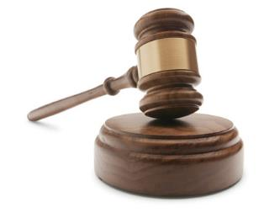
What does State Law Require?
NDCC 11-23-02. Auditor to prepare budget of county expenditures.
General Fund and each Debt Service and Special Revenue Fund
Form prescribed by the State Auditor
Must contain the following amounts for the preceding year, current year, and ensuing year:
Detailed Revenues
Detailed Expenditures
Transfers In & Out
Beginning & Ending Fund Balance
Cash Reserve < 75% of the fund's appropriation
Other Requirements

Slide 6
What does State Law Require?
NDCC 57-15-31. Determination of levy.
The amount to be levied must be computed in the following manner:
Total Estimated Expenditures
Plus: Required Reserve
Equals: Total Estimated Expenditures & Cash Reserve
Less: Surplus of Free and Unencumbered Cash
Less: Estimated Revenues From Non-Property Tax Sources
Less: Estimated Collections from Prior Tax Levies
Less: Expenditures Required to be Paid From Bond Sources
Less: Distributions from an Economic Growth Increment Pool under NDCC 57-15-61
Less: Payments in Lieu of Taxes on a Project under NDCC 40-57.1-03
Equals: Amount to be Levied
Allowance for Tax Collection Delinquency < 5% Amount to be Levied

Slide 7
What does State Law Require?
NDCC 57-15-27. Interim fund.
The governing body of any county, city, park district, or municipality, other than a school district, which is authorized to levy taxes may include in its budget an item to be known as the "interim fund.”
The interim fund must be:
Carried over to the next ensuing fiscal year;
Less than the amount required to finance the municipality for the first 9 months; and
Less than 75% of the current annual appropriation.

Slide 8
Other State Law Requirements
Protection of Taxpayers NDCC 57-15-01.1
City & Park Levy/Budget Info NDCC 40-40
School District NDCC 57-15-13
Water Resource District NDCC 61-16-06
Rural Fire Protection District NDCC 18-10-07
Soil Conservation District NDCC 4.1-20-24(1)(q)
Rural Ambulance District NDCC 11-28.3-09
Other Entities Review NDCC

Slide 9
SAO Budget File
www.nd.gov/auditor

Slide 10
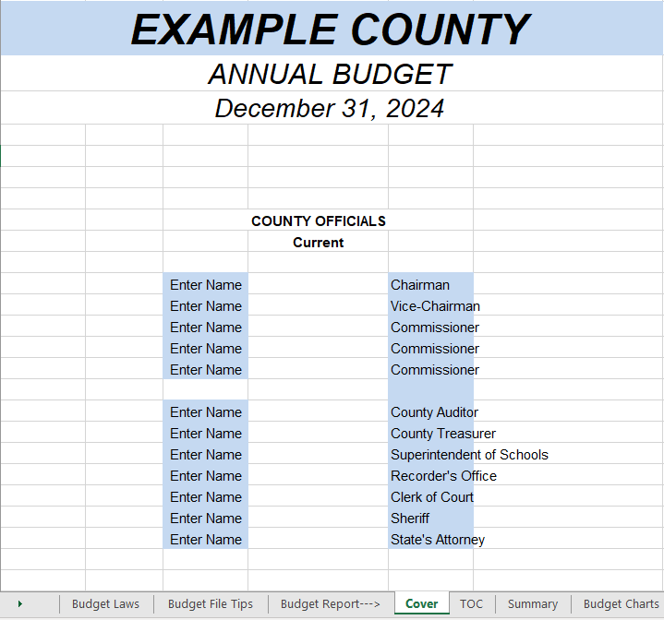
https://www.nd.gov/auditor/forms

Slide 11
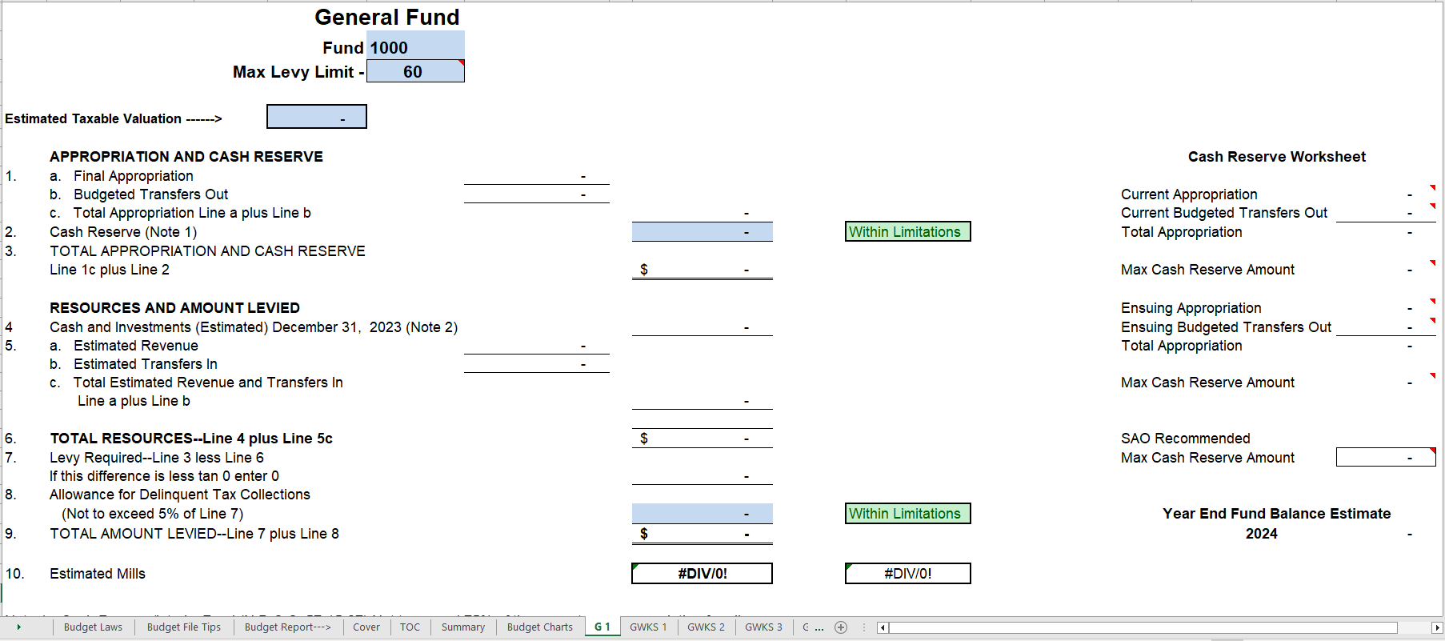

Slide 12
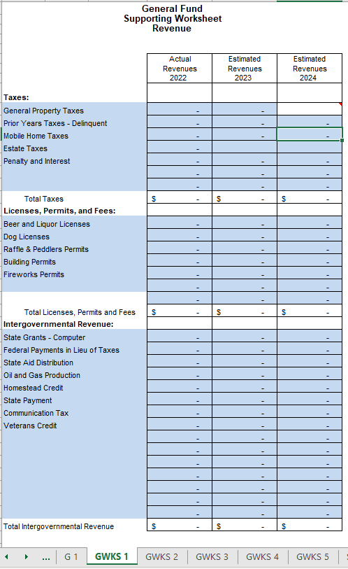
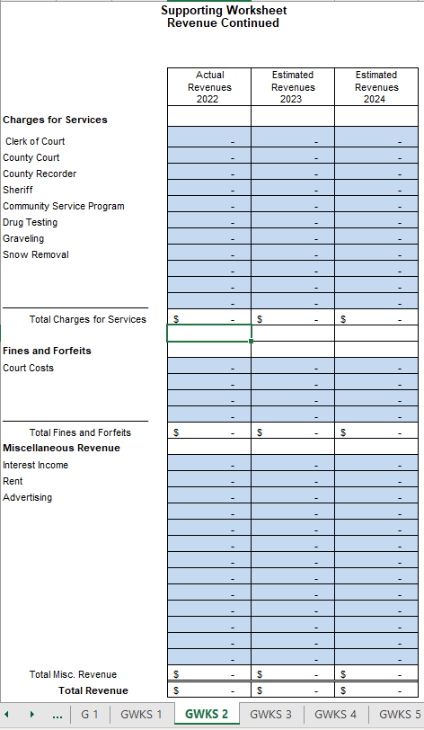

Slide 13
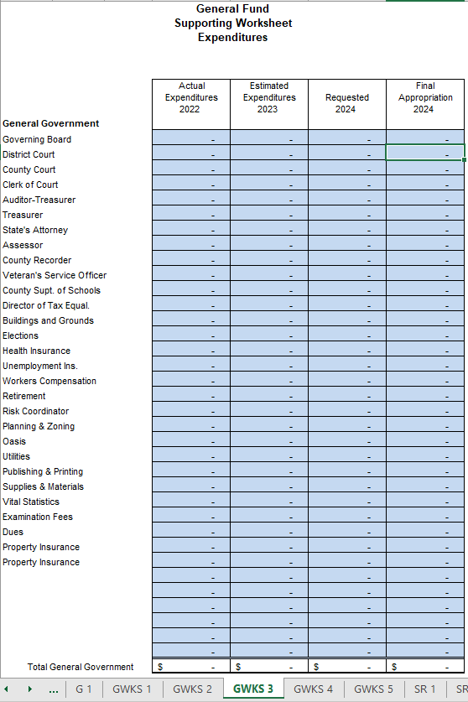
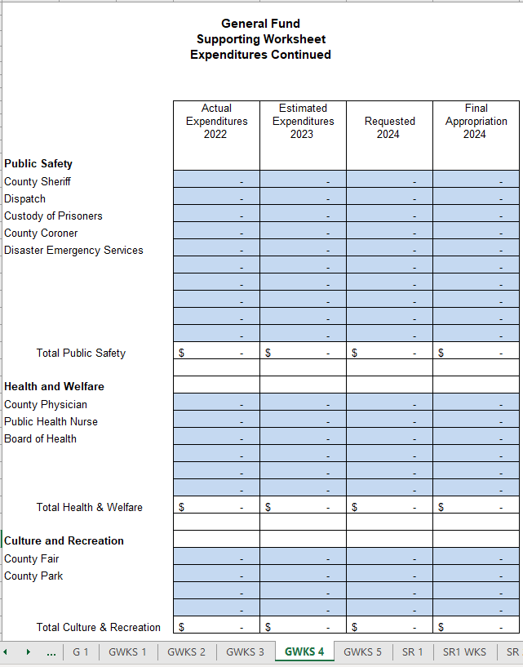
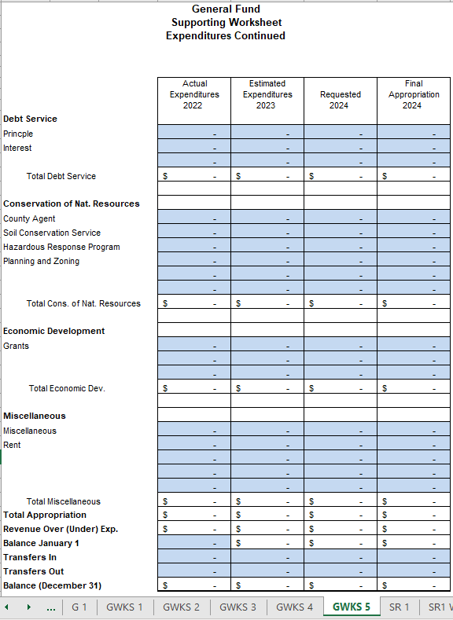

Slide 15
Common Issues
www.nd.gov/auditor

Slide 16
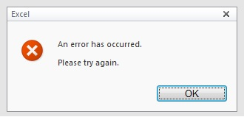
Common Issues
High Interim Fund
Imbalanced Transfers
Estimated Year End Cash
Lack of Support
No Budget

Slide 17
Budget Tips
www.nd.gov/auditor

Slide 18
Budget Tips
Use prior budget/actuals as a starting point
Review budget for all elements
Ensure transfers balance
Double check formulas
Ensure support for estimated cash agrees to budget

Slide 19
Budget Tips - Continued
Check interim fund calculation
Work with department heads
Review revenues/expenditures
Use the budget file provided by the SAO

Slide 20
Capital Projects
www.nd.gov/auditor

