Slide 1
GET WHAT YOU NEED WITH PUBLIC PROCUREMENT
Sherry Neas
Director of Shared Services

Slide 2
Mission
The Office of Management and Budget provides innovative leadership and support to state government.
Vision
OMB will set the standard for leadership and expertise in state government

Slide 3
OMB State Procurement Office
Notes:
To support state government by providing customers with quality products and services, enabling them to accomplish their mission.

Slide 4
Get What you Need wITH PUBLIC PROCUREMENT
What laws and procedures apply to your purchases?
Government Sources of Supply
Cooperative Purchasing
Importance of competition, transparency, and ethics
Legal Notices
Procurement U Training
Procurement Assistance

Slide 5
Types of purchases
Goods & Services
Equipment
Information Technology
Public Improvement
Architect, Engineering, Land Surveying, Construction Management
Concessions

Slide 6
Estimated Price
Total Cost
Reoccurring
Artificial Fragmentation
Total Cost of Ownership (Acquisition + Consumables + Service/Support + Life Cycle)

Slide 7
What Laws And Procedures Apply to your purchases?
Goods and Services – Procurement Requirements Vary
County
City
School Boards
Townships
State agencies, boards and commissions
Be sure employees know purchasing requirements!

Slide 8
Information Technology
Does your organization have special procedures for IT purchases?
Cyber security concerns
Terms and Conditions – Click Thru may contain provisions your organization cannot agree to
Internal procedures for “free” software and applications

Slide 9
Government Sources of Supply
State Contracts
Rough Rider Industries
Work Activity Centers
Cooperative Purchasing

Slide 10
Rough Rider Industries
Established in state law
Mission of prison industries
Government entities can purchase directly
Product lines and quality
Tours of Rough Rider Industries

Slide 11
Work Activity Centers
Established in state law
Employment for persons with disabilities
Licensed by Department of Health and Human Services
Government entities can purchase directly
Information on OMB website

Slide 12
State Contracts
OMB cooperative state contracts can be made available to local government entities
Office of Management and Budget Website
State Contract Listing
Contract Summary Sheet

Slide 13
Cooperative Purchasing
Legal Authority
OMB Cooperative State Contracts
Joint Powers Agreements
County law
City law
School Board law

Slide 14
Cooperative Purchasing
Multiple Cooperative Purchasing Entities
Compare pricing and terms
National Association of State Procurement
Officials (NASPO) ValuePoint
Sourcewell (Minnesota)
Educational Cooperatives
Nonprofit vs For Profit Cooperatives

Slide 15
Cooperative Purchasing
Using a cooperative in lieu of competition
Not all cooperatives have local resellers
OMB is required to notice intent to use cooperative instead of competitive process
Know laws that apply to your entity
Consult your legal counsel

Slide 16
Solicitation Types
Bid – Low bidder meeting specifications
Request for Proposal – Evaluate cost and quality
Informal competition – low dollar
Formal competition – public notice, public opening

Slide 17
PREFERENCE LAWS
Reciprocal Preference Law repealed in 2023
Preference Laws for Printing
Preference Law for Coal
US Flags – Made in US
ND Flags – Historically accurate
Resolution for ND Food Products
Resolution for Hemp Flags

Slide 18
Award
Purchase Order
State Purchasing Card Program
Tax Exempt

Slide 19
Award - Contracts
Involve Legal Counsel in negotiation
Office of the Attorney General Contract Drafting Manual with Sample Contract Templates
Have legal review vendor-furnished contracts

Slide 20
What Laws Apply to your purchases?
Public Improvements – N.D.C.C. Title 48
Over $200,000 Public Notice, Plans by Architect or Engineer
Definition of Public Improvement
Emergency Purchase Provision
Know your county/city/school board internal procedures for work under $200,000 and routine maintenance

Slide 21
What Laws Apply to your purchases?
Public Improvement over $200,000 Plans Requirement
Internal Procedures for contracting with Architect or Engineer
State agency law in N.D.C.C. Chapter 54-44.7 Architect, Engineer, Land Surveying and Construction Management
$35,000 and over require competition
Notice requirement established by entity

Slide 22
What Laws Apply to your purchases?
Concessions
$35,000 Annually
Public Notice Requirements

Slide 23
Contract Administration
Proof of Insurance
Secretary of State Registration
Contractor/Business License

Slide 24
Contract Amendments
Anticipated
Renewal
Extension
Price Adjustments
Unanticipated
Change Order
Templates

Slide 25
Contract Closeout
Inspect
Accept
Cure letter if needed
Payment

Slide 26
IMPORTANCE OF COMPETITION
Ensure employees know competition requirements
Specifications and requirements must not restrict competition
Know your entities’ internal procedures for noncompetitive purchases
Low dollar purchases
Sole Source" purchase approvals

Slide 27
TRANSPARENCY
Spending tax payer dollars
If spending grant dollars – What does the grant require?
Public Notice
Open Records
Open Meetings
Records Retention

Slide 28
Public Notice/Legal Notice
Official County Newspaper
Legal Notice publication rates established by OMB
Know deadlines for submission to ensure publication requirements are met
2025-2027 Proposed Rate Changes:
5% 1st Year
3% 2nd Year

Slide 29
Ethics IN PUBLIC PROCUREMENT
Artificial Fragmentation
Conflict of Interest
Attempt to Influence
Nondiscrimination in source selection
N.D.A.C. Chapter 4-12-04 applies to state agencies

Slide 30
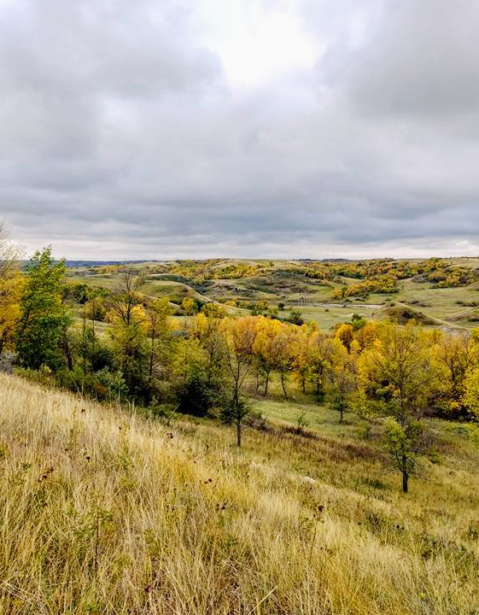
PROCUREMENT U
National Association of Procurement Officials (NASPO)
Many Free Courses
naspo.org/procurement-u

Slide 31
PROCUREMENT ASSISTANCE
Your county/city/school board legal counsel
Laws, Rules, Manuals
Attorney General’s Office Contract Drafting & Review Manual and Templates
Office of Management and Budget website

Slide 32
Conclusion
Public procurement ensures taxpayer dollars are spent through a fair and transparent process.
Procurement is simply getting information needed to make good purchasing decisions
Seek assistance before you make the purchase!

Slide 33
Questions?
Sherry Neas,
Director of Central Service

