Slide 1
Hot audit topics: Component units, inventory, support documentation By: Michael Scherr, audit manager Email: mascherr@nd.gov Phone: 701-328-9500

Slide 2
Component units

Slide 3
Component units
What a component unit is?
How does this affect me?
How to determine component units in your audits

Slide 4
What is a Component unit?
As defined per the Governmental Accounting Standards Board (GASB) in GASB statement 14, paragraph 20, as amended by GASB statement 61, paragraph 4b. “Component units are legally separate organizations for which the elected officials of the primary government are financially accountable (as discussed in paragraphs 21–37). In addition, component units can be other organizations for which the nature and significance of their relationship with a primary government are such that exclusion would cause the reporting entity‘s financial statements to be misleading (as discussed in paragraphs 39–41).

Slide 5
What is a Component unit?
The next slides go into more detail on how a component unit is determined as there is certain criteria that must be met to be qualified as a component unit of a primary government. (Financial accountability, Appointment of voting majority, Imposition of will, financial benefit, etc.) We will go into more detail on this while discussing the checklist.

Slide 6
Examples OF COMPONENT UNITS:
There are several entities that can be considered a component unit.
From our experience the following slides are common examples for each type of primary government.

Slide 7
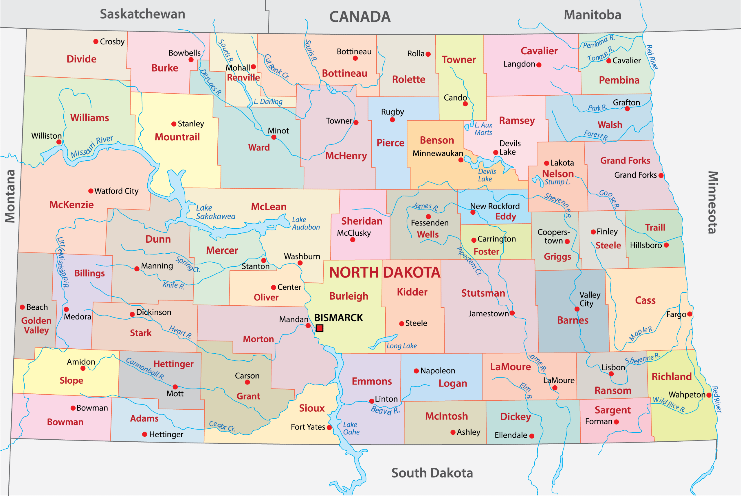
County examples:
County audits in our experience usually always have component units.
Some examples: Water Resource Districts, Job Development Authority, Health Districts, Fair boards, and Weed boards.
Note: No CU’s = start evaluating

Slide 8
city examples:
City audits often have component units also.
Some examples: Airport Authority, Library, Job Development Authority

Slide 9
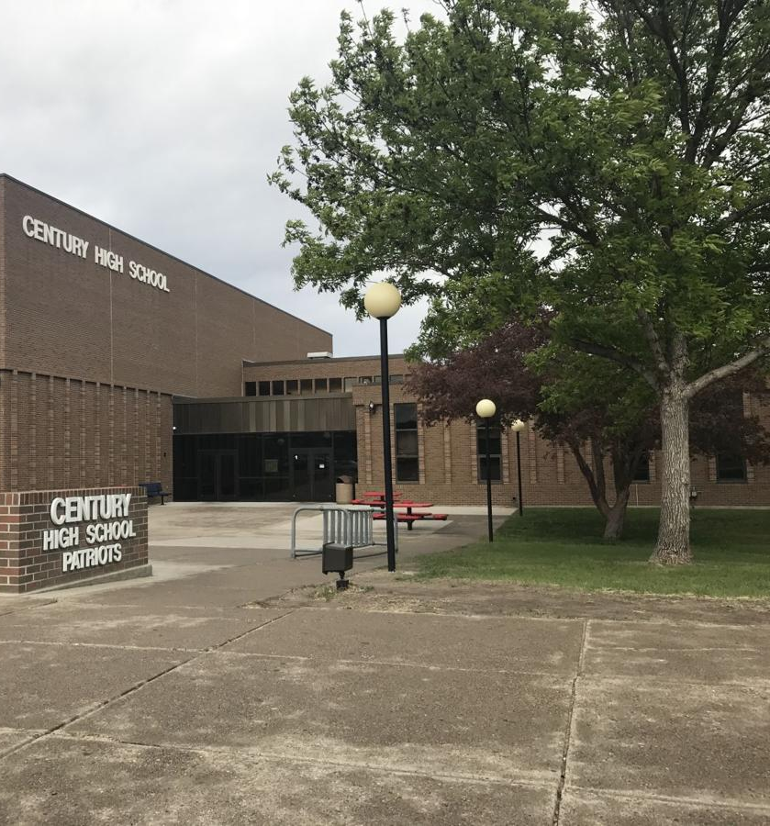
School examples:
School District’s do not usually have component units, but they can in some circumstances.
Some examples, Building Authority or Foundations if criteria for inclusion is met.

Slide 10
How does this affect me?
You need an audit!
ND Century Code 54-10-14 requires the State Auditor to audit or review each local government entity once every two years.
Note: SB2180 - $2 million threshold

Slide 11
How does this affect me?
As a primary government, there is a chance you are not including all proper component units in your report, and therefore have an audit report that does not have complete information.
If you are a small district, there is a chance you either need a standalone audit or could potentially receive an audit by being included as a component unit of a larger primary government.

Slide 12
Component unit determination
What you need to do!

Slide 13
Component unit determination
Potential component units can be classified into a few difference scenarios below:
Discretely Presented Component Unit – Should be included and presented with a separate column in the financial statements.
Fiduciary Fund/Governmental Fund – Sometimes an entity does not meet the criteria of a component unit and only is included as type of fund in the reporting entity.

Slide 14
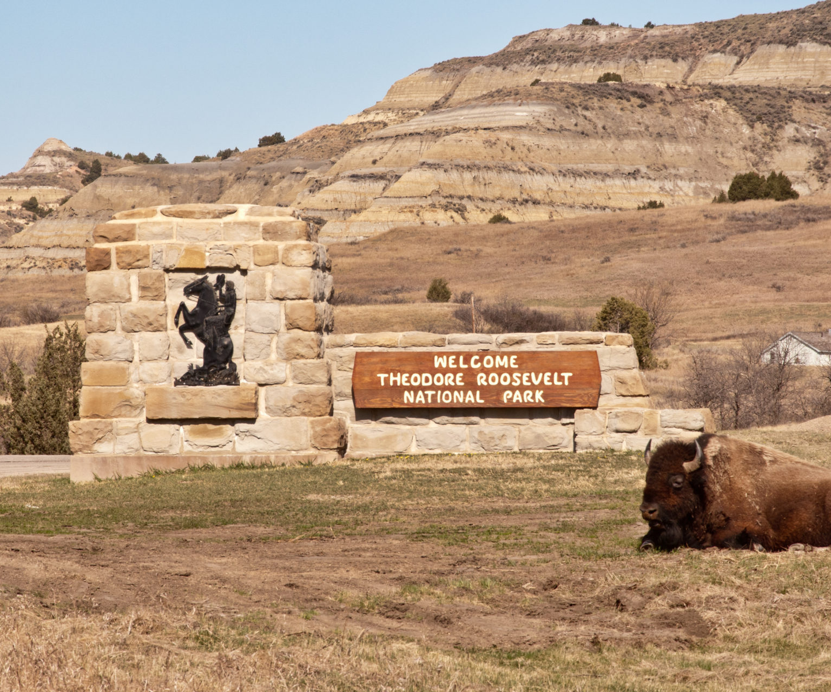
Component unit determination
Blended Component Unit – Sometimes an entity is not a discretely presented component unit, but instead a blended component unit.
Blended component units, although legally separate entities, are, in substance, part of the government’s operations and so data from this unit is combined with data from the primary government in the funds. Criteria outlined in GASB Statement No. 61 and 80 for blending component units.

Slide 15
Blended component unit criteria:
(a) the component units governing body is substantively the same as the governing body of the primary government, and there is a financial benefit or burden relationship, or management of the primary government has operational responsibility for the component unit. Operational responsibility exists if it manages the component unit in essentially the same manner in which it manages its own programs, departments, or agencies.
(b) the component unit provides services entirely, or almost entirely, to the primary government, or exclusively, or almost exclusively, benefits the primary government even though it does not provide services directly to it.
(c) the component unit's total debt outstanding is expected to be repaid entirely or almost entirely with resources of the primary government.

Slide 16
Component unit checklist

Slide 17
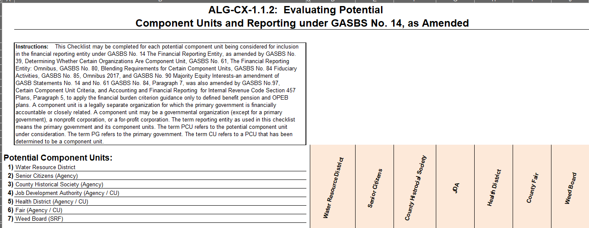

Slide 18
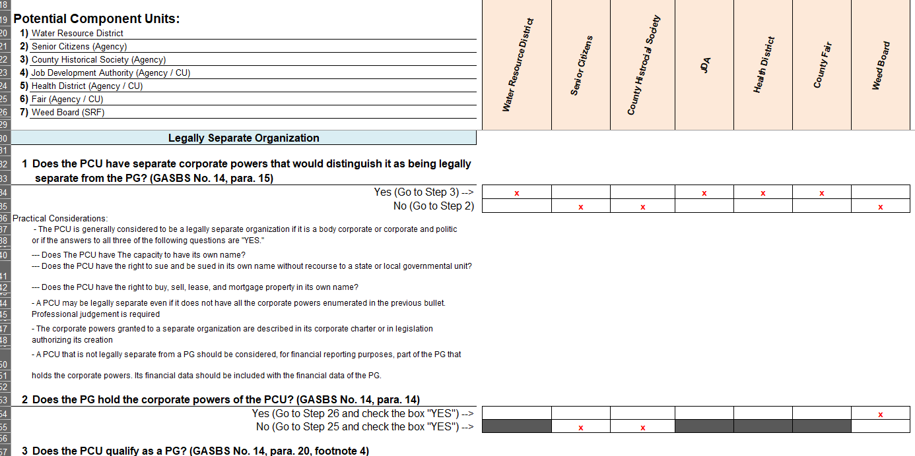

Slide 19
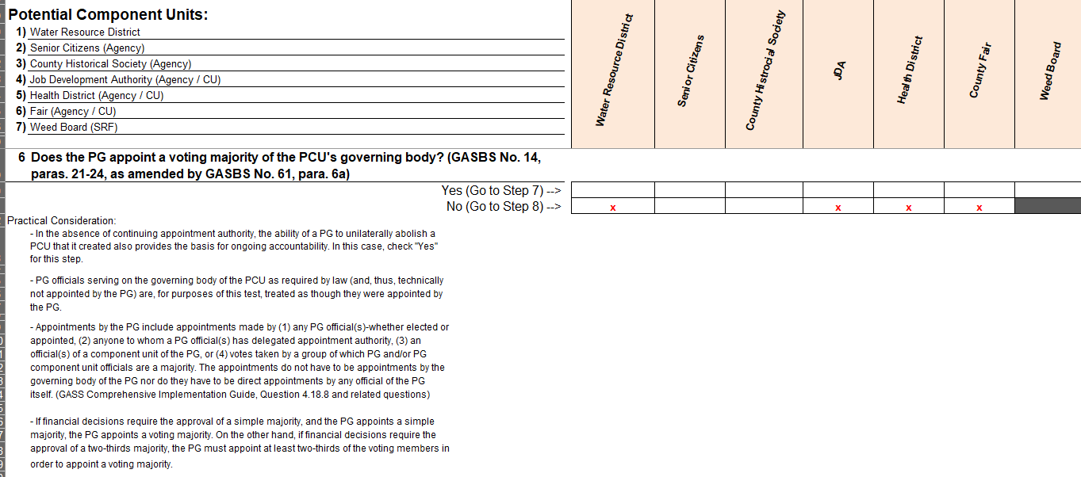

Slide 20
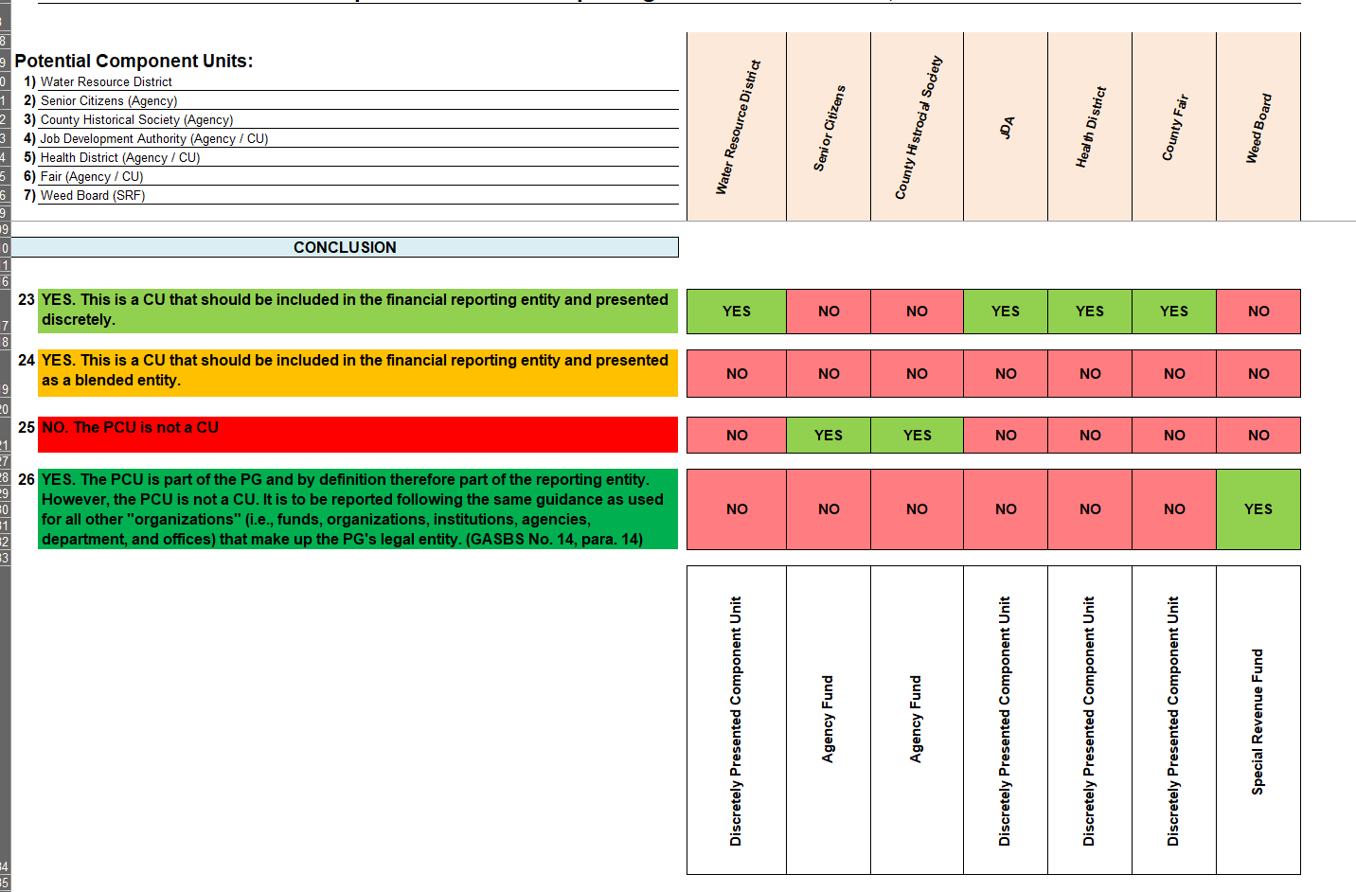

Slide 21
COMPONENT UNIT CHECKLIST
Questions that give an indication if there is a potential component unit:
How is the board of the PCU determined and what is the makeup?
Can the PG impose its will on the PCU?
Is the PCU fiscally dependent on the PG or does a financial burden exist?
Should the PCU be included because of the nature and significance of its relationship?

Slide 22
Component unit recap:
Ensure component units are being properly evaluated.
Evaluation can be done annually or before the audit is conducted.
The copy of the excel checklist I went over can be provided as a resource.

Slide 23
inventory

Slide 24
Inventory:
In this section we will discuss everything Inventory:
What is inventory?
What happens if I have Inventory and how to calculate?
How inventory is presented in my audit.
Best practices

Slide 25
Inventory:
Inventory is an asset that can be realized for revenue generation or has a value for exchange.
Examples: Gravel, culverts, chemicals, and vaccines.

Slide 26
Inventory:
Gravel has been a popular type of inventory we have come across. Especially for counties.
Some counties also have stockpiles of culverts and chemicals.
Health districts typically have vaccines stockpiled.
Other entities can also have inventory!

Slide 27
INVENTORY
What you need to know and how to measure.

Slide 28
Inventory:
Fiscal year end date = date of measurement
Total monetary value of inventory at measurement date = value of inventory.
Evaluate inventory for materiality
Note: Materiality

Slide 29
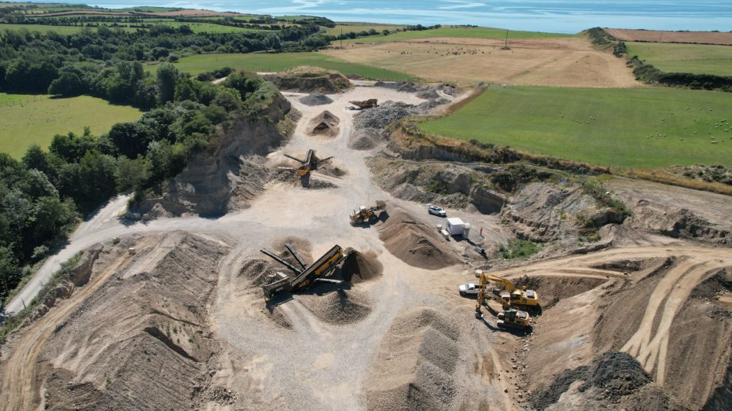
GRAVEL
What you need to know and how to measure.

Slide 30
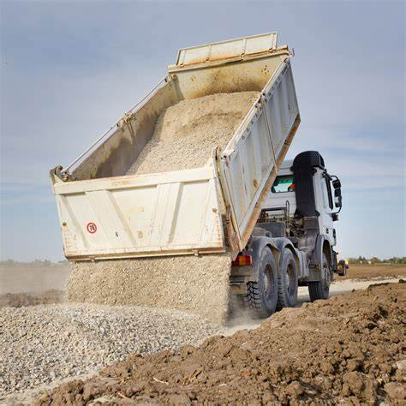
GRAVEL:
Calculate your inventory value based on the measurement that was conducted at fiscal year end of all pits.
For example, if there are 3 pits and all have 10,000 cubic yards; total inventory is 30,000 cubic yards. If all pits have the SAME price at $10 a cubic yard (including a $2 royalty). Total inventory at 12/31/2023 would be $300,000.

Slide 31
GRAVEL:
If you find you have gravel pits there are a few things to do:
Identify all pits the entity owns on the entity’s land
Identify all pits the entity owns on landowner’s land
Is there a measurement that is being conducted on each pit? (Drone reports or other measurement)
If not, contact an engineering firm or the county engineer to see if a measurement can be conducted.
Note: Measurement process importance (drone reports)

Slide 32
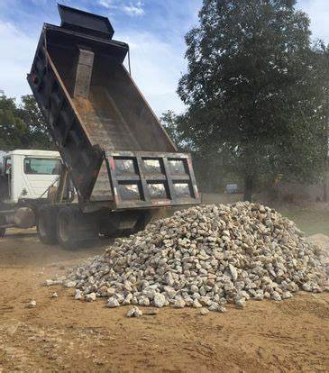
GRAVEL:
How is inventory that is being hauled away being tracked? (Hauling slips)
Inventory that is being crushed and added – is that being tracked? (crushing invoices)
Is there a royalty payment that is being paid to landowners?
Note: Good start with these.

Slide 33
GRAVEL recap:
Ensure a measurement is being conducted – ideally at the same time as the fiscal year end date (for example 12/31/2023).
Ensure hauling slips are being documented and saved to track what is being used throughout the year
Ensure crushing receipts are being saved to track what is being added to the pits.
Ensure a royalty is being paid and included when calculating the value of your inventory.

Slide 34
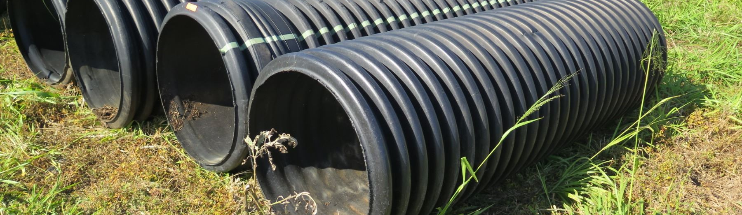
CULVERTS
Culverts are easier to keep track of.
Ensure a count is being conducted if culverts are being stockpiled, ideally at the same time as the measurement date.
Make sure the different culvert sizes and prices are being tracked

Slide 35
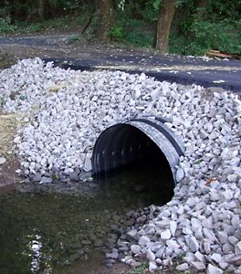
CULVERTS
Calculate your culverts based on what is on hand and the price point determined by the entity.
If your entity historically only sells extra stockpiled culverts to outside parties at a certain price point – use that price point in your inventory calculation.
If the entity never sells, use a price point of what the cost is or what is deemed adequate as a fair price for calculating the value.

Slide 36
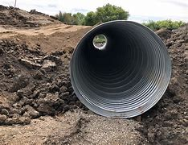
CULVERTS
Example: if an entity has 100 24” diameter culverts at a price of $500 and a 100 18” diameter culverts at $250. Total value of culverts on hand would be $75,000.
Price may change based on entity and what they have historically done.
Ensure rationale for price reasoning is documented.

Slide 37
chemicals:
Calculation and measurements are similar to culverts.
May be harder to track usage.
Ensure a count is being conducted close to fiscal year end date.
Ensure usage & purchases for additions are being tracked.

Slide 38
chemicals:
Valuation is determined just like the other methods.
Once you determine your measurement on hand - Take that by the price that you have determined to get a dollar value of the inventory of chemicals you have on hand.
Ensure usage is being tracked and a good process is in place.

Slide 39
vaccines
Usually only applies to Health Units and Districts
Conduct an inventory count and measure.
Calculate values based on prices for each vaccine that is on hand at fiscal year end

Slide 40
Inventory – how it is presented in my audit:
Inventory should be recorded as a current asset on the fund level statements or balance sheet and as an asset on your government wide statement or statement of net position.
If inventory existed in prior years that you did not have on your statements, a prior period adjustment will be needed.
Measurement will need to be conducted at the end of the fiscal year of the prior year to get your PPA amount.

Slide 42
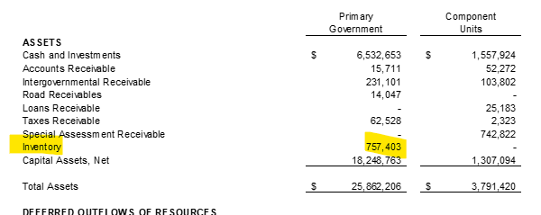

Slide 43
Inventory – best practices:
Ensure some sort of measurement or count is being conducted.
Drone reports are a good resource to get an idea of how much gravel you may have.
Some entities have inventory software to help assist with tracking.
Keep track of all documentation!

Slide 44
Inventory – RECAP:
What inventory is.
How to calculate and measure inventory and what you need to be doing.
How it is presented in your audit.
Some best practices.

Slide 45
Support documentation

Slide 46
SUPPORT DOCUMENTATION:
In this section we will discuss support documentation:
Importance of support
What we are seeing
Best Practices

Slide 47
SUPPORT DOCUMENTATION – IMPORTANTCE:
Why do I need to maintain supporting documentation?
It is the basis for your auditor to give their opinions.
Auditors support the conclusions in their reports with a work product called audit documentation.
The audit team needs to have corroborating evidence to support the opinion they form.
This is a major part of any audit.
Note: can not take word for it.

Slide 48
SUPPORT DOCUMENTATION – IMPORTANTCE:
Other oversight agencies
Grantors
Other audits
Helps yourself
Nice to have a reference
Note: Policy on record retention, IRS guidelines.

Slide 49
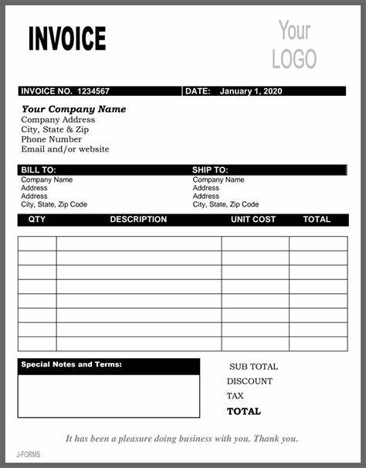
SUPPORT DOCUMENTATION – difficulties:
Support documentation can make or break your audit
No support = Opinion modifications
Make sure you are maintaining the correct support
Check/voucher image is usually not enough
There should be some sort of invoice/receipt from the vendor

Slide 50
SUPPORT DOCUMENTATION – difficulties:
Expenses – missing invoices for checks
Inventory – no tracking of hauling slips that are using gravel or chemical usage.
Manual Journal Entries – support for adjustments
Capital assets – missing support for all projects and activity

Slide 51
SUPPORT DOCUMENTATION – best practices:
Create a filing and tracking process
Utilize your software
Get multiple people involved
Organization is key
Capital asset folder
Other folders for other areas
General journal entries – create separate folders for each adjustment

Slide 52
SUPPORT DOCUMENTATION – section recap:
Importance of support
Difficulties you can encounter
Best practices to implement

Slide 53
Concluding remarks:
Component units – start evaluating if currently not.
It does not hurt to over evaluate to ensure nothing is missing.
Use the checklist every year.
Start looking into your potential inventory
Track, Measure, Support
Support documentation = Audit Opinions
Create a process to stay organized

Slide 54
Thank you
Mike Scherr, Audit Manager
701-328-9500
mascherr@nd.gov
https://www.nd.gov/auditor/

