Slide 1
common deficiencies in the SINGLE AUDIT
Lindsey Slappy

Slide 2
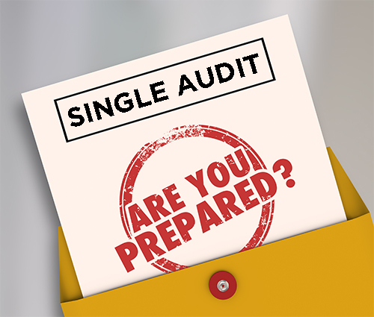
Agenda
What is a Single Audit
Preparing for an Audit
Common Findings
Tips & Tricks

Slide 3

WHAT IS A SINGLE AUDIT?

Slide 4

SINGLE AUDIT
Audit required by the Federal Government if you spend $750,000 or more in federal funds within the fiscal year

Slide 5
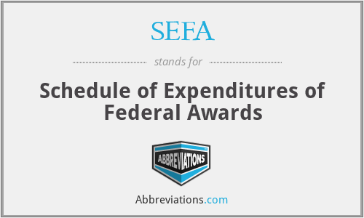
SEFA
Financial statement schedule that is prepared by management that lists an organizations expenditures of federal assistance for the fiscal year by federal agency, grant number, and amount.

Slide 6

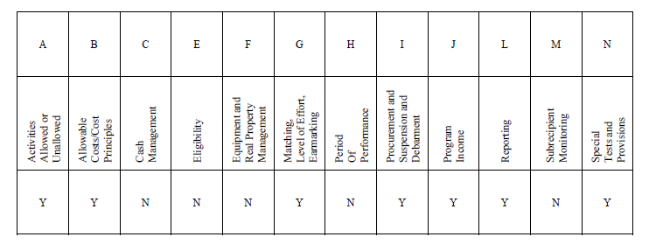
Compliance Supplement
Created by the Office of Management and Budget, this contains the audit objectives for most federal programs

Slide 7
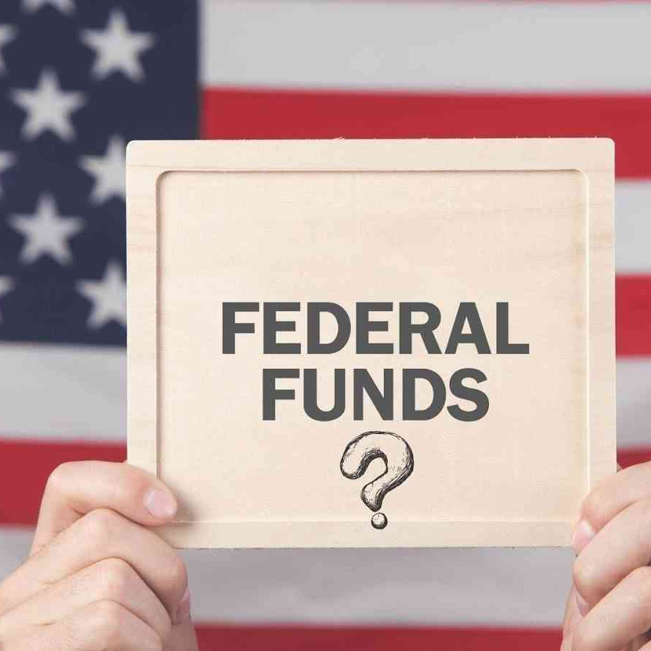
WHAT COUNTS?
Federal money received from the Federal Government
  Impact Aid
  Title I
  Disaster Grants
  ESSER
Notes:
Included a few common programs that we have been seeing over the last couple years.

Slide 8

PREPARING FOR AN AUDIT

Slide 9
How to Prepare
Read through the OMB Compliance Supplement
Read your grant agreement
Keep all supporting documentation to send to your auditors
Applications
Grant Agreements
Request for Reimbursement
Invoices
Copies of receipts
General Ledger of federal expenditures

Slide 10

COMMON FINDINGS

Slide 11
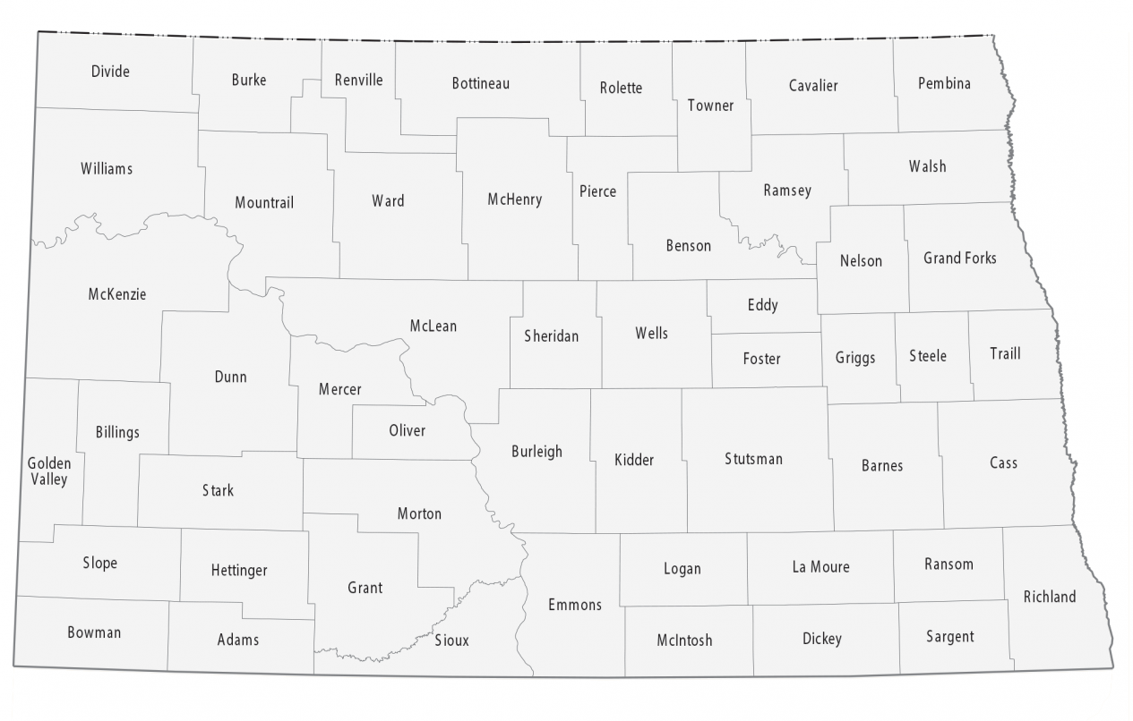
COUNTIES – ARPA
IMPROPER REPORTING OF EXPENDITURES
  Condition – County did not properly report total expenditures on their project and expenditure report
  Cause – This can cause the reimbursement amount to be incorrect
  Recommendation – closely review all expenditures

Slide 12
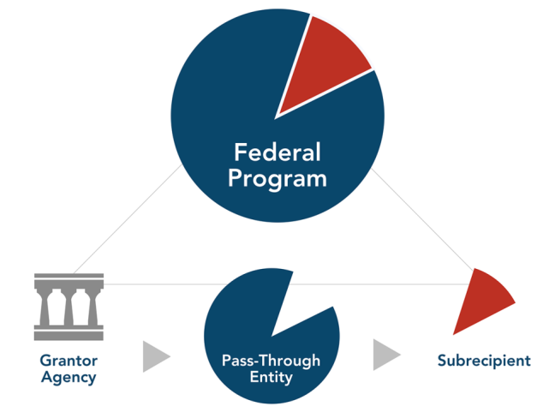
COUNTIES
NON-COMPLIANCE WITH SUBRECIPIENT GRANT AGREEMENTS
  Condition – County did not ensure all subrecipients receiving funding were in compliance with the Uniform Guidance
  Effect – Subrecipients may not be obtaining audits required, which can put the county at risk
  Recommendation – Entity should develop procedures to ensure all elements of subrecipient grant requirements are met

Slide 13

COUNTIES – ARPA
UNALLOWABLE COSTS – PREMIUM PAY
  Condition – Under ARPA funds, there are requirements for what funds can/cannot be used for. In this instance, the county did not properly report premium pay in the correct category.
  Cause – This caused the amounts for each category to be misstated.
  Recommendation – We recommend they review the applicable requirements to ensure expenditures are in their proper category.

Slide 14

SCHOOLS – IMPACT AID
WAGE RATE REQUIRMENTS
  Condition – If funds are being used for construction projects, there are usually specific wage rate requirements listed in the grant that must be followed (most common is Davis-Bacon)
  Cause – Most are not aware of requirement, which causes them to pay contractors incorrectly. This can lead to expenses not being allowable under the grant.
  Recommendation – make sure you are reading through grant agreements to ensure you are in compliance with the wage rate requirements.

Slide 15

OTHER FINDINGS
LACK OF SUPPORTING DOCUMENTATION
  Condition – Occurs when an entity did not obtain adequate supporting documentation for expenditures charged to the grant program
  Cause – Entity might not have been aware of what documentation was important
  Recommendation – Encourage entity to keep ALL supporting documentation (better to have extra support than not enough)

Slide 16

OTHER FINDINGS
LACK OF INTERNAL CONTROLS
  Condition – When the entity does not establish and maintain effective internal controls to ensure expenditures are being properly approved.
  Effect – This usually means they are not in compliance with reporting requirements and expenditures may have been charged incorrectly.
  Recommendation – We recommend they implement procedures to comply with reporting requirements.

Slide 17


Slide 18

Tips and Tricks
Keep track of all support (applications, expenditure support, requests, etc.)
Establish a strong process of internal controls for federal expenditures
Read through compliance supplement - this is your friend ☺
Look into getting single audit costs of the portion of the audit reimbursed by the feds if applicable

Slide 19

QUESTIONS?

Slide 20
Thank you
Lindsey Slappy, CPA, Director of Quality Assurance
701-328-2336
lslappy@nd.gov
https://www.nd.gov/auditor/

