Slide 1
Budget season, your favorite season
Heath Erickson, CPA
Audit Manager, Local Government Division
hmerickson@nd.gov

Slide 2
Topics that will be covered
Top 5 reasons you should do a budget
State laws that may impact your entity
The benefits of having a good budget
Monthly budget maintenance
What can go wrong?
Topics of interest
Top tips for the budget file on our site

Slide 3
Top 5 Reasons you should do a budget
It may be required under State Law.
Citizens will appreciate seeing where their tax dollars are going.
Your entity will be able to plan for upcoming projects, additions for staffing, and new equipment that is needed.
Departments will be able to know what can be spent and in what fiscal year.
Board members will have more information on where tax dollars are going to better serve the citizens.

Slide 4
State laws that may impact your entity
N.D.C.C. §11-23-02 states, " The county auditor shall prepare an annual budget for the general fund, each special revenue fund, and each debt service fund of the county in the form prescribed by the state auditor. The budget must set forth specifically:
1. The detailed breakdown of the estimated revenues and appropriations requested for each fund for the ensuing year.
2. The detailed breakdown of the revenues and expenditures for each fund for the preceding year.
3. The detailed breakdown of estimated revenues and expenditures for each fund for the current year.
4. The transfers in or out for each fund for the preceding year and the estimated transfers in or out for the current year and the ensuing year.
5. The beginning and ending balance of each fund or estimates of the balances for the preceding year, current year, and ensuing year.
6. The tax levy request for any funds levying taxes for the ensuing year.
7. The certificate of levy showing the amount levied for each fund and the total amount levied.
8. The budget must be prepared on the same basis of accounting used by the county for its annual financial reports.
9. The amount of cash reserve for the general fund and each special revenue fund, not to exceed seventy-five percent of the appropriation for the fund.

Slide 5
State laws that may impact your entity
N.D.C.C. §57-15-31(1) states, “The amount to be levied by any county, city, township, school district, park district, or other municipality authorized to levy taxes must be computed by deducting from the amount of estimated expenditures for the current fiscal year as finally determined, plus the required reserve fund determined upon by the governing board from the past experience of the taxing district, the total of the following items:
The available surplus consisting of the free and unencumbered cash balance;
Estimated revenues from sources other than direct property taxes;
The total estimated collections from tax levies for previous years;
Expenditures that must be made from bond sources;
The amount of distributions received from an economic growth increment pool under section 57-15-61; and
The estimated amount to be received from payments in lieu of taxes on a project under section 40-57.1-03.”

Slide 6
State laws that may impact your entity
N.D.C.C §57-15-27. Interim fund.
The governing body of any county, city, park district, or municipality, other than a school district, which is authorized to levy taxes may include in its budget an item to be known as the "interim fund" which must be carried over to the next ensuing fiscal year to meet the cash requirements of all funds or purposes to which the credit of the municipality may be legally extended, for that portion of such fiscal year prior to the receipt of taxes therein. In no case may the interim fund be in excess of the amount reasonably required to finance the municipality for the first nine months of the next ensuing fiscal year. The interim fund may not be in excess of three-fourths of the current annual appropriation for all purposes other than debt retirement purposes and appropriations financed from bond sources.

Slide 7
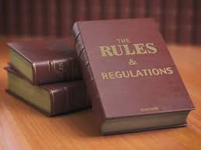
State laws that may impact your entity
NDCC §57-15-31. Determination of levy. (Formula Model)
The amount to be levied must be computed in the following manner:
Total Estimated Expenditures
Plus: Required Reserve
Equals: Total Estimated Expenditures & Cash Reserve
Less: Surplus of Free and Unencumbered Cash
Less: Estimated Revenues From Non-Property Tax Sources
Less: Estimated Collections from Prior Tax Levies
Less: Expenditures Required to be Paid From Bond Sources
Less: Distributions from an Economic Growth Increment Pool under NDCC 57-15-61
Less: Payments in Lieu of Taxes on a Project under NDCC 40-57.1-03
Equals: Amount to be Levied
Allowance for Tax Collection Delinquency < 5% Amount to be Levied

Slide 8
State laws that may impact your entity
N.D.C.C §40-40-02. Definitions. In this chapter, unless the context or subject matter otherwise requires: 1. "Governing body" means the city council, board of city commissioners, park commissioners, or city manager. 2. "Municipality" means any city or park district in this state.
N.D.C.C §40-40-09. Determination of amount to be levied - Adoption of levy - Limitations. After completing the final budget on or before October seventh, the governing body shall proceed to make the annual tax levy in an amount sufficient to meet the expenses for the ensuing year as determined at the budget meeting. In determining the amount required to be levied, the governing body first shall ascertain its net current resources by adding the estimated revenue for the ensuing year other than property taxes, any transfers in, and the estimated fund balance at the end of the current year. Then the governing body shall ascertain its appropriation and reserve by adding the final appropriation for the ensuing year, any transfers out, and the cash reserve. The net current resources must be deducted from the appropriation and reserve and the balance shall be considered the amount that is required to be raised by taxation during the ensuing year. The determination of the amount of the levy that can be collected within the ensuing year must be made by the governing body based upon the past experience of the district. The levy as finally adopted must be approved by a majority vote of the members of the governing body and noted in the proceedings of the governing body. The amount levied is subject to the limitations as prescribed by the laws of this state and is subject to the further Page No. 2 limitation that the amount may not exceed the levy requested by the municipality. The levy adopted must appropriate in specific amounts the money necessary to meet the expenses and liabilities of the municipality.

Slide 9
State laws that may impact your entity
Protection of Taxpayers NDCC 57-15-01.1
City & Park Levy/Budget Info NDCC 40-40
School District NDCC 57-15-13
Water Resource District NDCC 61-16-06
Rural Fire Protection District NDCC 18-10-07
Soil Conservation District NDCC 4.1-20-24(1)(q)
Rural Ambulance District NDCC 11-28.3-09
Other Entities Review NDCC

Slide 10
Benefits of having a good budget
Management can plan for revenue coming in from local, state, federal, or other sources which may decrease what is needed from the taxpayers.
Each fiscal year has a plan to follow and should keep your entity from overspending.
Helps your entity with short and long-term goals.
It may help you with decisions about taking on long term debt.
Your entity will start to think about years ahead and not just one.

Slide 11
Monthly budget maintenance
Management should review the budget monthly at a minimum by fund and line item.
The board should review budget information monthly and ask questions during meetings.
The entity’s finance committee is a good group to help watch the budget.
Depending on the situation, you may need to amend the budget. (Things happen!)
Expenditure type topics such as staffing, capital projects, and equipment, may force you to change the plan!
Revenues that were expected may not come in, so a change in plans for spending may be in order.

Slide 12
What can go wrong??
The entity may not have budgeted enough funds or line items to cover the costs for the year.
The entity may have budgeted too much for certain funds or line items.
For most local governments, there is a deadline to submit the budget to the County. The deadline could be missed.
The budget could have been finalized with errors. Use a method that can check for errors or at least minimize the opportunity for errors.

Slide 13
Topics of interest
Capital Projects –
Options in the budget for a capital project that will now be next year: (Ex. Building Addition)
1. You can transfer funds into a specific capital projects fund if the project extends past one year if originally in a special revenue fund.
2. You can keep the funds in the original special revenue fund but will have to ensure the next year’s budget has the cash balance and the potentially repeated expenses for the project included.
3. You may have the project in a specific capital project fund currently due to managements preference or due to a bond covenant.
Note: If you know that a capital project will need to be done in 3-5 years, make sure you plan for it in the budget if you don’t plan on doing a loan or bond. Counties – Don’t forget about N.D.C.C § 57-15-06.6 (See next slide for the section)

Slide 14
Topics of interest
N.D.C.C §57-15-06.6. County capital projects levy.
1. The board of county commissioners of each county may levy an annual tax not exceeding ten mills plus any voter-approved additional levy as provided in subsection 8 of section 57-15-06.7 for the purpose of the following capital projects:
a. Constructing, equipping, and maintaining structural and mechanical components of regional or county corrections centers or for the purpose of contracting for corrections center space capacity from another public or private entity.
b. Acquiring real estate as a site for public parks and construction, equipping, and maintaining structural and mechanical components of recreational facilities under section 11-28-06.
c. Acquiring real estate as a site for county buildings and operations and constructing, equipping, and maintaining structural and mechanical components of county buildings and property.
d. Acquiring real estate as a site for county fair buildings and operations and constructing, equipping, and maintaining structural and mechanical components of county fair buildings and property as provided in section 4-02-26. e. Acquiring and developing real estate, capital improvements, buildings, pavement, equipment, and debt service associated with financing for county supported airports or airport authorities.
f. Expenditures for the cost of leasing as an alternative means of financing for any of the purposes for which expenditures are authorized under subdivisions a through e.
g. Improvement of the county road system, including the acquisition of land; construction of new paved and unpaved roads, bridges, or public places; replacement of existing paved and unpaved roads, bridges, or public places; and maintenance and repair of existing paved and unpaved roads, bridges, or public places.
2. Any voter-approved levy for the purposes specified in this section approved by the electors before January 1, 2015, remains effective through 2024 or the period of time for which it was approved by the electors, whichever is less, under the provisions of law in effect at the time it was approved. After January 1, 2015, approval or reauthorization by electors of increased levy authority under this section may not be effective for more than ten taxable years.

Slide 15
Topics of interest
Estimated revenues, expenses, cash reserve, transfers, and cash balances.
Revenues – Think about all the known sources of revenues that should be in your budget. You may have a history of some of them coming in or you may know changes to them as well.
Expenses – Go through each department and make sure you include all expenses that are needed to be included. If some items are missing but really need to be included, a budget amendment will need to be done and approved by the board. (Amendments do happen)
Cash Reserve – For the general fund and each special revenue fund, you can’t set your cash reserve amount over 75%. (SAO recommends not over appropriations and transfers out of current or ensuing year)

Slide 16
Topics of interest
Transfers In and Out:
Make sure that you think about potential transfers between funds that you think will be needed. Remember, transfers in and out should equal between funds.
Cash Balances
Make sure that you have support for you cash balances. You may use cash balances set up assuming the budgeted revenues, expenses, and transfers will happen. You also may use a different number if you know that detours from the budget will happen if you wish.

Slide 17
Top Tips for the budget file on our site
1. During your budget meetings, you can adjust the tabs such as the file on the right if needed and like magic the fund summary file will adjust. Also, use the estimates and limit features.

Slide 18
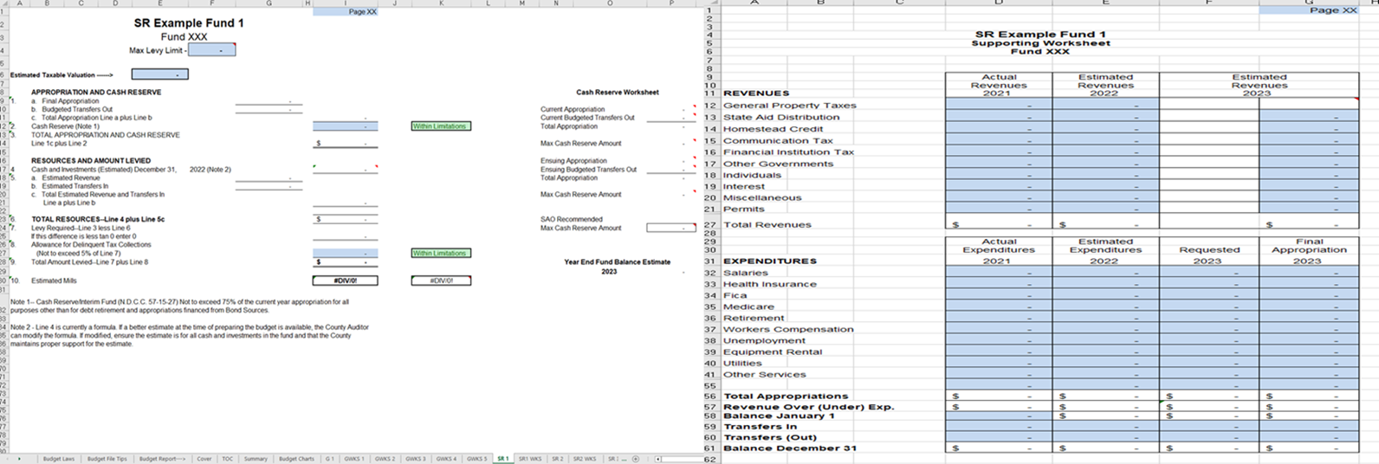
Top Tips for the budget file on our site
2. Fill in the blue cells. If you click in the white cells, they will most likely be a formula that you don’t need to update.

Slide 19
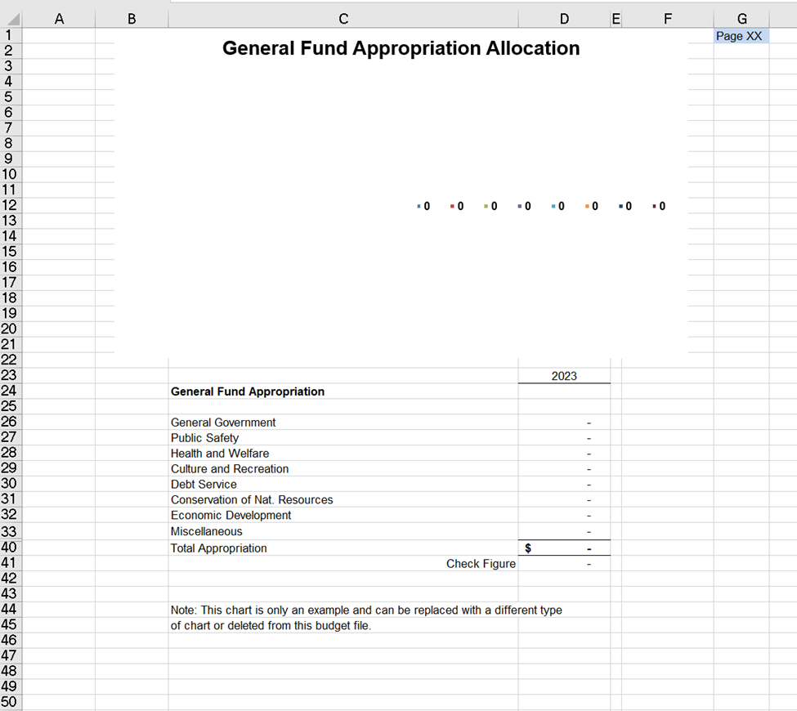
Top Tips for the budget file on our site
3. Don’t be afraid to use the pie chart for the general fund. It’s already there for you and it’s linked!

Slide 20
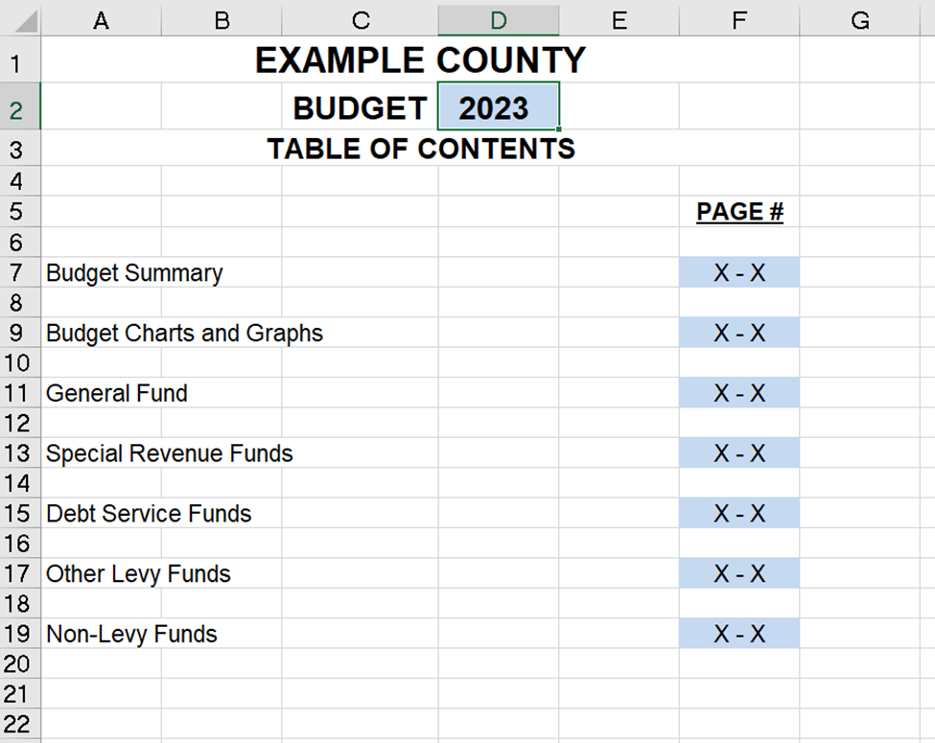
Top Tips for the budget file on our site
4. If you were having trouble forgetting to update dates and tables for the new year. Update one location for the entire file as seen below. You will find it to be helpful.

Slide 21
Thank You!
Questions?

